Slide 1
eMasters – Communication Systems E920 Wireless Communications
Notes, References, Questions, Problems, and Solutions
Venkateswar Reddy Melachervu
Jan 2023

Slide 2
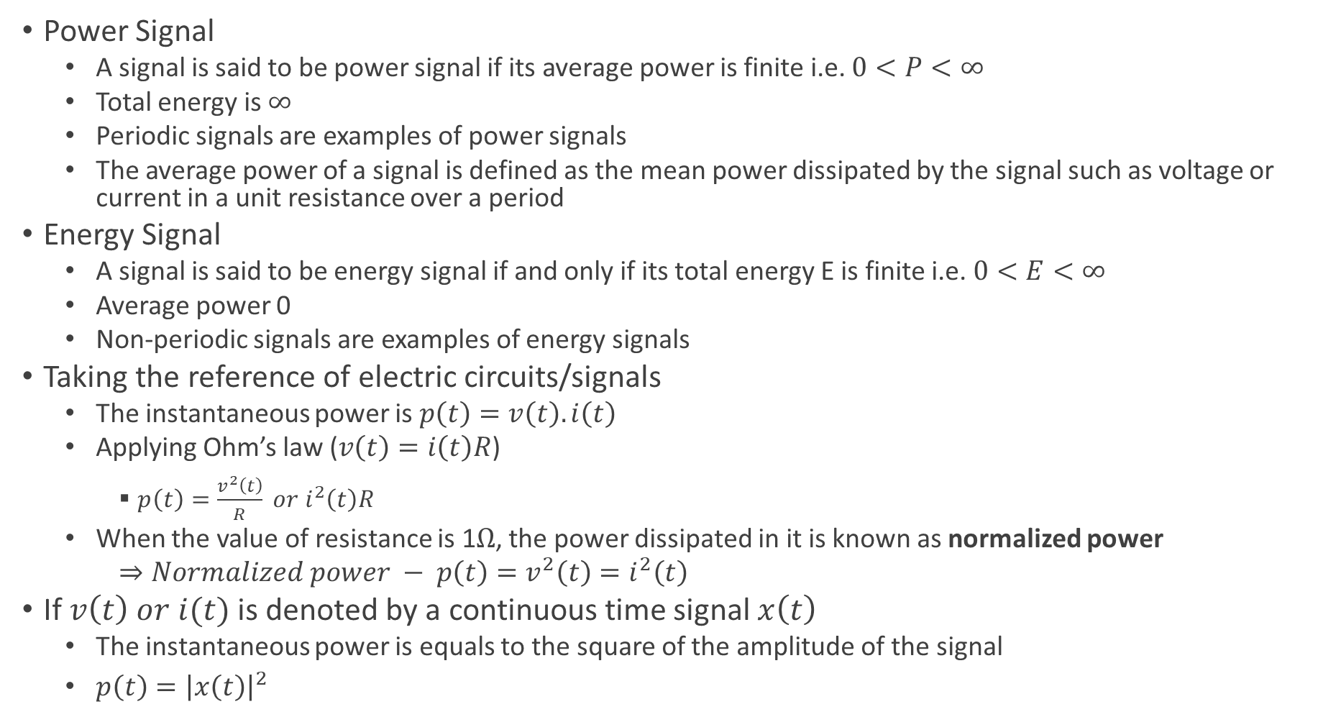
Key Concepts in Signal Processing
Power Signal
A signal is said to be power signal if its average power is finite i.e. $0<P<∞$
Total energy is $∞$
Periodic signals are examples of power signals
The average power of a signal is defined as the mean power dissipated by the signal such as voltage or current in a unit resistance over a period
Energy Signal
A signal is said to be energy signal if and only if its total energy E is finite i.e. $0<E<∞$
Average power 0
Non-periodic signals are examples of energy signals
Taking the reference of electric circuits/signals
The instantaneous power is $p\left(t\right)=v\left(t\right).i\left(t\right)$
Applying Ohm’s law ($v\left(t\right)=i\left(t\right)R$)
$p\left(t\right)=\frac{v^{2}\left(t\right)}{R} or i^{2}\left(t\right)R$
When the value of resistance is 1$Ω$, the power dissipated in it is known as normalized power
$⇒Normalized power − p\left(t\right)=v^{2}\left(t\right)=i^{2}\left(t\right)$
If $v\left(t\right) or i(t)$ is denoted by a continuous time signal $x\left(t\right)$
The instantaneous power is equals to the square of the amplitude of the signal
$p\left(t\right)={\left|x\left(t\right)\right|}^{2}$

Slide 3
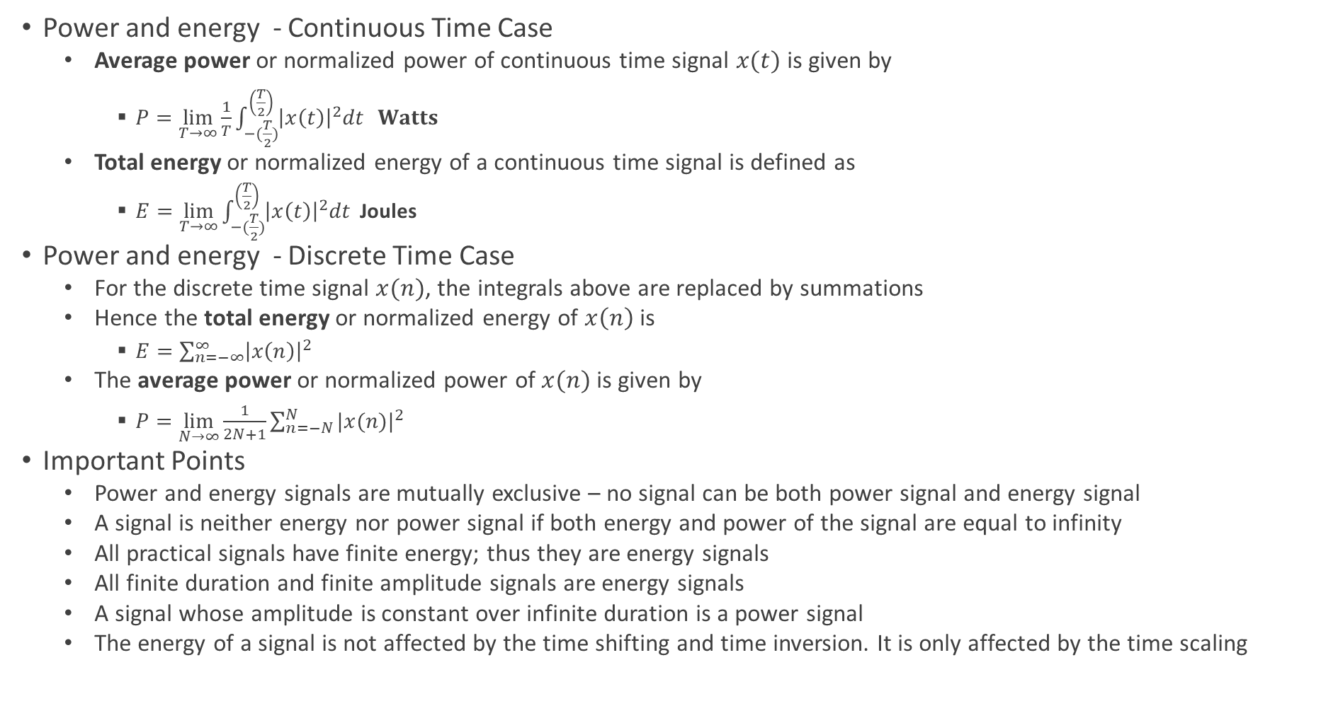
Key Concepts in Signal Processing
Power and energy - Continuous Time Case
Average power or normalized power of continuous time signal $x(t)$ is given by
$P=\lim_{T→∞}{\frac{1}{T}\int_{−(\frac{T}{2})}^{\left(\frac{T}{2}\right)}{{\left|x\left(t\right)\right|}^{2}dt} } Watts$
Total energy or normalized energy of a continuous time signal is defined as
$E=\lim_{T→∞}{\int_{−(\frac{T}{2})}^{\left(\frac{T}{2}\right)}{{\left|x\left(t\right)\right|}^{2}dt} }$Joules
Power and energy - Discrete Time Case
For the discrete time signal $x(n)$, the integrals above are replaced by summations
Hence the total energy or normalized energy of $x\left(n\right)$ is
$E=\sum_{n=−∞}^{∞}{{\left|x\left(n\right)\right|}^{2}}$
The average power or normalized power of $x(n)$ is given by
$P=\lim_{N→∞}{\frac{1}{2N+1}\sum_{n=−N}^{N}{{|x(n)|}^{2}}}$
Important Points
Power and energy signals are mutually exclusive – no signal can be both power signal and energy signal
A signal is neither energy nor power signal if both energy and power of the signal are equal to infinity
All practical signals have finite energy; thus they are energy signals
All finite duration and finite amplitude signals are energy signals
A signal whose amplitude is constant over infinite duration is a power signal
The energy of a signal is not affected by the time shifting and time inversion. It is only affected by the time scaling

Slide 4
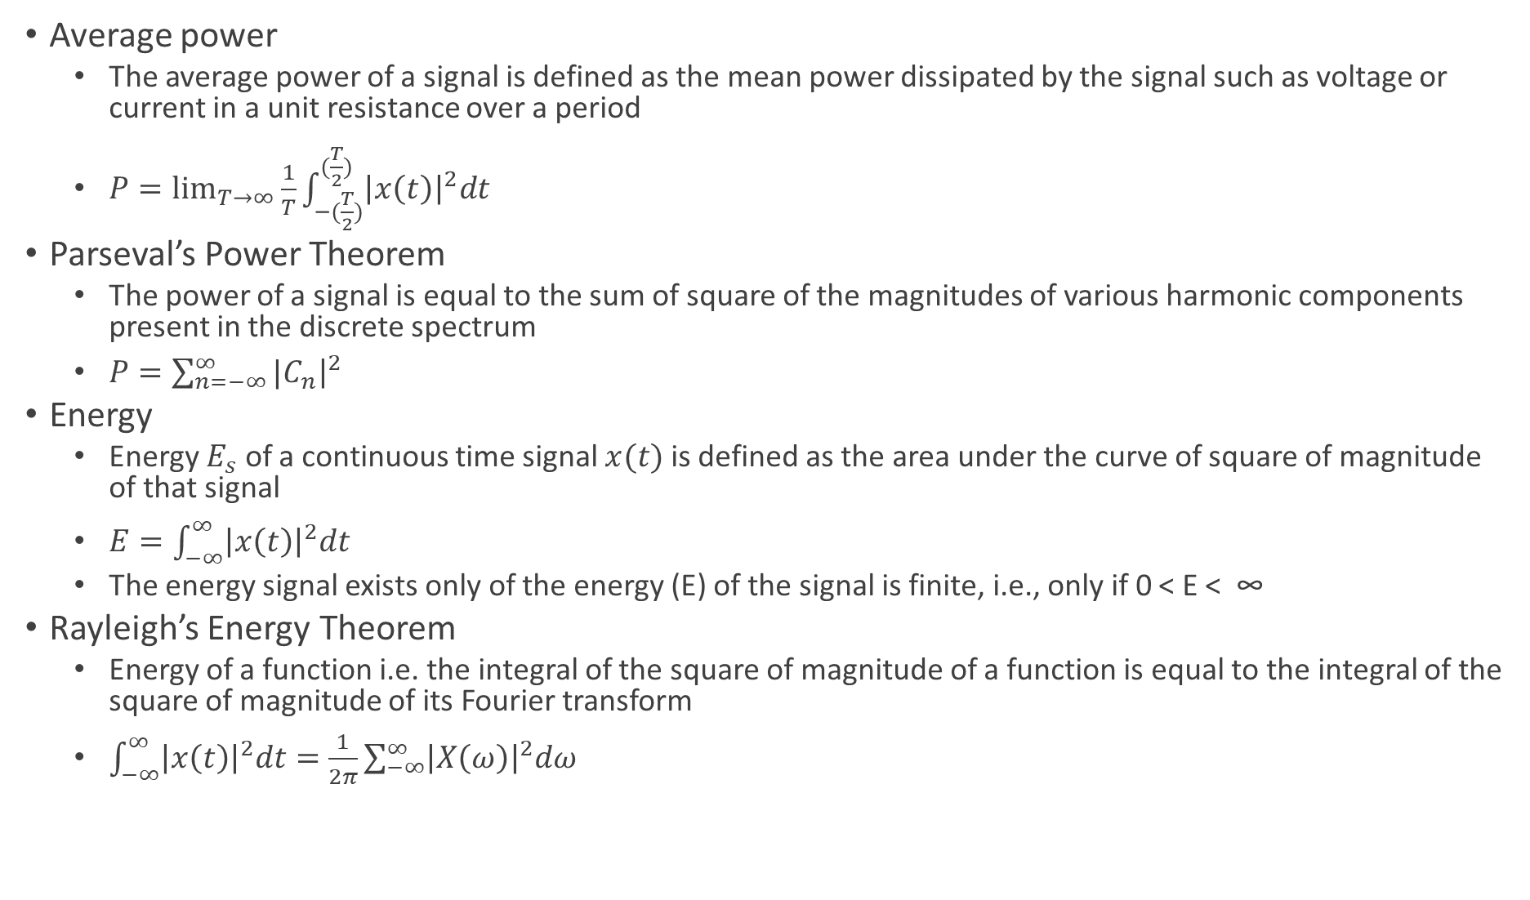
Key Concepts in Signal Processing
Average power
The average power of a signal is defined as the mean power dissipated by the signal such as voltage or current in a unit resistance over a period
$P=\lim_{T→∞}{\frac{1}{T}\int_{−(\frac{T}{2})}^{(\frac{T}{2})}{{\left|x\left(t\right)\right|}^{2}dt}}$
Parseval’s Power Theorem
The power of a signal is equal to the sum of square of the magnitudes of various harmonic components present in the discrete spectrum
$P=\sum_{n=−∞}^{∞}{{|C}_{n}{\left.​\right|}^{2}}$
Energy
Energy $E_{s}$ of a continuous time signal $x(t)$ is defined as the area under the curve of square of magnitude of that signal
$E=\int_{−∞}^{∞}{{\left|x\left(t\right)\right|}^{2}dt}$
The energy signal exists only of the energy (E) of the signal is finite, i.e., only if 0 < E < ∞
Rayleigh’s Energy Theorem
Energy of a function i.e. the integral of the square of magnitude of a function is equal to the integral of the square of magnitude of its Fourier transform
$\int_{−∞}^{∞}{{\left|x\left(t\right)\right|}^{2}dt=\frac{1}{2π}\sum_{−∞}^{∞}{{\left|X\left(ω\right)\right|}^{2}dω}}$

Slide 5
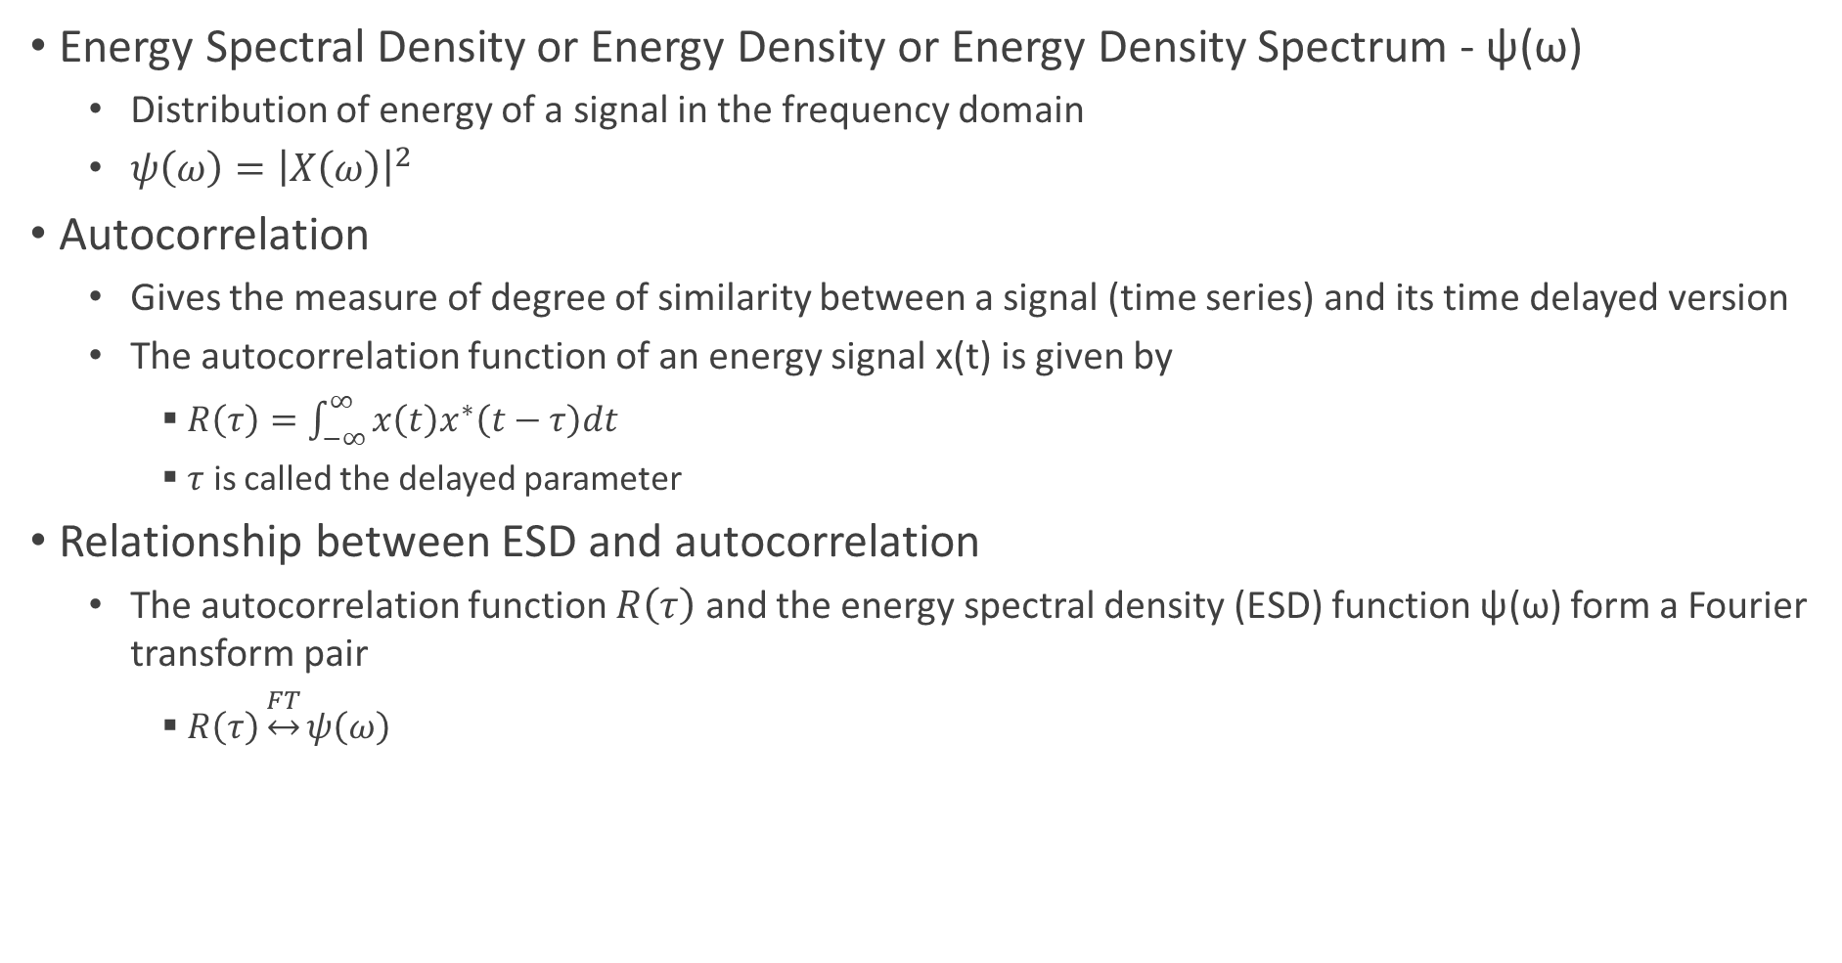
Energy Spectral Density and Autocorrelation
Energy Spectral Density or Energy Density or Energy Density Spectrum - ψ(ω)
Distribution of energy of a signal in the frequency domain
$ψ\left(ω\right)={\left|X\left(ω\right)\right|}^{2}$
Autocorrelation
Gives the measure of degree of similarity between a signal (time series) and its time delayed version
The autocorrelation function of an energy signal x(t) is given by
$R\left(τ\right)=\int_{−∞}^{∞}{x\left(t\right)x^{∗}\left(t−τ\right)dt}$
$τ$ is called the delayed parameter
Relationship between ESD and autocorrelation
The autocorrelation function $R\left(τ\right)$ and the energy spectral density (ESD) function ψ(ω) form a Fourier transform pair
$R\left(τ\right)\underset{↔}{FT}ψ\left(ω\right)$

Slide 6
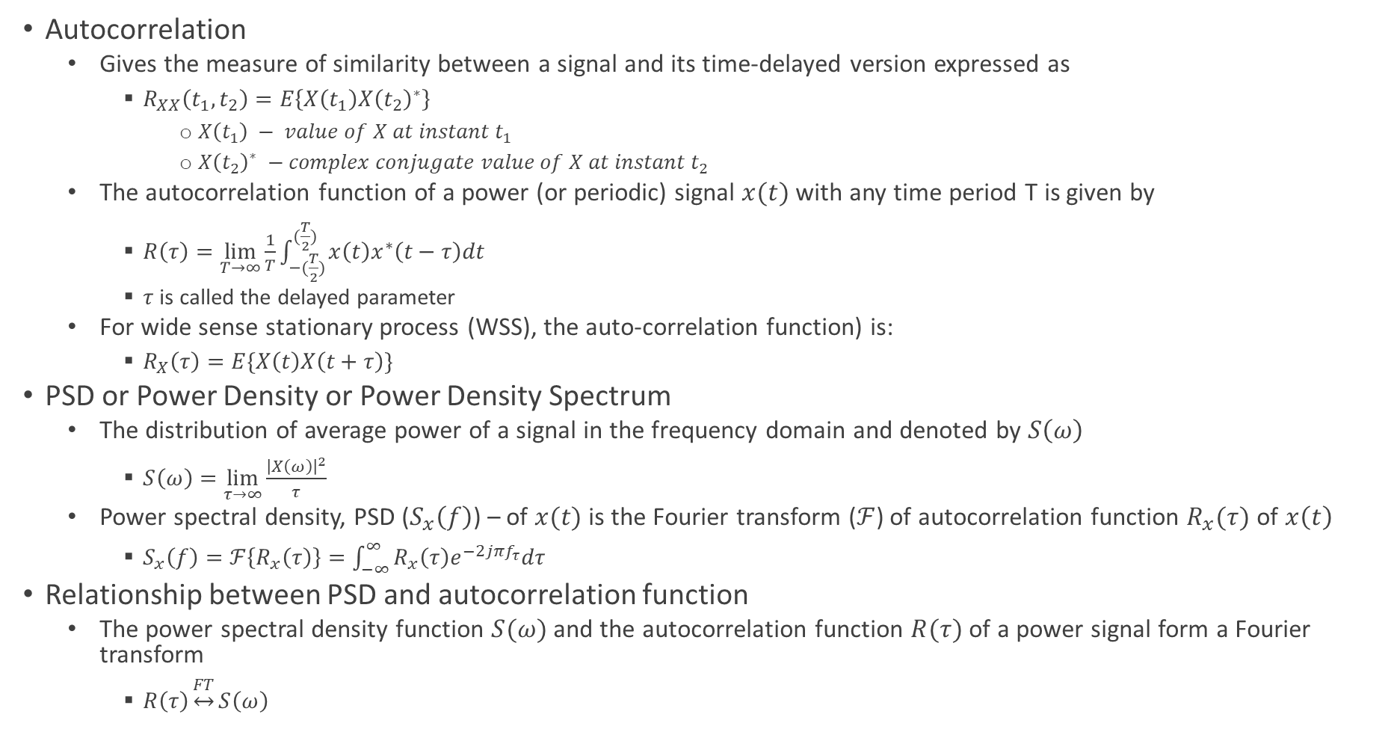
Power Spectral Density and Autocorrelation
Autocorrelation
Gives the measure of similarity between a signal and its time-delayed version expressed as
$R_{XX}\left(t_{1},t_{2}\right)=E\left\{X\left(t_{1}\right)X{\left(t_{2}\right)}^{∗}\right\}$
$X\left(t_{1}\right) − value of X at instant t_{1}$
$X{\left(t_{2}\right)}^{∗} −complex conjugate value of X at instant t_{2}$
The autocorrelation function of a power (or periodic) signal $x(t)$ with any time period T is given by
$R\left(τ\right)=\lim_{T→∞}{\frac{1}{T}\int_{−(\frac{T}{2})}^{(\frac{T}{2})}{x\left(t\right)x^{∗}\left(t−τ\right)dt}}$
$τ$ is called the delayed parameter
For wide sense stationary process (WSS), the auto-correlation function) is:
$R_{X}\left(τ\right)=E\{X\left(t\right)X\left(t+τ\right)\}$
PSD or Power Density or Power Density Spectrum
The distribution of average power of a signal in the frequency domain and denoted by $S\left(ω\right)$
$S\left(ω\right)=\lim_{τ→∞}{\frac{{\left|X\left(ω\right)\right|}^{2}}{τ}}$
Power spectral density, PSD ($S_{x}\left(f\right)$) – of $x(t)$is the Fourier transform ($ℱ$) of autocorrelation function $R_{x}(τ)$ of $x\left(t\right)$
$S_{x}\left(f\right)=ℱ\left\{R_{x}\left(τ\right)\right\}=\int_{−∞}^{∞}{R_{x}\left(τ\right)e^{−2jπf_{τ}}dτ}$
Relationship between PSD and autocorrelation function
The power spectral density function $S(ω)$ and the autocorrelation function $R(τ)$ of a power signal form a Fourier transform
$R\left(τ\right)\underset{↔}{FT}S\left(ω\right)$

Slide 7
Modern Communication Technologies and Systems
Cutting edge wireless technologies
Multiple Antennae Systems
Multiple Input and Multiple Output - MIMO Technology
OFDM – Orthogonal Frequency Division Multiplexing
Large bandwidth divided into several sub-bands and multiple uses sub-carriers
CDMA
Spreading code
Modern cellular and wifi systems built on cutting edge wireless technologies
LTE
5G – NR
802.11 AC, 802.11 AX

Slide 8
Principles and Models of Modern Wireless Systems
Large Scale Fading
Due to path loss of signal as a function of distance and shadowing by large structures – buildings and hills
Occurs as mobile moves through a distance of the order of the cell size
Frequency independent
Small Scale Fading
Due to constructive and destructive interference of the multiple signal paths between the transmitter and receiver
Occurs at the spatial scale of the order of the carrier wavelength
Frequency dependent

Slide 9
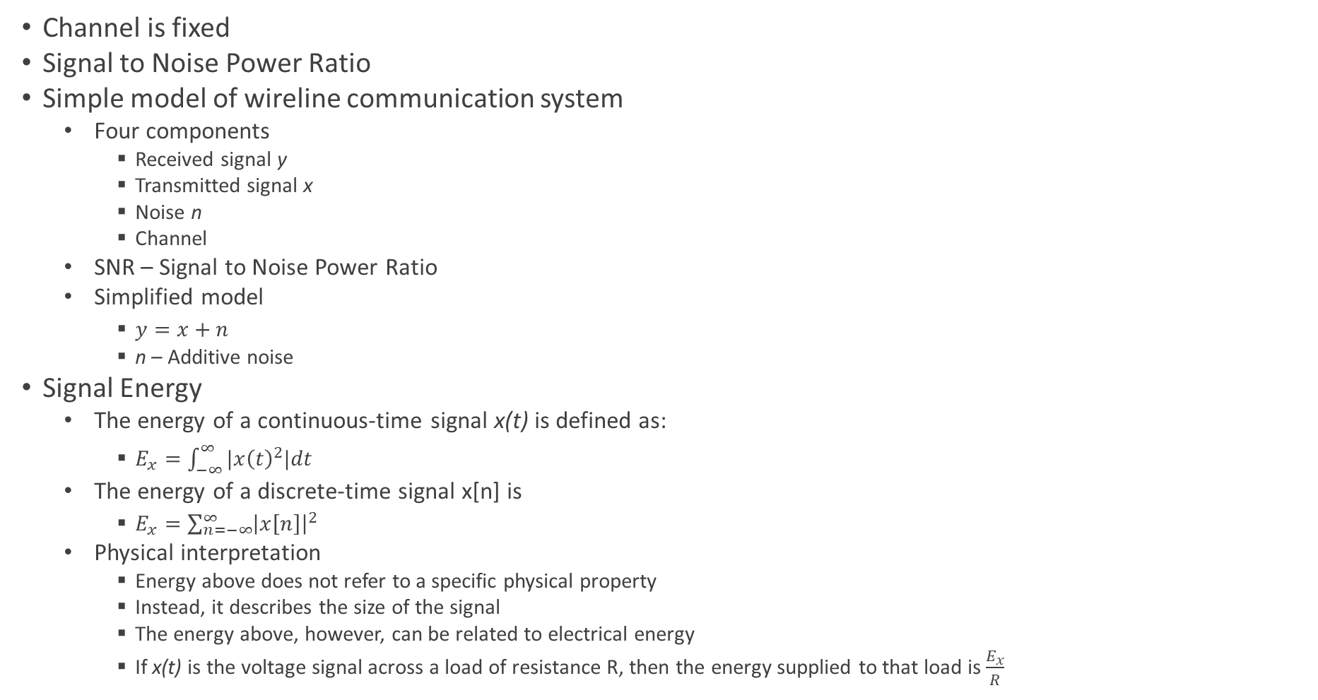
Modern Wireline Digital Communication System
Channel is fixed
Signal to Noise Power Ratio
Simple model of wireline communication system
Four components
Received signal y
Transmitted signal x
Noise n
Channel
SNR – Signal to Noise Power Ratio
Simplified model
$y=x+n$
n – Additive noise
Signal Energy
The energy of a continuous-time signal x(t) is defined as:
$E_{x}=\int_{−∞}^{∞}{|x{\left(t\right)}^{2}|dt}$
The energy of a discrete-time signal x[n] is
$E_{x}=\sum_{n=−∞}^{∞}{{\left|x\left[n\right]\right|}^{2}}$
Physical interpretation
Energy above does not refer to a specific physical property
Instead, it describes the size of the signal
The energy above, however, can be related to electrical energy
If x(t) is the voltage signal across a load of resistance R, then the energy supplied to that load is $\frac{E_{x}}{R}$

Slide 10
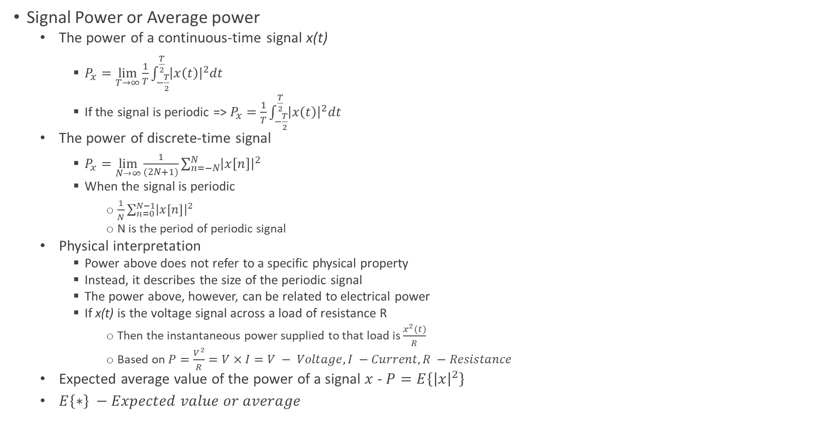
Modern Wireline Digital Communication System
Signal Power or Average power
The power of a continuous-time signal x(t)
$P_{x}=\lim_{T→∞}{\frac{1}{T}\int_{−\frac{T}{2}}^{\frac{T}{2}}{{\left|x\left(t\right)\right|}^{2}dt}}$
If the signal is periodic => $P_{x}=$ $\frac{1}{T}\int_{−\frac{T}{2}}^{\frac{T}{2}}{{\left|x\left(t\right)\right|}^{2}dt}$
The power of discrete-time signal
$P_{x}=\lim_{N→∞}{\frac{1}{(2N+1)}\sum_{n=−N}^{N}{{\left|x\left[n\right]\right|}^{2}}}$
When the signal is periodic
$\frac{1}{N}\sum_{n=0}^{N−1}{{\left|x\left[n\right]\right|}^{2}}$
N is the period of periodic signal
Physical interpretation
Power above does not refer to a specific physical property
Instead, it describes the size of the periodic signal
The power above, however, can be related to electrical power
If x(t) is the voltage signal across a load of resistance R
Then the instantaneous power supplied to that load is $\frac{x^{2}(t)}{R}$
Based on $P=\frac{V^{2}}{R}=V×I=V − Voltage, I −Current, R −Resistance$
Expected average value of the power of a signal $x$ - $P=E\left\{{\left|x\right|}^{2}\right\}$
$E\left\{∗\right\} −Expected value or average$

Slide 11
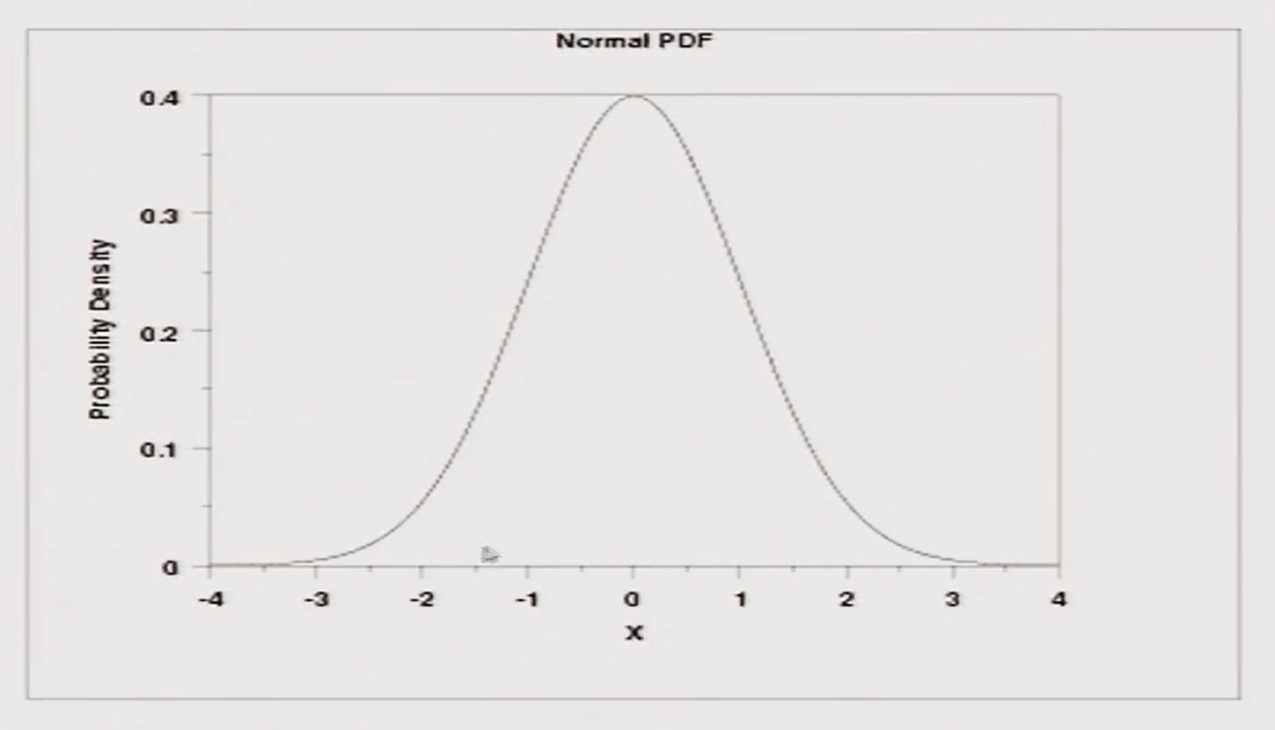
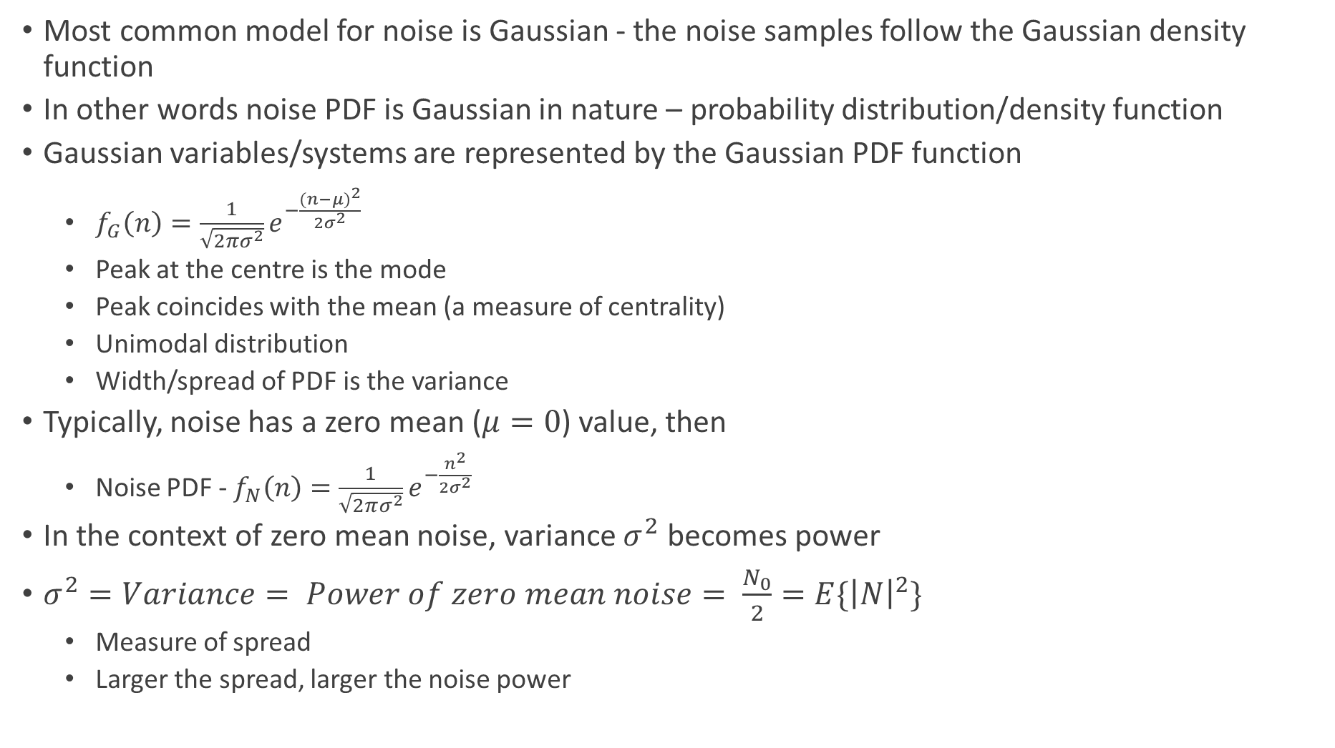
White Gaussian Noise
Most common model for noise is Gaussian - the noise samples follow the Gaussian density function
In other words noise PDF is Gaussian in nature – probability distribution/density function
Gaussian variables/systems are represented by the Gaussian PDF function
$f_{G}\left(n\right)=\frac{1}{\sqrt{2πσ^{2}}}e^{−\frac{{(n−μ)}^{2}}{2σ^{2}}}$
Peak at the centre is the mode
Peak coincides with the mean (a measure of centrality)
Unimodal distribution
Width/spread of PDF is the variance
Typically, noise has a zero mean ($μ=0$) value, then
Noise PDF - $f_{N}\left(n\right)=\frac{1}{\sqrt{2πσ^{2}}}e^{−\frac{n^{2}}{2σ^{2}}}$
In the context of zero mean noise, variance $σ^{2}$ becomes power
$σ^{2}=Variance= Power of zero mean noise= \frac{N_{0}}{2}=E\{{\left|N\right|}^{2}\}$
Measure of spread
Larger the spread, larger the noise power

Slide 12
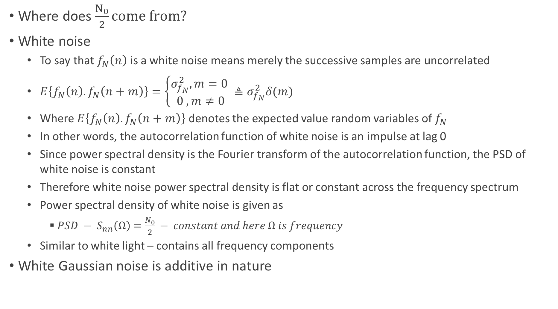
Additive White Gaussian Noise
Where does $\frac{N_{0}}{2}come from?$
White noise
To say that $f_{N}\left(n\right)$ is a white noise means merely the successive samples are uncorrelated
$E\left\{f_{N}\left(n\right).f_{N}\left(n+m\right)\right\}=\left\{\begin{aligned}σ_{f_{N}}^{2}, m=0 \\ 0 , m≠0\end{aligned}≜σ_{f_{N}}^{2}δ(m)\right.$
Where $E\left\{f_{N}\left(n\right).f_{N}\left(n+m\right)\right\}$ denotes the expected value random variables of $f_{N}$
In other words, the autocorrelation function of white noise is an impulse at lag 0
Since power spectral density is the Fourier transform of the autocorrelation function, the PSD of white noise is constant
Therefore white noise power spectral density is flat or constant across the frequency spectrum
Power spectral density of white noise is given as
$PSD − S_{nn}\left(Ω\right)=\frac{N_{0}}{2} − constant and here Ω is frequency$
Similar to white light – contains all frequency components
White Gaussian noise is additive in nature

Slide 13
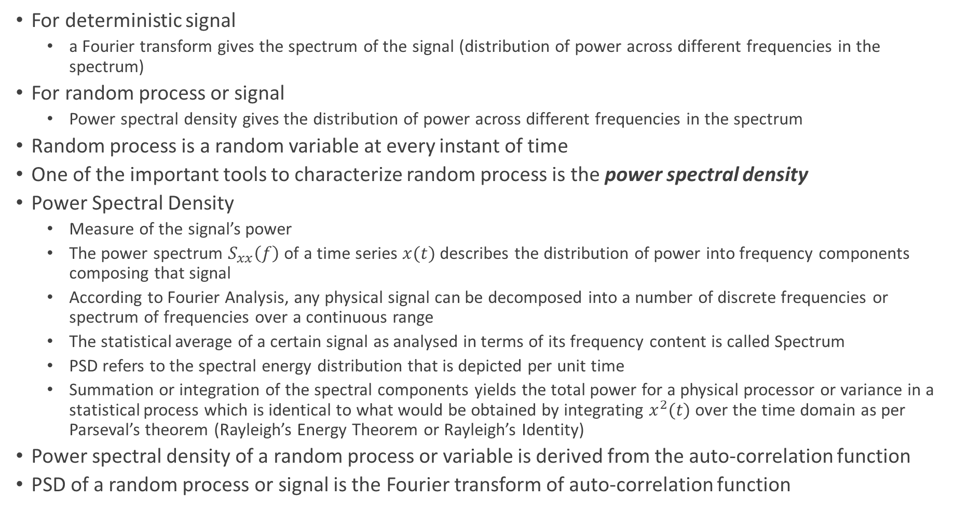
Random Process Characterization - Power Spectral Density
For deterministic signal
a Fourier transform gives the spectrum of the signal (distribution of power across different frequencies in the spectrum)
For random process or signal
Power spectral density gives the distribution of power across different frequencies in the spectrum
Random process is a random variable at every instant of time
One of the important tools to characterize random process is the power spectral density
Power Spectral Density
Measure of the signal’s power
The power spectrum $S_{xx}\left(f\right)$ of a time series $x(t)$ describes the distribution of power into frequency components composing that signal
According to Fourier Analysis, any physical signal can be decomposed into a number of discrete frequencies or spectrum of frequencies over a continuous range
The statistical average of a certain signal as analysed in terms of its frequency content is called Spectrum
PSD refers to the spectral energy distribution that is depicted per unit time
Summation or integration of the spectral components yields the total power for a physical processor or variance in a statistical process which is identical to what would be obtained by integrating $x^{2}(t)$ over the time domain as per Parseval’s theorem (Rayleigh’s Energy Theorem or Rayleigh’s Identity)
Power spectral density of a random process or variable is derived from the auto-correlation function
PSD of a random process or signal is the Fourier transform of auto-correlation function

Slide 14
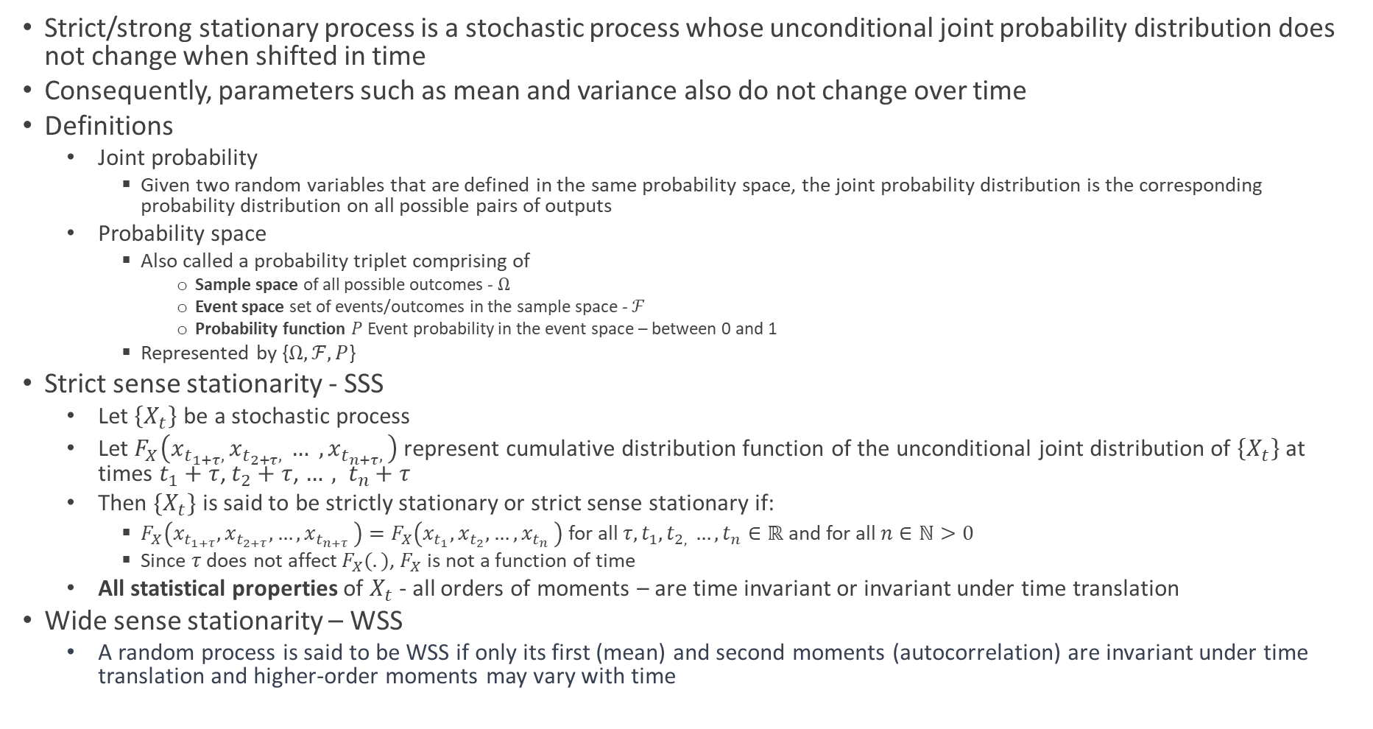
Stationary Process
Strict/strong stationary process is a stochastic process whose unconditional joint probability distribution does not change when shifted in time
Consequently, parameters such as mean and variance also do not change over time
Definitions
Joint probability
Given two random variables that are defined in the same probability space, the joint probability distribution is the corresponding probability distribution on all possible pairs of outputs
Probability space
Also called a probability triplet comprising of
Sample space of all possible outcomes - $Ω$
Event space set of events/outcomes in the sample space - $ℱ$
Probability function $P$Event probability in the event space – between 0 and 1
Represented by {$Ω, ℱ, P$}
Strict sense stationarity - SSS
Let $\left\{X_{t}\right\}$ be a stochastic process
Let $F_{X}\left(x_{t_{1+τ}, }x_{t_{2+τ}, }… , x_{t_{n+τ}, }\right)$represent cumulative distribution function of the unconditional joint distribution of $\left\{X_{t}\right\}$ at times $t_{1}+τ$, $t_{2}+τ$, ${…, t}_{n}+τ$
Then $\{X_{t}\}$ is said to be strictly stationary or strict sense stationary if:
$F_{X}\left(x_{t_{1+τ}}, x_{t_{2+τ}}, {…, x}_{t_{n+τ}}\right)=F_{X}\left(x_{t_{1}}, x_{t_{2}}, {…, x}_{t_{n}}\right)$ for all $τ, t_{1}, t_{2, }{…, t}_{n}∈ℝ$ and for all $n∈ℕ>0$
Since $τ$ does not affect $F_{X}(.)$, $F_{X}$ is not a function of time
All statistical properties of $X_{t}$ - all orders of moments – are time invariant or invariant under time translation
Wide sense stationarity – WSS
A random process is said to be WSS if only its first (mean) and second moments (autocorrelation) are invariant under time translation and higher-order moments may vary with time

Slide 15
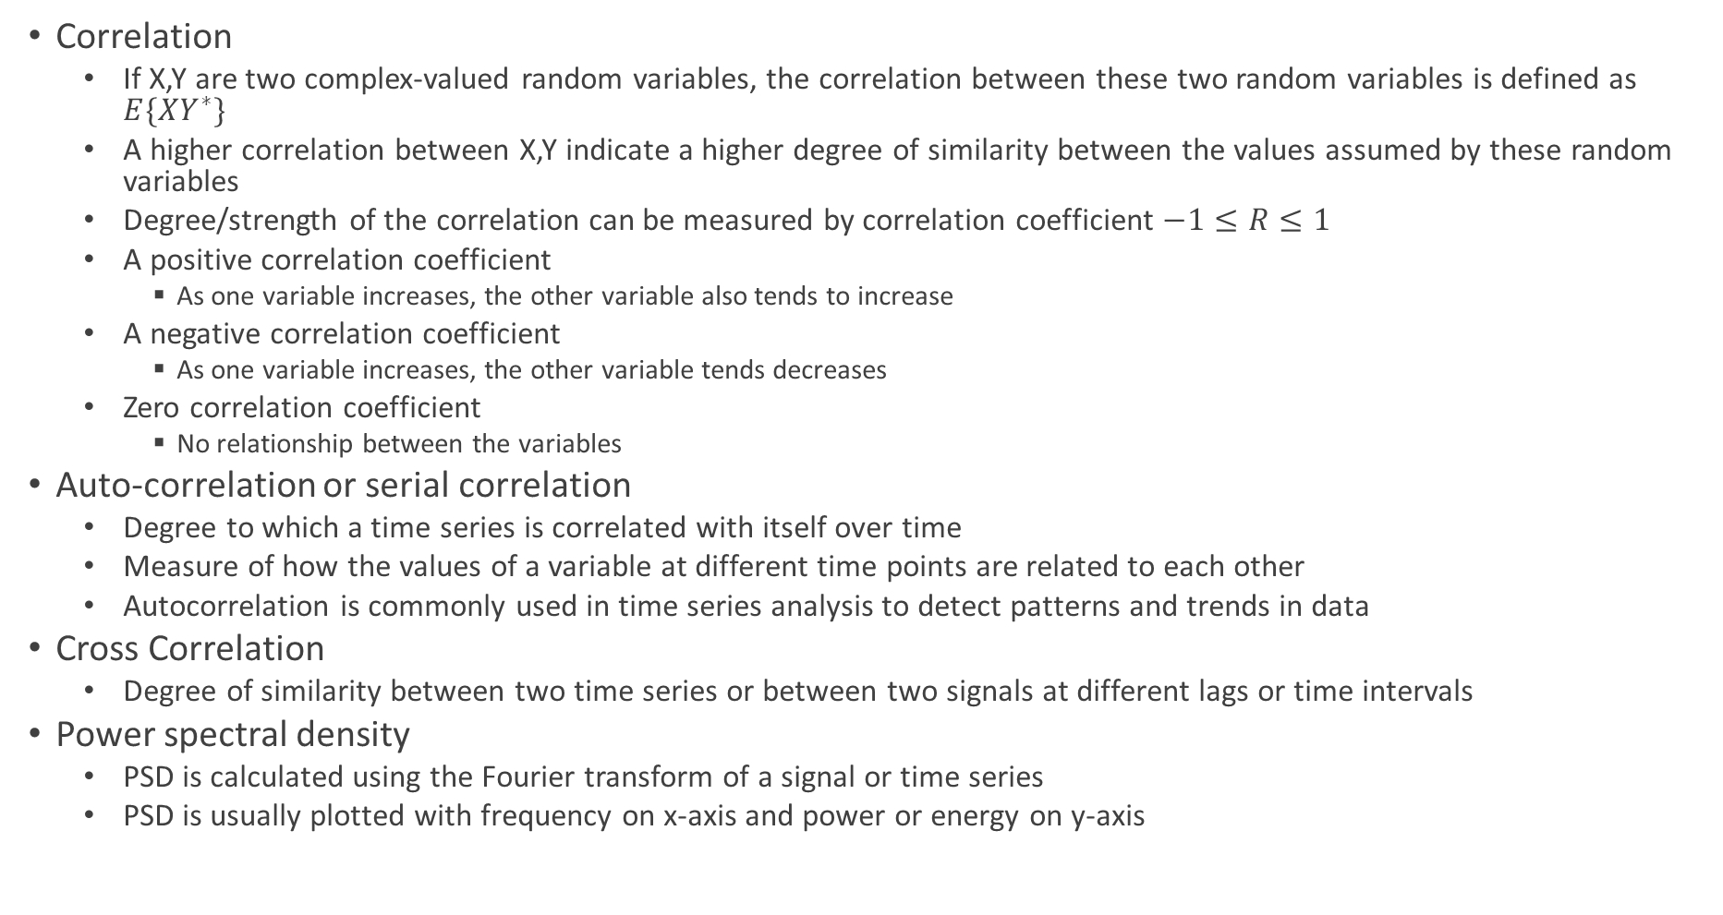
Auto-correlation, Cross Correlation and Power Spectral Density
Correlation
If X,Y are two complex-valued random variables, the correlation between these two random variables is defined as $E\{XY^{∗}\}$
A higher correlation between X,Y indicate a higher degree of similarity between the values assumed by these random variables
Degree/strength of the correlation can be measured by correlation coefficient $−1≤R≤1$
A positive correlation coefficient
As one variable increases, the other variable also tends to increase
A negative correlation coefficient
As one variable increases, the other variable tends decreases
Zero correlation coefficient
No relationship between the variables
Auto-correlation or serial correlation
Degree to which a time series is correlated with itself over time
Measure of how the values of a variable at different time points are related to each other
Autocorrelation is commonly used in time series analysis to detect patterns and trends in data
Cross Correlation
Degree of similarity between two time series or between two signals at different lags or time intervals
Power spectral density
PSD is calculated using the Fourier transform of a signal or time series
PSD is usually plotted with frequency on x-axis and power or energy on y-axis

Slide 16
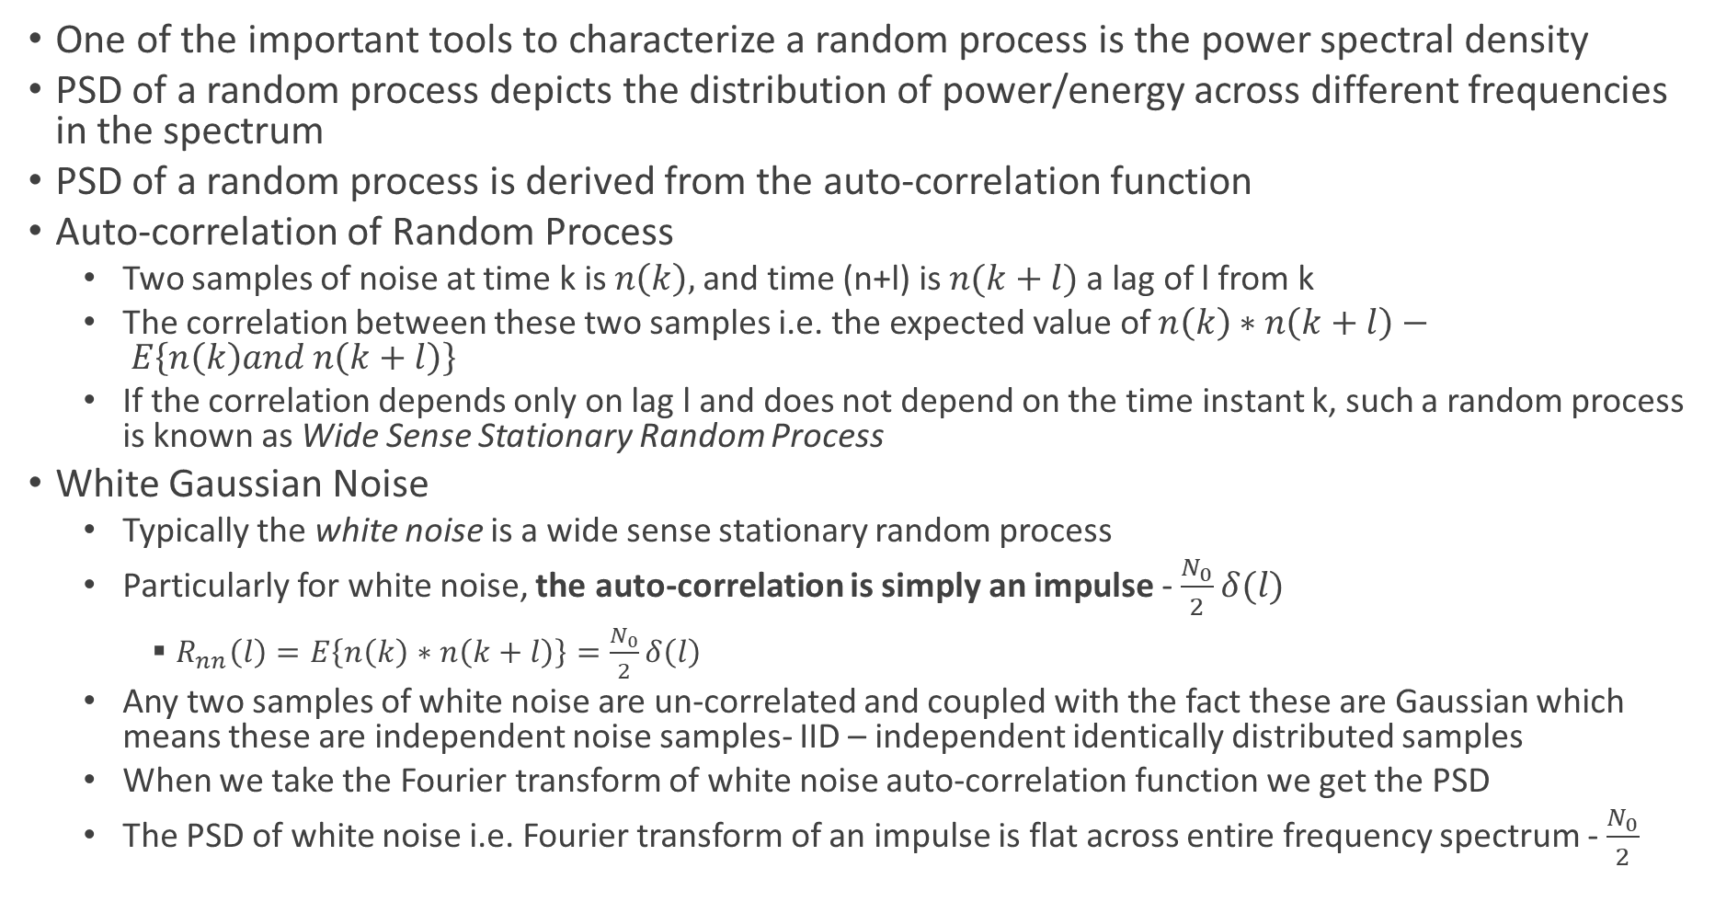
PSD of Random Process and White Noise
One of the important tools to characterize a random process is the power spectral density
PSD of a random process depicts the distribution of power/energy across different frequencies in the spectrum
PSD of a random process is derived from the auto-correlation function
Auto-correlation of Random Process
Two samples of noise at time k is $n\left(k\right),$and time (n+l) is $n(k+l)$ a lag of l from k
The correlation between these two samples i.e. the expected value of $n\left(k\right)∗n\left(k+l\right)− E\left\{n\left(k\right)and n\left(k+l\right)\right\}$
If the correlation depends only on lag l and does not depend on the time instant k, such a random process is known as Wide Sense Stationary Random Process
White Gaussian Noise
Typically the white noise is a wide sense stationary random process
Particularly for white noise, the auto-correlation is simply an impulse - $\frac{N_{0}}{2}δ(l)$
$R_{nn}\left(l\right)=E\left\{n\left(k\right)∗n\left(k+l\right)\right\}=\frac{N_{0}}{2}δ\left(l\right)$
Any two samples of white noise are un-correlated and coupled with the fact these are Gaussian which means these are independent noise samples- IID – independent identically distributed samples
When we take the Fourier transform of white noise auto-correlation function we get the PSD
The PSD of white noise i.e. Fourier transform of an impulse is flat across entire frequency spectrum - $\frac{N_{0}}{2}$

Slide 17
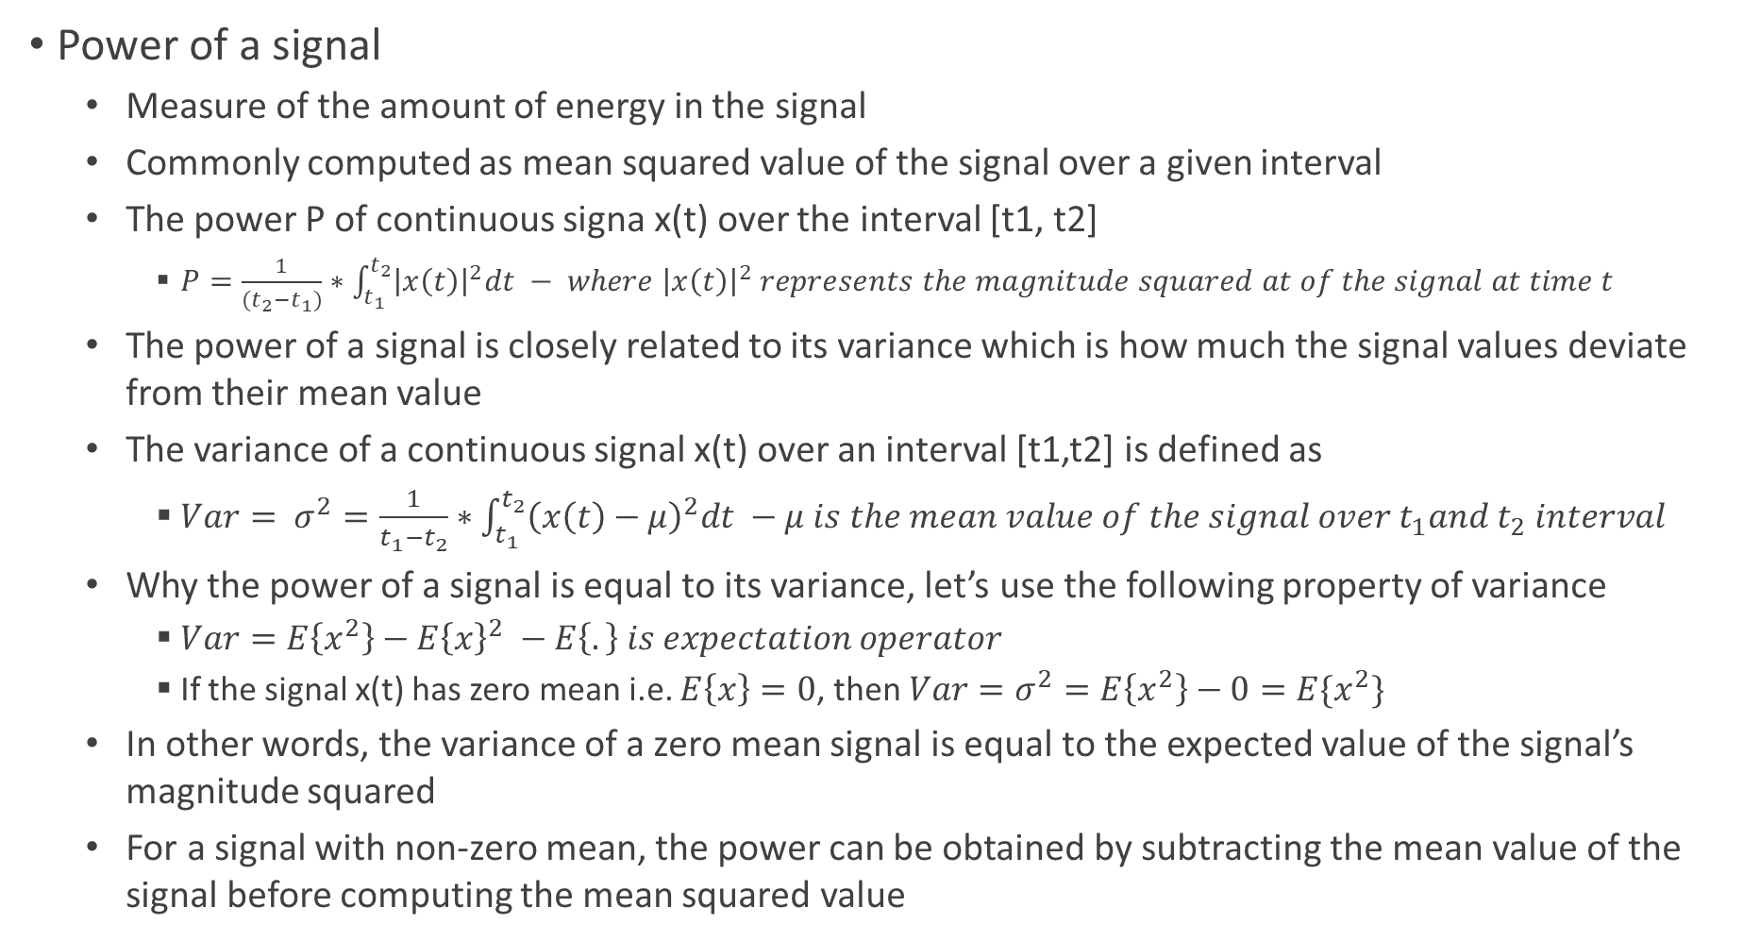
Notes – Power of a Signal and PSD of White Noise
Power of a signal
Measure of the amount of energy in the signal
Commonly computed as mean squared value of the signal over a given interval
The power P of continuous signa x(t) over the interval [t1, t2]
$P=\frac{1}{(t_{2}−t_{1})}∗\int_{t_{1}}^{t_{2}}{{\left|x\left(t\right)\right|}^{2}dt} − where {\left|x\left(t\right)\right|}^{2} represents the magnitude squared at of the signal at time t$
The power of a signal is closely related to its variance which is how much the signal values deviate from their mean value
The variance of a continuous signal x(t) over an interval [t1,t2] is defined as
$Var= σ^{2}=\frac{1}{t_{1}−t_{2}}∗\int_{t_{1}}^{t_{2}}{{\left(x\left(t\right)−μ\right)}^{2}dt} −μ is the mean value of the signal over t_{1}and t_{2} interval$
Why the power of a signal is equal to its variance, let’s use the following property of variance
$Var=E\left\{x^{2}\right\}−E{\left\{x\right\}}^{2} −E\left\{.\right\} is expectation operator$
If the signal x(t) has zero mean i.e. $E\left\{x\right\}=0$, then $Var=σ^{2}=E\left\{x^{2}\right\}−0=E\{x^{2}\}$
In other words, the variance of a zero mean signal is equal to the expected value of the signal’s magnitude squared
For a signal with non-zero mean, the power can be obtained by subtracting the mean value of the signal before computing the mean squared value

Slide 18
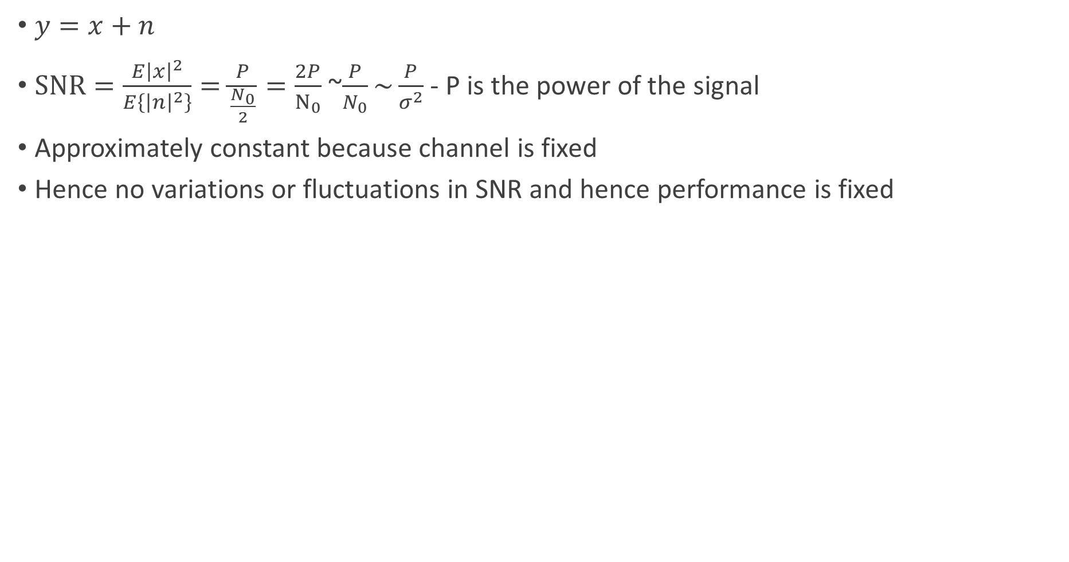
Wireline SNR – Signal to Noise Power Ratio
$y=x+n$
$SNR=\frac{E{\left|x\right|}^{2}}{E\left\{{\left|n\right|}^{2}\right\}}=\frac{P}{\frac{N_{0}}{2}}=\frac{2P}{N_{0}}$ ~$\frac{P}{N_{0}}\sim \frac{P}{σ^{2}}$ - P is the power of the signal
Approximately constant because channel is fixed
Hence no variations or fluctuations in SNR and hence performance is fixed

Slide 19
Performance of Communication System
BER is the probability that a single received bit is in error
Bit Error Rate is an important metric for communication system performance

Slide 20
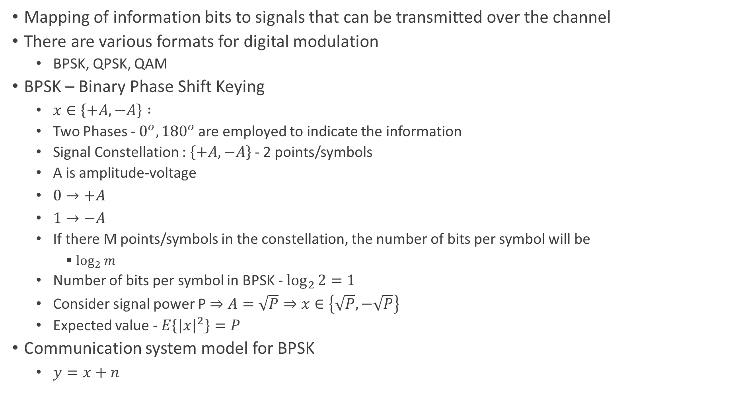
Digital Modulation - BPSK
Mapping of information bits to signals that can be transmitted over the channel
There are various formats for digital modulation
BPSK, QPSK, QAM
BPSK – Binary Phase Shift Keying
$x∈\left\{+A, −A\right\} :$
Two Phases - $0^{o}, {180}^{o}$are employed to indicate the information
Signal Constellation : $\left\{+A,−A\right\}$ - 2 points/symbols
A is amplitude-voltage
$0→+A$
$1→−A$
If there M points/symbols in the constellation, the number of bits per symbol will be
$\log_{2}{m}$
Number of bits per symbol in BPSK - $\log_{2}{2}=1$
Consider signal power P$⇒A=\sqrt{P}⇒x∈\left\{\sqrt{P},−\sqrt{P}\right\}$
Expected value - $E\left\{{\left|x\right|}^{2}\right\}=P$
Communication system model for BPSK
$y=x+n$

Slide 21
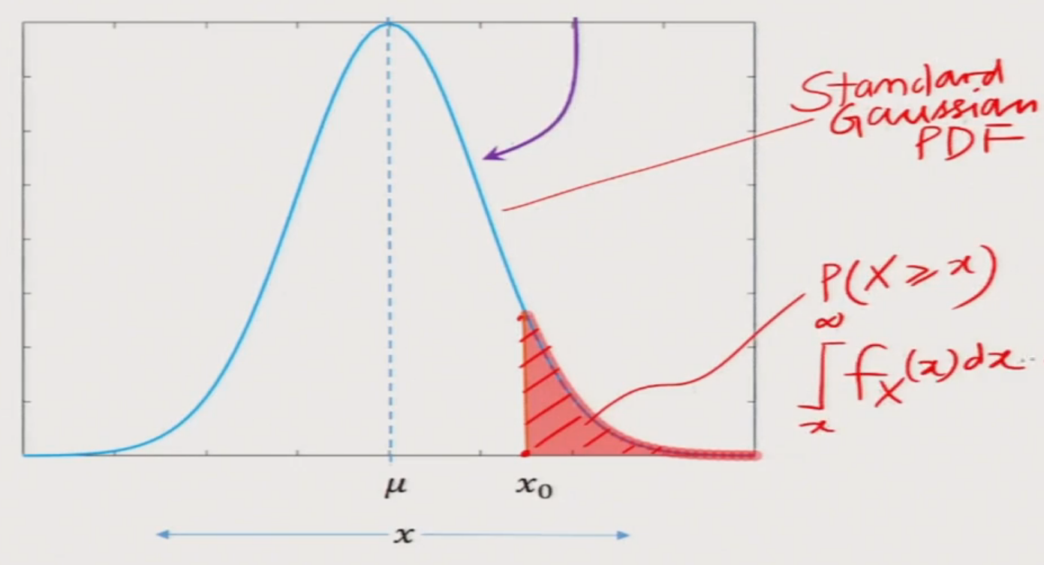
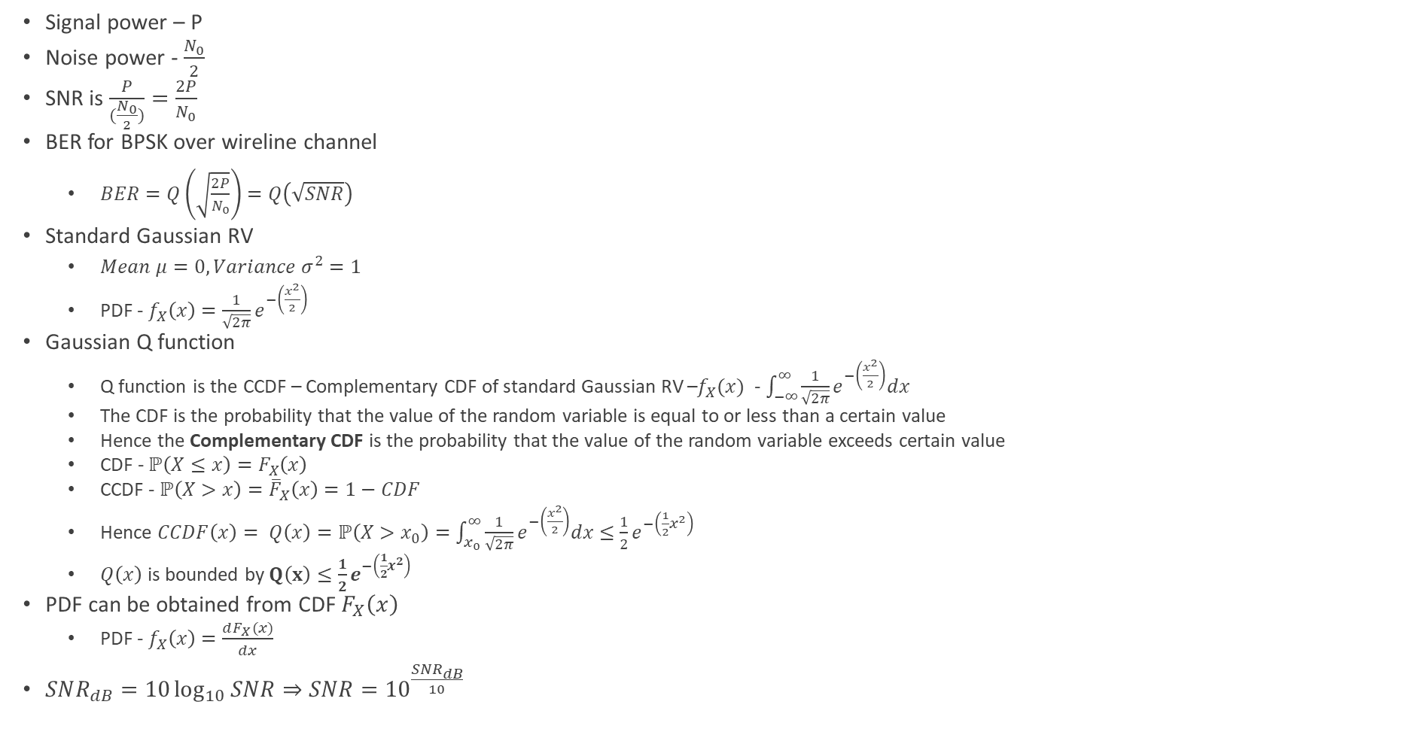
BPSK Wireline Performance
Signal power – P
Noise power - $\frac{N_{0}}{2}$
SNR is $\frac{P}{(\frac{N_{0}}{2})}=\frac{2P}{N_{0}}$
BER for BPSK over wireline channel
$BER=Q\left(\sqrt{\frac{2P}{N_{0}}}\right)=Q\left(\sqrt{SNR}\right)$
Standard Gaussian RV
$Mean μ=0, Variance σ^{2}=1$
PDF - $f_{X}\left(x\right)=\frac{1}{\sqrt{2π}}e^{−\left(\frac{x^{2}}{2}\right)}$
Gaussian Q function
Q function is the CCDF – Complementary CDF of standard Gaussian RV –$f_{X}(x)$ - $\int_{−∞}^{∞}{\frac{1}{\sqrt{2π}}e^{−\left(\frac{x^{2}}{2}\right)}dx }$
The CDF is the probability that the value of the random variable is equal to or less than a certain value
Hence the Complementary CDF is the probability that the value of the random variable exceeds certain value
CDF - $ℙ\left(X≤x\right)=F_{X}\left(x\right)$
CCDF - $ℙ\left(X>x\right)={\overline{F}}_{X}\left(x\right)=1−CDF$
Hence $CCDF\left(x\right)= Q\left(x\right)=ℙ\left(X>x_{0}\right)=\int_{x_{0}}^{∞}{\frac{1}{\sqrt{2π}}}e^{−\left(\frac{x^{2}}{2}\right)}dx≤\frac{1}{2}e^{−\left(\frac{1}{2}x^{2}\right)}$
$Q\left(x\right)$ is bounded by$Q\left(x\right)≤\frac{1}{2}e^{−\left(\frac{1}{2}x^{2}\right)}$
PDF can be obtained from CDF $F_{X}\left(x\right)$
PDF - $f_{X}\left(x\right)=\frac{dF_{X}(x)}{dx}$
$SNR_{dB}=10\log_{10}{SNR⇒SNR={10}^{\frac{SNR_{dB}}{10}}}$
CCDF aka Q Function of Gaussian RV

Slide 22
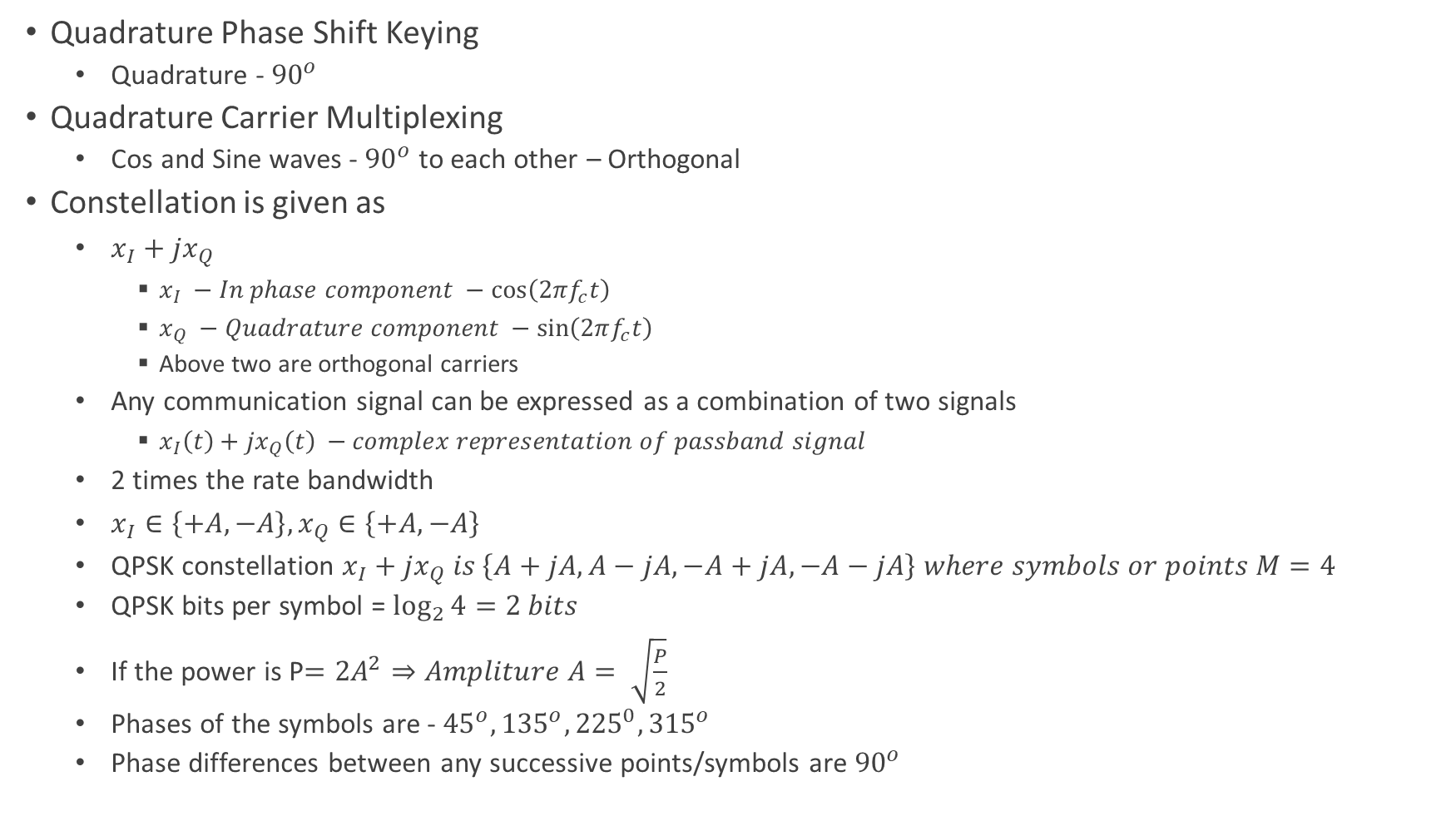
QPSK
Quadrature Phase Shift Keying
Quadrature - ${90}^{o}$
Quadrature Carrier Multiplexing
Cos and Sine waves - ${90}^{o}$ to each other – Orthogonal
Constellation is given as
$x_{I}+{jx}_{Q}$
$x_{I} −In phase component −\cos\left(2πf_{c}t\right)$
$x_{Q} −Quadrature component −\sin\left(2πf_{c}t\right)$
Above two are orthogonal carriers
Any communication signal can be expressed as a combination of two signals
$x_{I}\left(t\right)+{jx}_{Q}\left(t\right) −complex representation of passband signal$
2 times the rate bandwidth
$x_{I}∈\left\{+A, −A\right\}, x_{Q}∈\left\{+A,−A\right\}$
QPSK constellation $x_{I}+{jx}_{Q} is \left\{A+jA, A−jA, −A+jA, −A−jA\right\} where symbols or points M=4$
QPSK bits per symbol = $\log_{2}{4}=2 bits$
If the power is P$=2A^{2}⇒Ampliture A= \sqrt{\frac{P}{2}}$
Phases of the symbols are - ${45}^{o}, {135}^{o}, {225}^{0},{315}^{o}$
Phase differences between any successive points/symbols are ${90}^{o}$

Slide 23
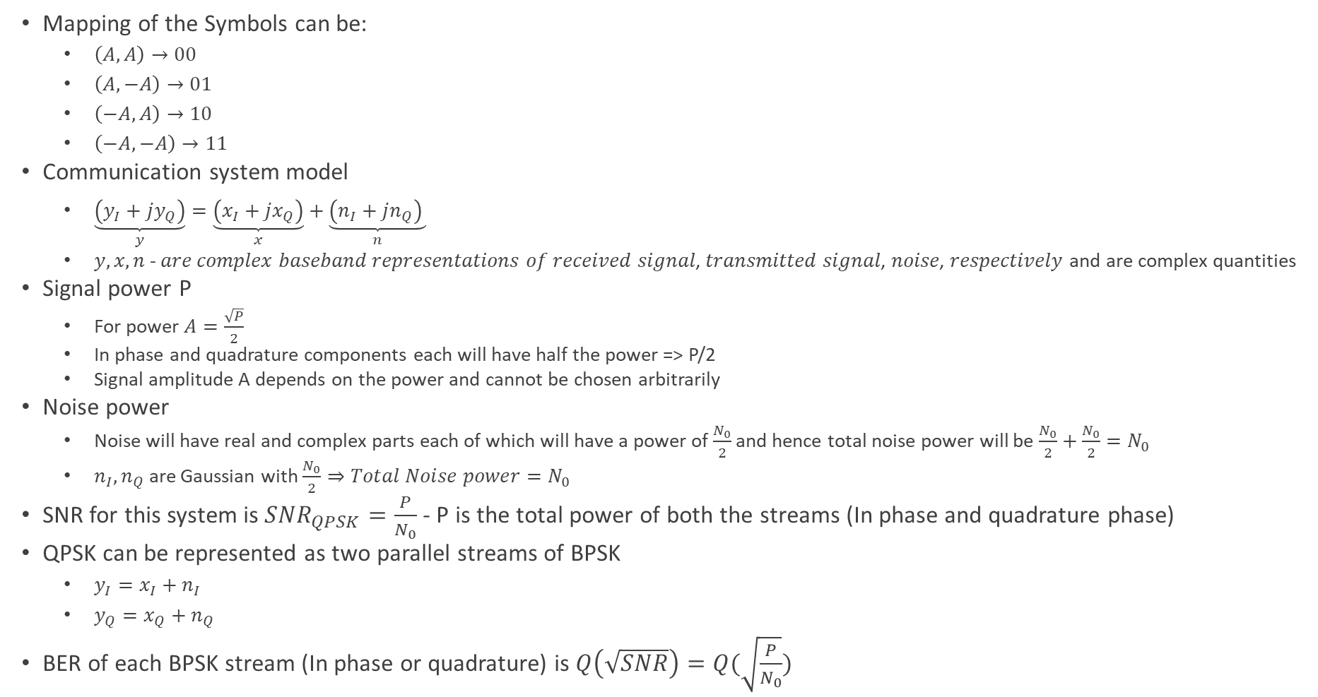
QPSK
Mapping of the Symbols can be:
$\left(A,A\right)→00$
$\left(A,−A\right)→01$
$\left(−A,A\right)→10$
$\left(−A,−A\right)→11$
Communication system model
$\underset{y}{\underbrace{\left(y_{I}+jy_{Q}\right)}}=\underset{x}{\underbrace{\left(x_{I}+jx_{Q}\right)}}+\underset{n}{\underbrace{\left(n_{I}+jn_{Q}\right) }}$
$y,x,n$- 𝑎𝑟𝑒 𝑐𝑜𝑚𝑝𝑙𝑒𝑥 𝑏𝑎𝑠𝑒𝑏𝑎𝑛𝑑 𝑟𝑒𝑝𝑟𝑒𝑠𝑒𝑛𝑡𝑎𝑡𝑖𝑜𝑛𝑠 𝑜𝑓 𝑟𝑒𝑐𝑒𝑖𝑣𝑒𝑑 𝑠𝑖𝑔𝑛𝑎𝑙, 𝑡𝑟𝑎𝑛𝑠𝑚𝑖𝑡𝑡𝑒𝑑 𝑠𝑖𝑔𝑛𝑎𝑙, 𝑛𝑜𝑖𝑠𝑒, 𝑟𝑒𝑠𝑝𝑒𝑐𝑡𝑖𝑣𝑒𝑙𝑦 and are complex quantities
Signal power P
For power $A=\frac{\sqrt{P}}{2}$
In phase and quadrature components each will have half the power => P/2
Signal amplitude A depends on the power and cannot be chosen arbitrarily
Noise power
Noise will have real and complex parts each of which will have a power of $\frac{N_{0}}{2}$ and hence total noise power will be $\frac{N_{0}}{2}+\frac{N_{0}}{2}=N_{0}$
$n_{I},n_{Q}$ are Gaussian with $\frac{N_{0}}{2}⇒Total Noise power=N_{0}$
SNR for this system is $SNR_{QPSK}=\frac{P}{N_{0}}$ - P is the total power of both the streams (In phase and quadrature phase)
QPSK can be represented as two parallel streams of BPSK
$y_{I}=x_{I}+n_{I}$
$y_{Q}=x_{Q}+n_{Q}$
BER of each BPSK stream (In phase or quadrature) is $Q\left(\sqrt{SNR}\right)=Q(\sqrt{\frac{P}{N_{0}}})$

Slide 24
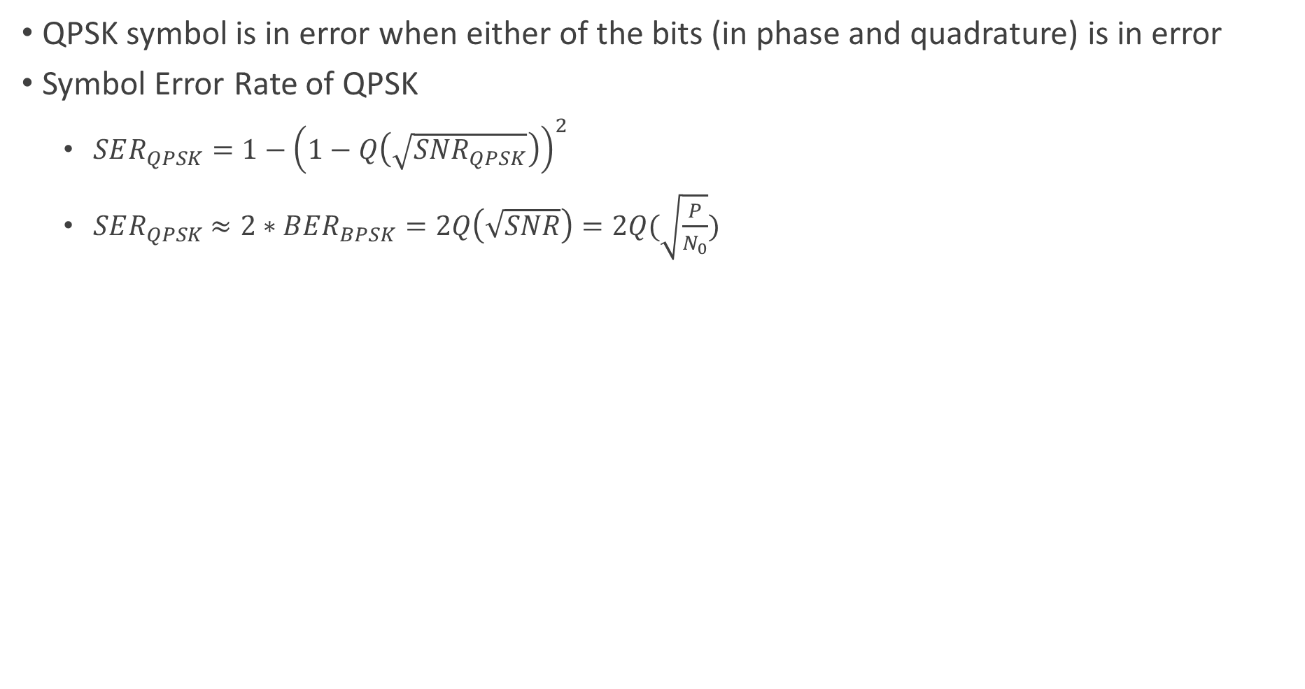
QPSK
QPSK symbol is in error when either of the bits (in phase and quadrature) is in error
Symbol Error Rate of QPSK
$SER_{QPSK}=1−{\left(1−Q\left(\sqrt{SNR_{QPSK}}\right)\right)}^{2}$
$SER_{QPSK}$ $≈2∗BER_{BPSK}=2Q\left(\sqrt{SNR}\right)=2Q(\sqrt{\frac{P}{N_{0}}})$

Slide 25
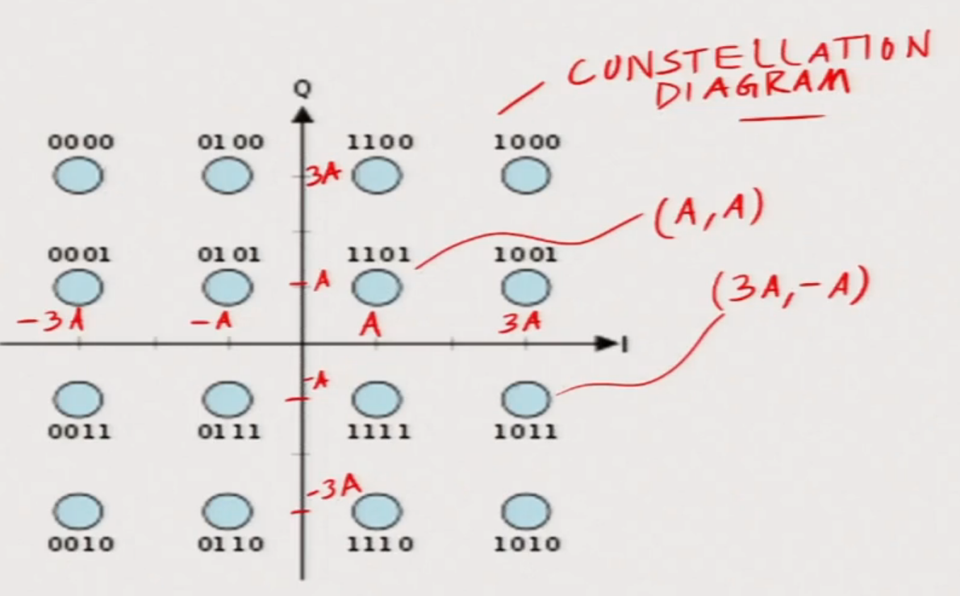
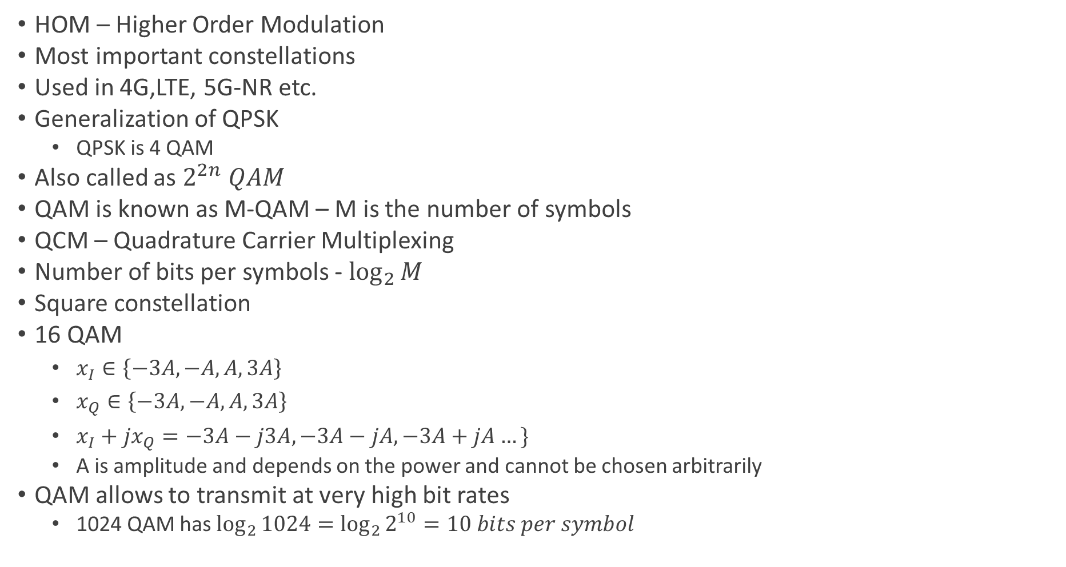
QAM – Quadrature Amplitude Modulation
HOM – Higher Order Modulation
Most important constellations
Used in 4G,LTE, 5G-NR etc.
Generalization of QPSK
QPSK is 4 QAM
Also called as $2^{2n} QAM$
QAM is known as M-QAM – M is the number of symbols
QCM – Quadrature Carrier Multiplexing
Number of bits per symbols - $\log_{2}{M}$
Square constellation
16 QAM
$x_{I}∈\left\{−3A, −A, A,3A\right\}$
$x_{Q}∈\left\{−3A, −A, A,3A\right\}$
$x_{I}+{jx}_{Q}=−3A−j3A,−3A−jA, −3A+jA…\}$
A is amplitude and depends on the power and cannot be chosen arbitrarily
QAM allows to transmit at very high bit rates
1024 QAM has $\log_{2}{1024=\log_{2}{2^{10}}=10 bits per symbol}$

Slide 26
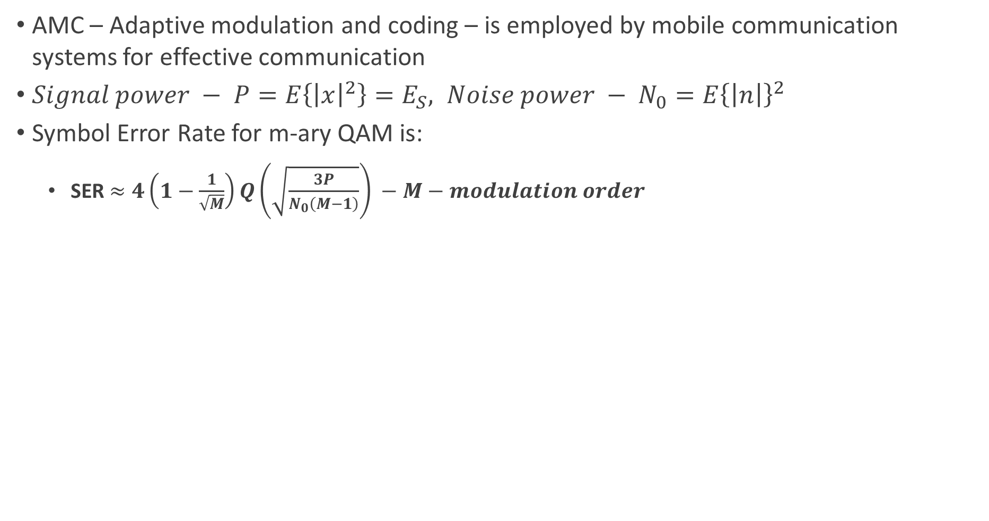
QAM
AMC – Adaptive modulation and coding – is employed by mobile communication systems for effective communication
$Signal power − P=E\left\{{\left|x\right|}^{2}\right\}=E_{S}, Noise power − N_{0}=E{\left\{\left|n\right|\right\}}^{2}$
Symbol Error Rate for m-ary QAM is:
SER $≈4\left(1−\frac{1}{\sqrt{M}}\right)Q\left(\sqrt{\frac{3P}{N_{0}\left(M−1\right)}}\right) −M−modulation order$

Slide 27
Wireless Channel and Performance
Multiple propagation paths – LOS, and several NLOS – multipath propagation due to scatterers
Multipaths exists due to large objects or scatters
Multipath propagation leads to multiple copies of the signal at the receiver
Multiple signal copies causes superposition of the signals at the receiver resulting interference – constructive and destructive
Because of interference, the SNR varies or fluctuates
Due to interference, received signal power fluctuates or varies and this phenomenon is called fading
Wireless channel is also called fading channel - where the received power dips significantly is termed as deep fade

Slide 28
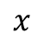
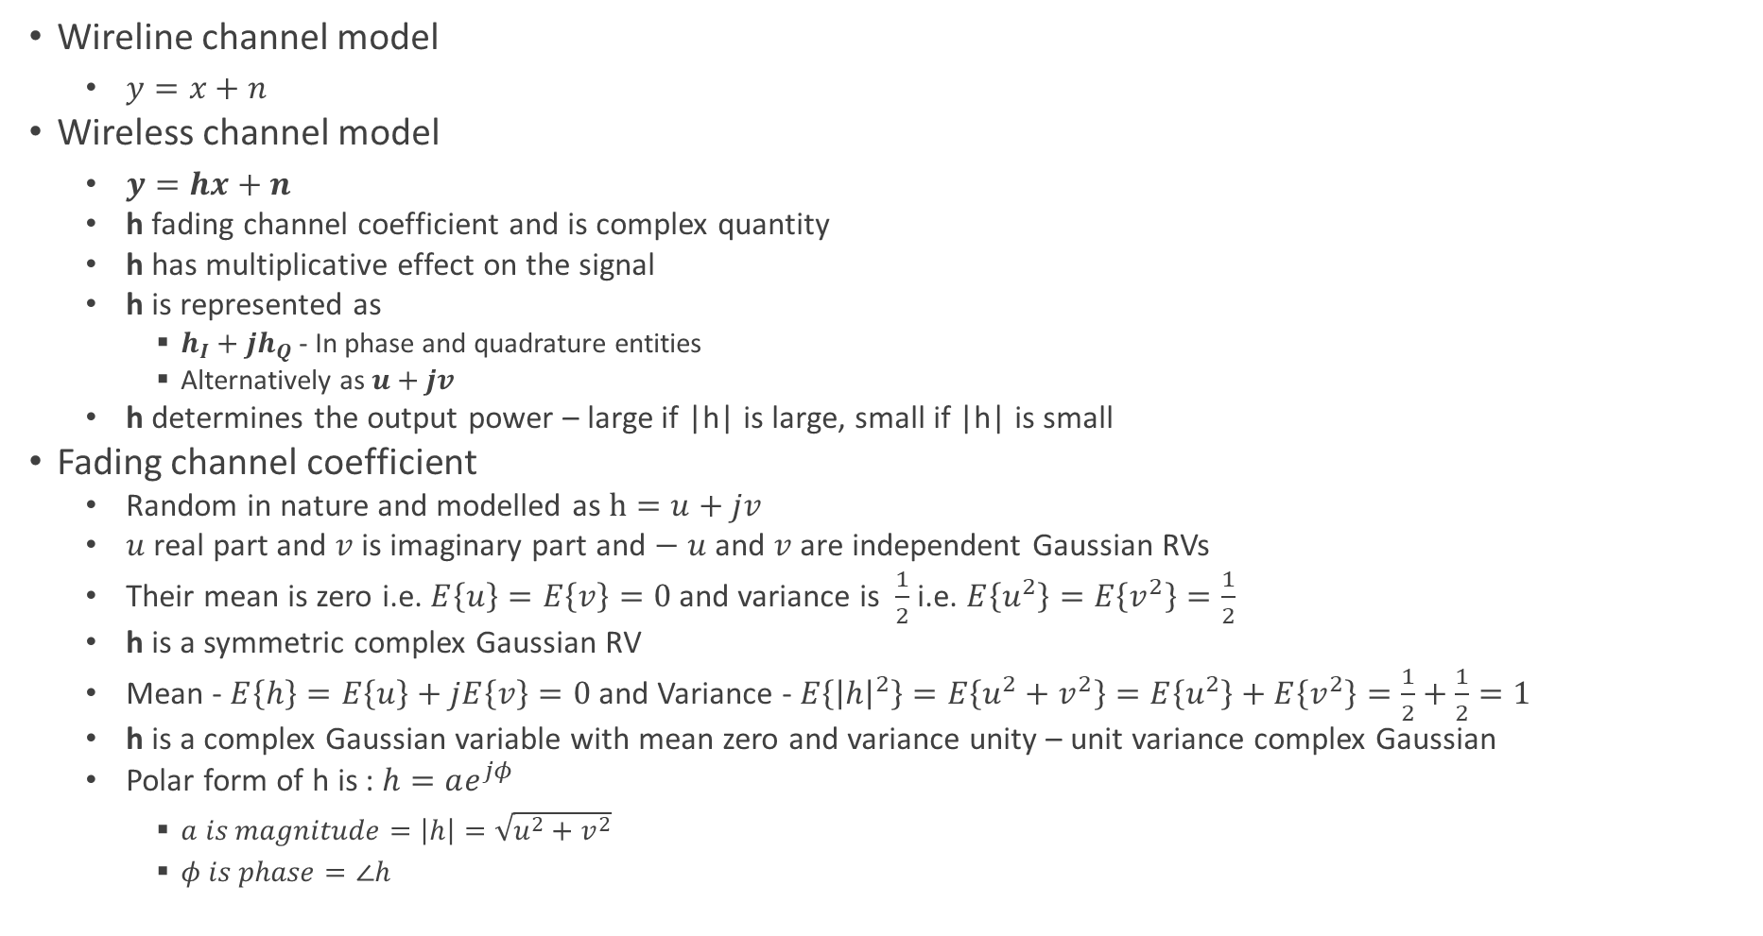

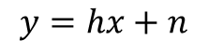
Wireless Channel Model
Wireline channel model
$y=x+n$
Wireless channel model
$y=hx+n$
h fading channel coefficient and is complex quantity
h has multiplicative effect on the signal
h is represented as
$h_{I}+jh_{Q}$ - In phase and quadrature entities
Alternatively as $u+jv$
h determines the output power – large if |h| is large, small if |h| is small
Fading channel coefficient
Random in nature and modelled as $h=u+jv$
$u$real part and $v$is imaginary part and $− u$ and $v$ are independent Gaussian RVs
Their mean is zero i.e. $E\left\{u\right\}=E\left\{v\right\}=0$ and variance is $\frac{1}{2}$ i.e. $E\left\{u^{2}\right\}=E\left\{v^{2}\right\}=\frac{1}{2}$
h is a symmetric complex Gaussian RV
Mean - $E\left\{h\right\}=E\left\{u\right\}+jE\left\{v\right\}=0$ and Variance - $E\left\{{\left|h\right|}^{2}\right\}=E\left\{u^{2}+v^{2}\right\}=E\left\{u^{2}\right\}+E\left\{v^{2}\right\}=\frac{1}{2}+\frac{1}{2}=1$
h is a complex Gaussian variable with mean zero and variance unity – unit variance complex Gaussian
Polar form of h is : $h=ae^{jφ}$
$a is magnitude=\left|h\right|=\sqrt{u^{2}+v^{2}}$
$φ is phase=∠h$
$$h$$
$$x$$
$$y=hx+n$$
$$n −Receiver thermal noise$$

Slide 29
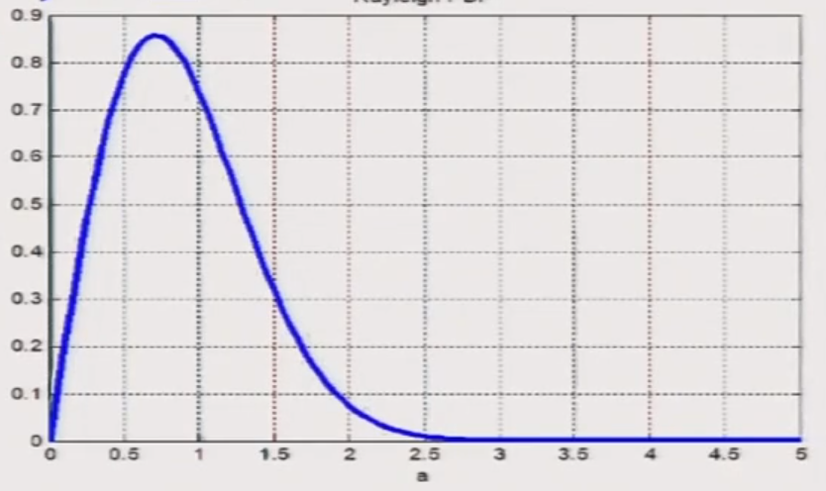
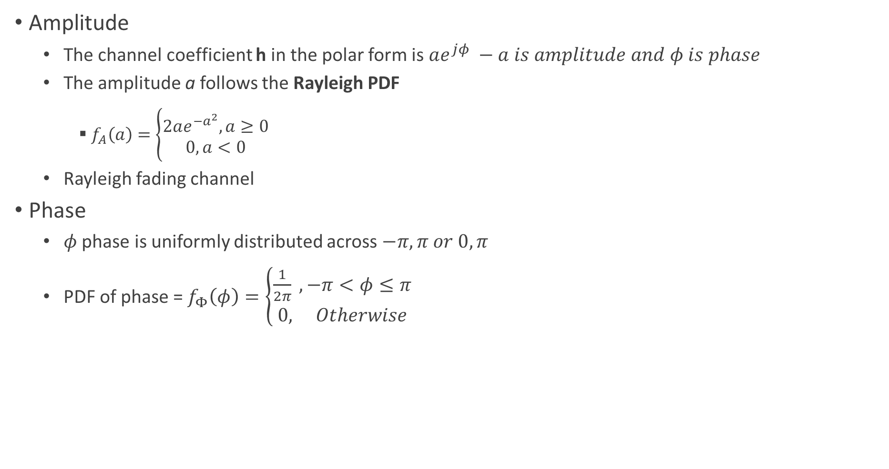
Fading Channel Coefficient
Amplitude
The channel coefficient h in the polar form is $ae^{jφ} −a is amplitude and φ is phase$
The amplitude a follows the Rayleigh PDF
$f_{A}\left(a\right)=\left\{\begin{aligned}2ae^{−a^{2}}, a≥0 \\ 0, a<0\end{aligned}\right.$
Rayleigh fading channel
Phase
$φ$ phase is uniformly distributed across $−π,π or 0,π$
PDF of phase = $f_{Φ}\left(φ\right)=\left\{\begin{aligned}\frac{1}{2π} , −π<φ≤π \\ 0, Otherwise\end{aligned}\right.$

Slide 30
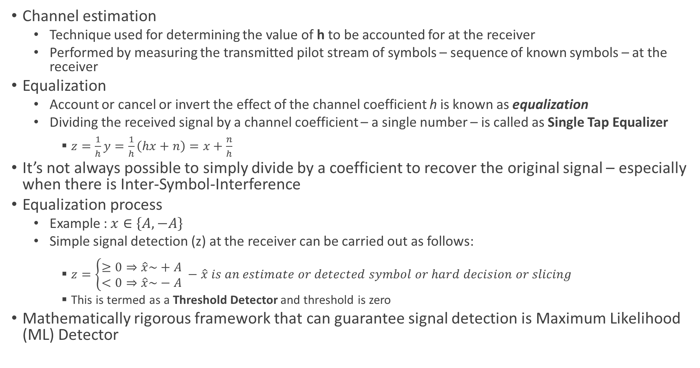
Symbol Detection – Equalization and Estimation
Channel estimation
Technique used for determining the value of h to be accounted for at the receiver
Performed by measuring the transmitted pilot stream of symbols – sequence of known symbols – at the receiver
Equalization
Account or cancel or invert the effect of the channel coefficient h is known as equalization
Dividing the received signal by a channel coefficient – a single number – is called as Single Tap Equalizer
$z=\frac{1}{h}y=\frac{1}{h}\left(hx+n\right)=x+\frac{n}{h}$
It’s not always possible to simply divide by a coefficient to recover the original signal – especially when there is Inter-Symbol-Interference
Equalization process
Example : $x∈\left\{A,−A\right\}$
Simple signal detection (z) at the receiver can be carried out as follows:
$z=\left\{\begin{aligned}≥0⇒\hat{x}\sim +A \\ <0⇒\hat{x}\sim −A\end{aligned}\right. −\hat{x} is an estimate or detected symbol or hard decision or slicing$
This is termed as a Threshold Detector and threshold is zero
Mathematically rigorous framework that can guarantee signal detection is Maximum Likelihood (ML) Detector

Slide 31
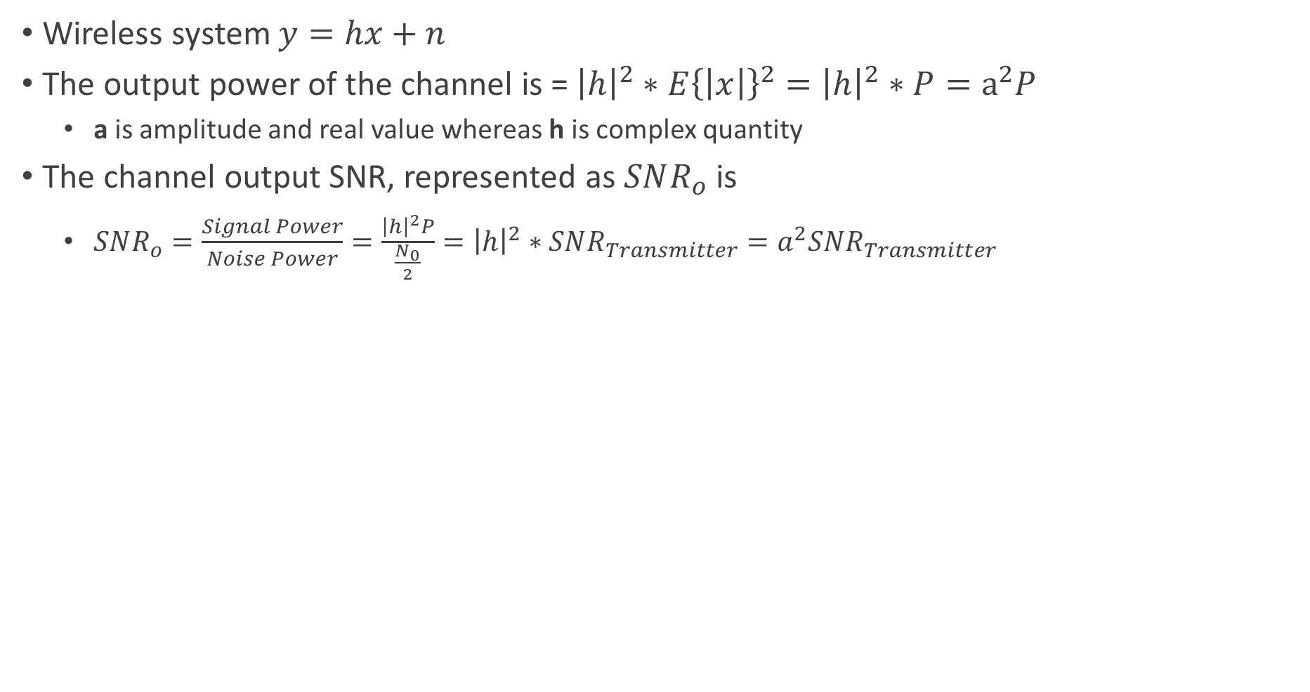
Wireless Channel Output SNR
Wireless system $y=hx+n$
The output power of the channel is = ${\left|h\right|}^{2}∗E{\left\{\left|x\right|\right\}}^{2}={\left|h\right|}^{2}∗P=a^{2}P$
a is amplitude and real value whereas h is complex quantity
The channel output SNR, represented as $SNR_{o}$ is
$SNR_{o}=\frac{Signal Power}{Noise Power}=\frac{{\left|h\right|}^{2}P}{\frac{N_{0}}{2}}={\left|h\right|}^{2}∗SNR_{Transmitter}=a^{2}SNR_{Transmitter}$

Slide 32
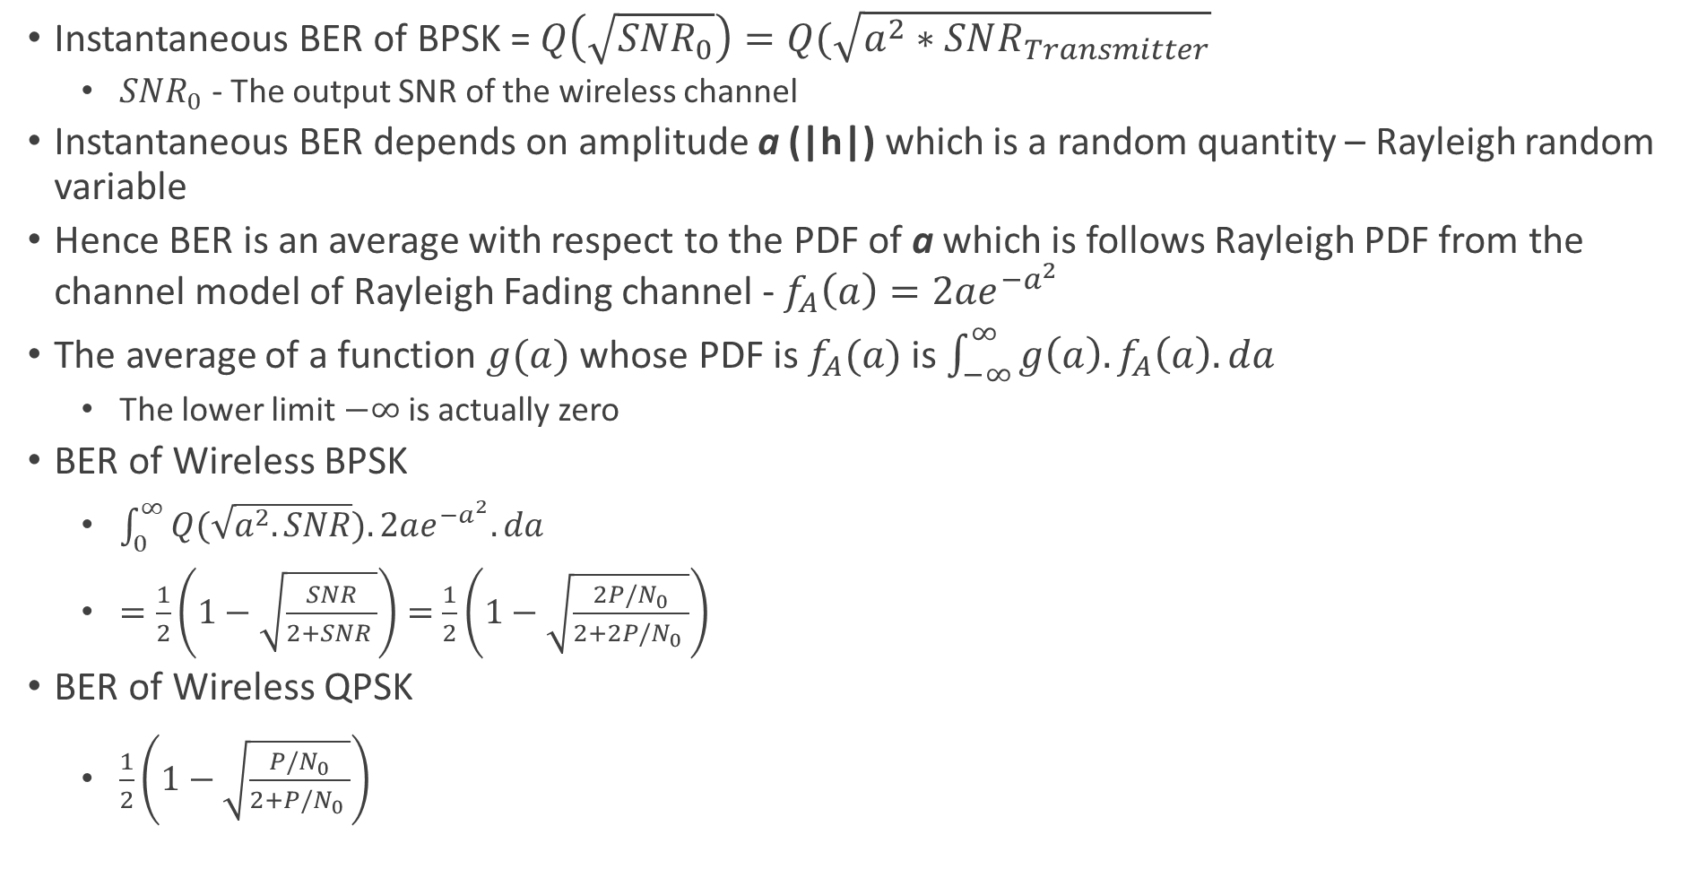
Wireless Channel Performance - BER
Instantaneous BER of BPSK = $Q\left(\sqrt{SNR_{0}}\right)=Q(\sqrt{a^{2}∗SNR_{Transmitter}}$
$SNR_{0}$ - The output SNR of the wireless channel
Instantaneous BER depends on amplitude a (|h|) which is a random quantity – Rayleigh random variable
Hence BER is an average with respect to the PDF of a which is follows Rayleigh PDF from the channel model of Rayleigh Fading channel - $f_{A}\left(a\right)=2ae^{−a^{2}}$
The average of a function $g(a)$ whose PDF is $f_{A}(a)$ is $\int_{−∞}^{∞}{g\left(a\right).f_{A}\left(a\right).da}$
The lower limit $−∞$ is actually zero
BER of Wireless BPSK
$\int_{0}^{∞}{Q(\sqrt{a^{2}.SNR}).2ae^{−a^{2}}.da}$
$=\frac{1}{2}\left(1−\sqrt{\frac{SNR}{2+SNR }}\right)=$ $\frac{1}{2}\left(1−\sqrt{\frac{2P/N_{0}}{2+2P/N_{0} }}\right)$
BER of Wireless QPSK
$\frac{1}{2}\left(1−\sqrt{\frac{P/N_{0}}{2+P/N_{0} }}\right)$

Slide 33
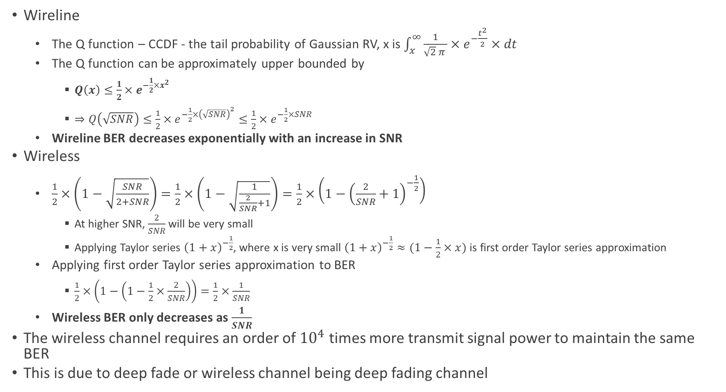
BER of Rayleigh Fading Channel
Wireline
The Q function – CCDF - the tail probability of Gaussian RV, x is $\int_{x}^{∞}{\frac{1}{\sqrt{2} π }×e^{−\frac{t^{2}}{2}}×dt}$
The Q function can be approximately upper bounded by
$Q\left(x\right)≤\frac{1}{2}{×e}^{−\frac{1}{2}×x^{2}}$
$⇒Q\left(\sqrt{SNR}\right)≤\frac{1}{2}×e^{−\frac{1}{2}×{\left(\sqrt{SNR}\right)}^{2}}≤\frac{1}{2}×e^{−\frac{1}{2}×SNR}$
Wireline BER decreases exponentially with an increase in SNR
Wireless
$\frac{1}{2}×\left(1−\sqrt{\frac{SNR}{2+SNR}}\right)=\frac{1}{2}×\left(1−\sqrt{\frac{1}{\frac{2}{SNR}+1}}\right)=\frac{1}{2}×\left(1−{\left(\frac{2}{SNR}+1\right)}^{−\frac{1}{2}}\right)$
At higher SNR, $\frac{2}{SNR}$ will be very small
Applying Taylor series ${\left(1+x\right)}^{−\frac{1}{2}}$, where x is very small ${\left(1+x\right)}^{−\frac{1}{2}}≈(1−\frac{1}{2}×x)$ is first order Taylor series approximation
Applying first order Taylor series approximation to BER
$\frac{1}{2}×\left(1−\left(1−\frac{1}{2}×\frac{2}{SNR}\right)\right)=\frac{1}{2}×\frac{1}{SNR}$
Wireless BER only decreases as $\frac{1}{SNR}$
The wireless channel requires an order of ${10}^{4}$ times more transmit signal power to maintain the same BER
This is due to deep fade or wireless channel being deep fading channel

Slide 34
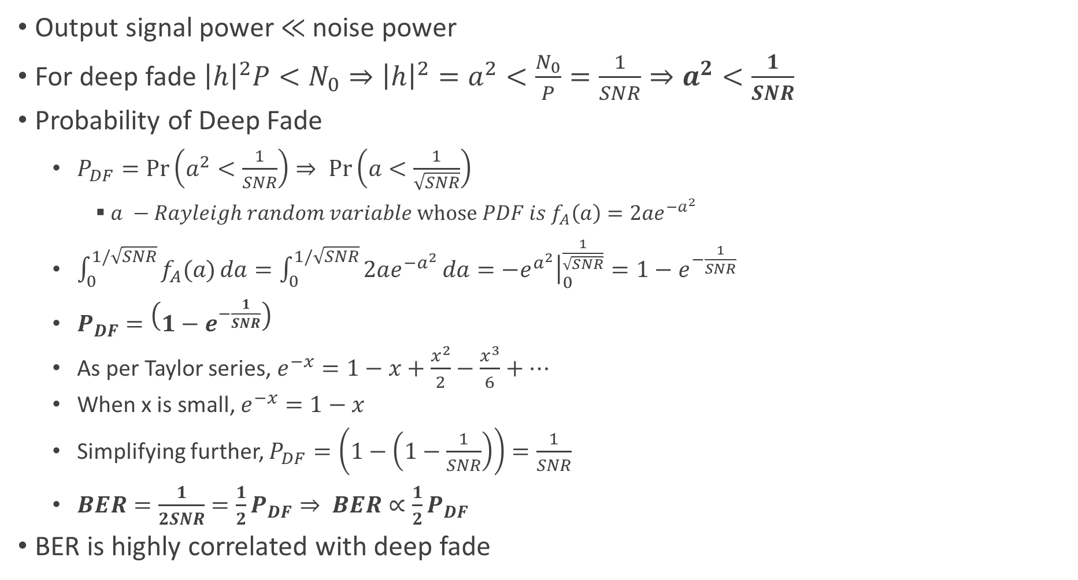
Deep Fade
Output signal power $≪$noise power
For deep fade ${\left|h\right|}^{2}P<N_{0}⇒{\left|h\right|}^{2}=a^{2}<\frac{N_{0}}{P}=\frac{1}{SNR}⇒a^{2}<\frac{1}{SNR}$
Probability of Deep Fade
$P_{DF}=\operatorname{Pr}\left(a^{2}<\frac{1}{SNR}\right)⇒ \operatorname{Pr}\left(a<\frac{1}{\sqrt{SNR}}\right)$
$a −Rayleigh random variable whose PDF is f_{A}\left(a\right)=2ae^{−a^{2}}$
$\int_{0}^{1/\sqrt{SNR}}{f_{A}(a)}da=\int_{0}^{1/\sqrt{SNR}}{2ae^{−a^{2}}}da={\left.−e^{a^{2}}\right|}_{0}^{\frac{1}{\sqrt{SNR}}}=1−e^{−\frac{1}{SNR}}$
$P_{DF}=\left(1−e^{−\frac{1}{SNR}}\right)$
As per Taylor series, $e^{−x}=1−x+\frac{x^{2}}{2}−\frac{x^{3}}{6}+…$
When x is small, $e^{−x}=1−x$
Simplifying further, $P_{DF}=\left(1−\left(1−\frac{1}{SNR}\right)\right)=\frac{1}{SNR}$
$BER=\frac{1}{2SNR}=\frac{1}{2}P_{DF}⇒ BER∝\frac{1}{2}P_{DF}$
BER is highly correlated with deep fade

Slide 35
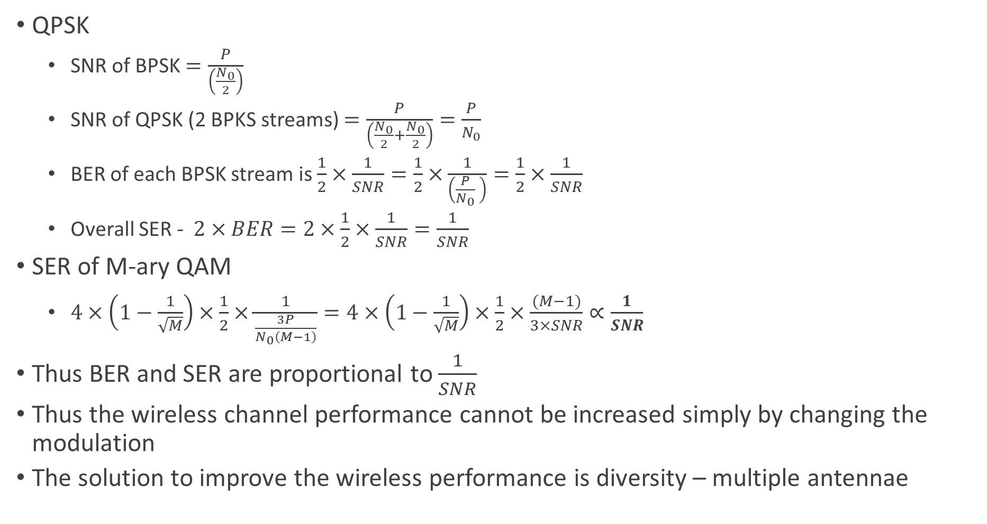
BER and SER of QPSK and QAM
QPSK
SNR of BPSK $=\frac{P}{\left(\frac{N_{0}}{2}\right)}$
SNR of QPSK (2 BPKS streams) $=\frac{P}{\left(\frac{N_{0}}{2}+\frac{N_{0}}{2}\right)}=\frac{P}{N_{0}}$
BER of each BPSK stream is $\frac{1}{2}×\frac{1}{SNR}=\frac{1}{2}×\frac{1}{\left(\frac{P}{N_{0}} \right)}=\frac{1}{2}×\frac{1}{SNR}$
Overall SER - $2×BER=2×\frac{1}{2}×\frac{1}{SNR}=\frac{1}{SNR}$
SER of M-ary QAM
$4×\left(1−\frac{1}{\sqrt{M}}\right)×\frac{1}{2}×\frac{1}{\frac{3P}{N_{0}\left(M−1\right)}}=4×\left(1−\frac{1}{\sqrt{M}}\right)×\frac{1}{2}×\frac{(M−1)}{3×SNR}∝\frac{1}{SNR}$
Thus BER and SER are proportional to $\frac{1}{SNR}$
Thus the wireless channel performance cannot be increased simply by changing the modulation
The solution to improve the wireless performance is diversity – multiple antennae

Slide 36
Multiple Antenna Diversity

Slide 37
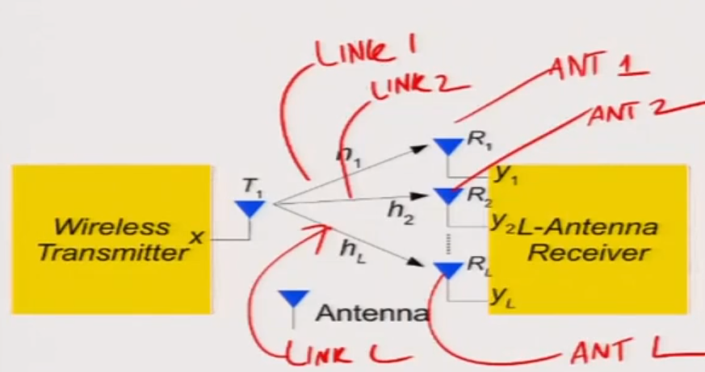
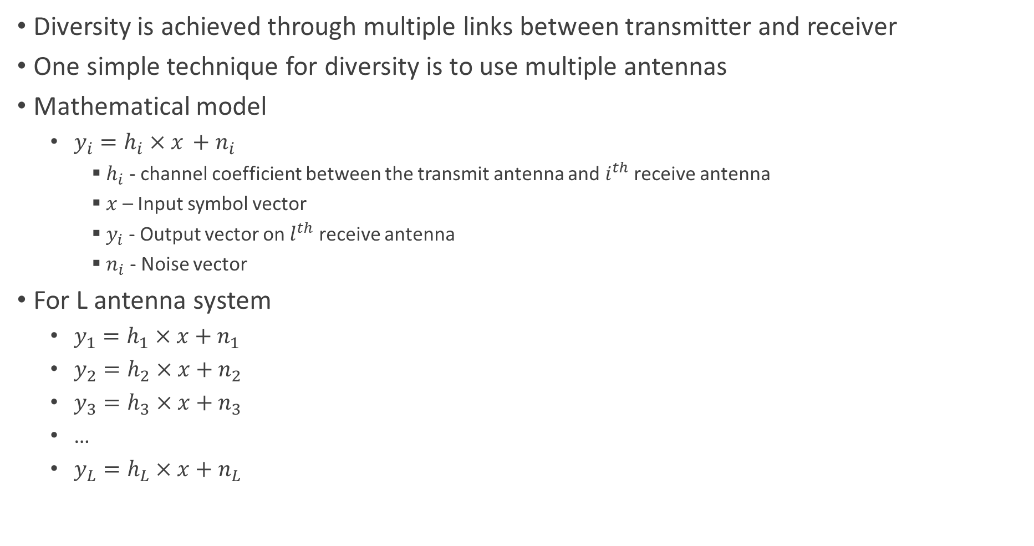
Multiple Antennas and Diversity
Diversity is achieved through multiple links between transmitter and receiver
One simple technique for diversity is to use multiple antennas
Mathematical model
$y_{i}={h_{i}×x}_{ }+n_{i}$
$h_{i}$ - channel coefficient between the transmit antenna and $i^{th}$ receive antenna
$x$ – Input symbol vector
$y_{i}$ - Output vector on $l^{th}$ receive antenna
$n_{i}$ - Noise vector
For L antenna system
$y_{1}=h_{1}×x+n_{1}$
$y_{2}=h_{2}×x+{ n}_{2}$
$y_{3}=h_{3}×x+{ n}_{3}$
…
$y_{L}=h_{L}×x+n_{L}$
SIMO Diversity

Slide 38
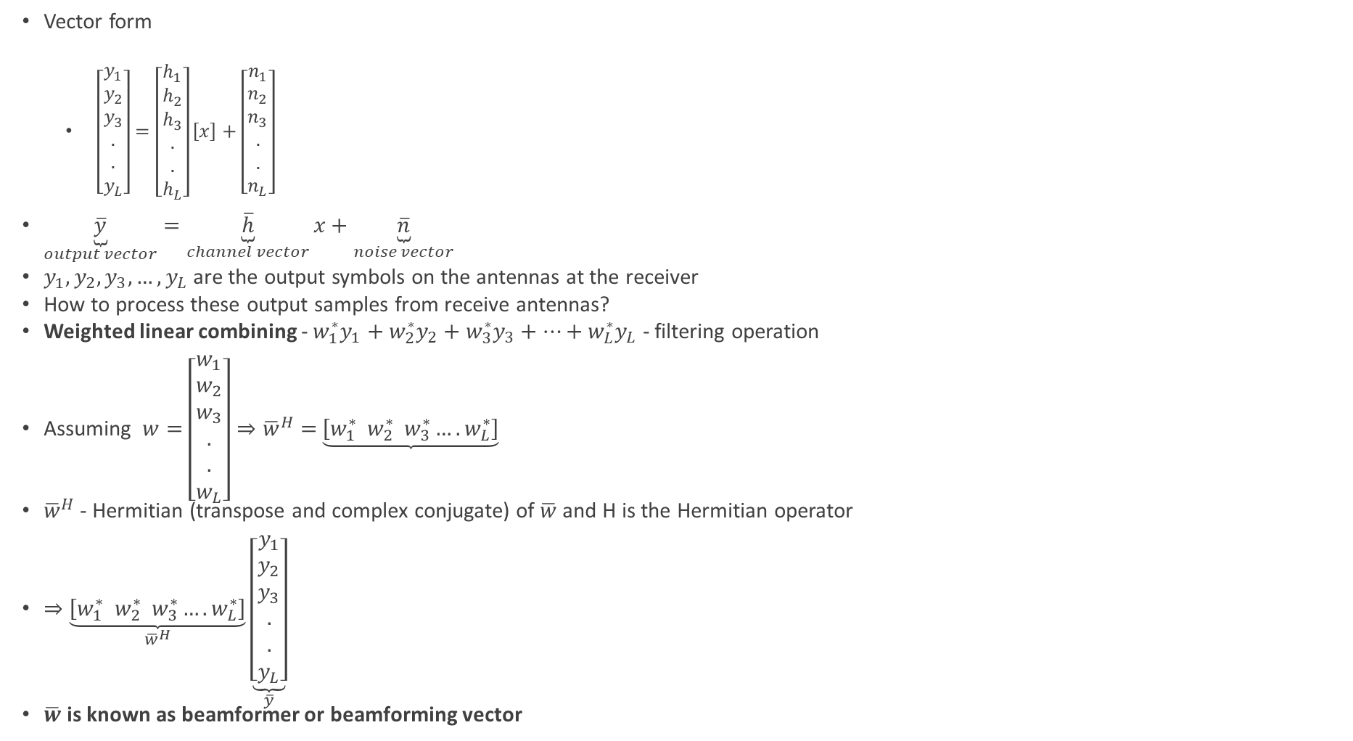
SIMO System – Weighted Linear Combining
Vector form
$\left[\begin{aligned}y_{1} \\ y_{2} \\ y_{3} \\ . \\ . \\ y_{L}\end{aligned}\right]=\left[\begin{aligned}h_{1} \\ h_{2} \\ h_{3} \\ . \\ . \\ h_{L}\end{aligned}\right]\left[x\right]+\left[\begin{aligned}n_{1} \\ n_{2} \\ n_{3} \\ . \\ . \\ n_{L}\end{aligned}\right]$
$\underset{output vector}{\underbrace{\overline{y}}}=\underset{channel vector}{\underbrace{\overline{h}}}x+\underset{noise vector}{\underbrace{\overline{n}}}$
$y_{1},y_{2},y_{3},…,y_{L}$ are the output symbols on the antennas at the receiver
How to process these output samples from receive antennas?
Weighted linear combining - $w_{1}^{∗}y_{1}+w_{2}^{∗}y_{2}+w_{3}^{∗}y_{3}+…+w_{L}^{∗}y_{L}$ - filtering operation
Assuming $w=$ $\left[\begin{aligned}w_{1} \\ w_{2} \\ w_{3} \\ . \\ . \\ w_{L}\end{aligned}\right]⇒{\overline{w}}^{H}=$ $\underbrace{\left[w_{1}^{∗} w_{2}^{∗} w_{3}^{∗}….w_{L}^{∗}\right]}$
${\overline{w}}^{H}$ - Hermitian (transpose and complex conjugate) of $\overline{w}$ and H is the Hermitian operator
$⇒\underset{{\overline{w}}^{H}}{\underbrace{\left[w_{1}^{∗} w_{2}^{∗} w_{3}^{∗}….w_{L}^{∗}\right]}}\underset{\overline{y}}{\underbrace{\left[\begin{aligned}y_{1} \\ y_{2} \\ y_{3} \\ . \\ . \\ y_{L}\end{aligned}\right]}}$
$\overline{w}$ is known as beamformer or beamforming vector

Slide 39
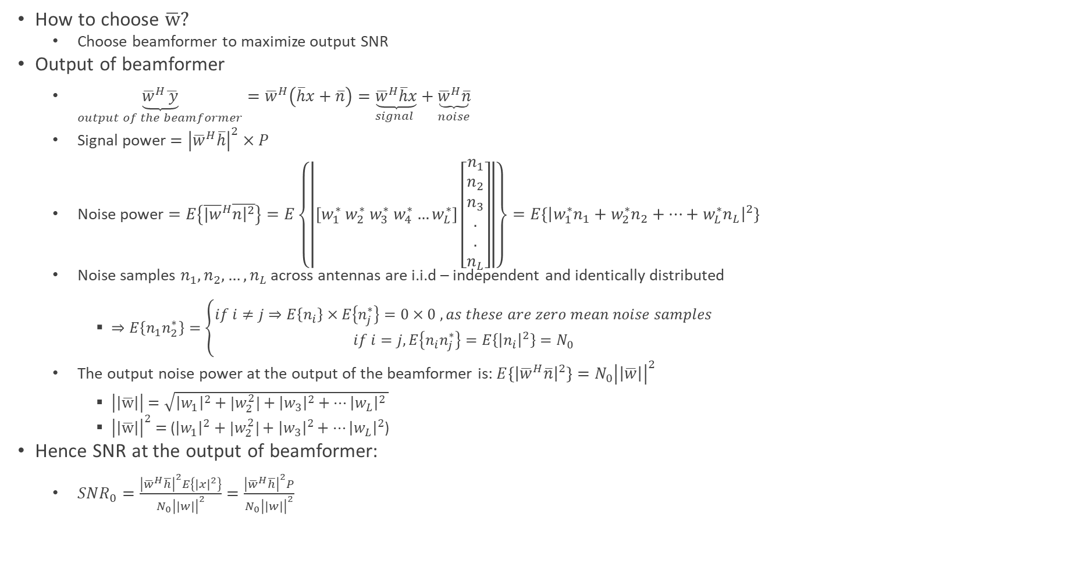
SIMO - Beamformer
How to choose $\overline{w}?$
Choose beamformer to maximize output SNR
Output of beamformer
$\underset{output of the beamformer}{\underbrace{{\overline{w}}^{H}\overline{ y}}}={\overline{w}}^{H}\left(\overline{h}x+\overline{n}\right)=\underset{signal }{\underbrace{{\overline{w}}^{H}\overline{h}x}}+\underset{noise}{\underbrace{{\overline{w}}^{H}\overline{n}}}$
Signal power $={\left|{\overline{w}}^{H}\overline{h}\right|}^{2}×P$
Noise power $=E\left\{{\overline{|w}}^{H}\overline{n{\left.​\right|}^{2}}\right\}=E\left\{\left|\left[w_{1}^{∗} w_{2}^{∗} w_{3}^{∗} w_{4}^{∗}…w_{L}^{∗}\right]\left[\begin{aligned}n_{1} \\ n_{2} \\ n_{3} \\ . \\ . \\ n_{L}\end{aligned}\right]\right|\right\}=E\{{\left|w_{1}^{∗}n_{1}+w_{2}^{∗}n_{2}+…+w_{L}^{∗}n_{L}\right|}^{2}\}$
Noise samples $n_{1},n_{2},…,n_{L}$ across antennas are i.i.d – independent and identically distributed
$⇒E\left\{n_{1}n_{2}^{∗}\right\}=\left\{\begin{aligned}if i≠j⇒E\left\{n_{i}\right\}×E\left\{n_{j}^{∗}\right\}=0×0 , as these are zero mean noise samples \\ if i=j, E\left\{n_{i}n_{j}^{∗}\right\}=E\left\{{\left|n_{i}\right|}^{2}\right\}=N_{0}\end{aligned}\right.$
The output noise power at the output of the beamformer is: $E\left\{{\left|{\overline{w}}^{H}\overline{n}\right|}^{2}\right\}=N_{0}{\left|\left|\overline{w}\right|\right|}^{2}$
$\left|\left|\overline{w}\right|\right|=\sqrt{{\left|w_{1}\right|}^{2}+{|w_{2}^{2}|+\left|w_{3}\right|}^{2}+…{\left|w_{L}\right|}^{2} }$
${\left|\left|\overline{w}\right|\right|}^{2}=$ (${\left|w_{1}\right|}^{2}+{|w_{2}^{2}|+\left|w_{3}\right|}^{2}+…{\left|w_{L}\right|}^{2}$)
Hence SNR at the output of beamformer:
$SNR_{0}=\frac{{\left|{\overline{w}}^{H}\overline{h}\right|}^{2}E\left\{{\left|x\right|}^{2}\right\}}{N_{0}{\left|\left|w\right|\right|}^{2}}=\frac{{\left|{\overline{w}}^{H}\overline{h}\right|}^{2}P}{N_{0}{\left|\left|w\right|\right|}^{2}}$

Slide 40
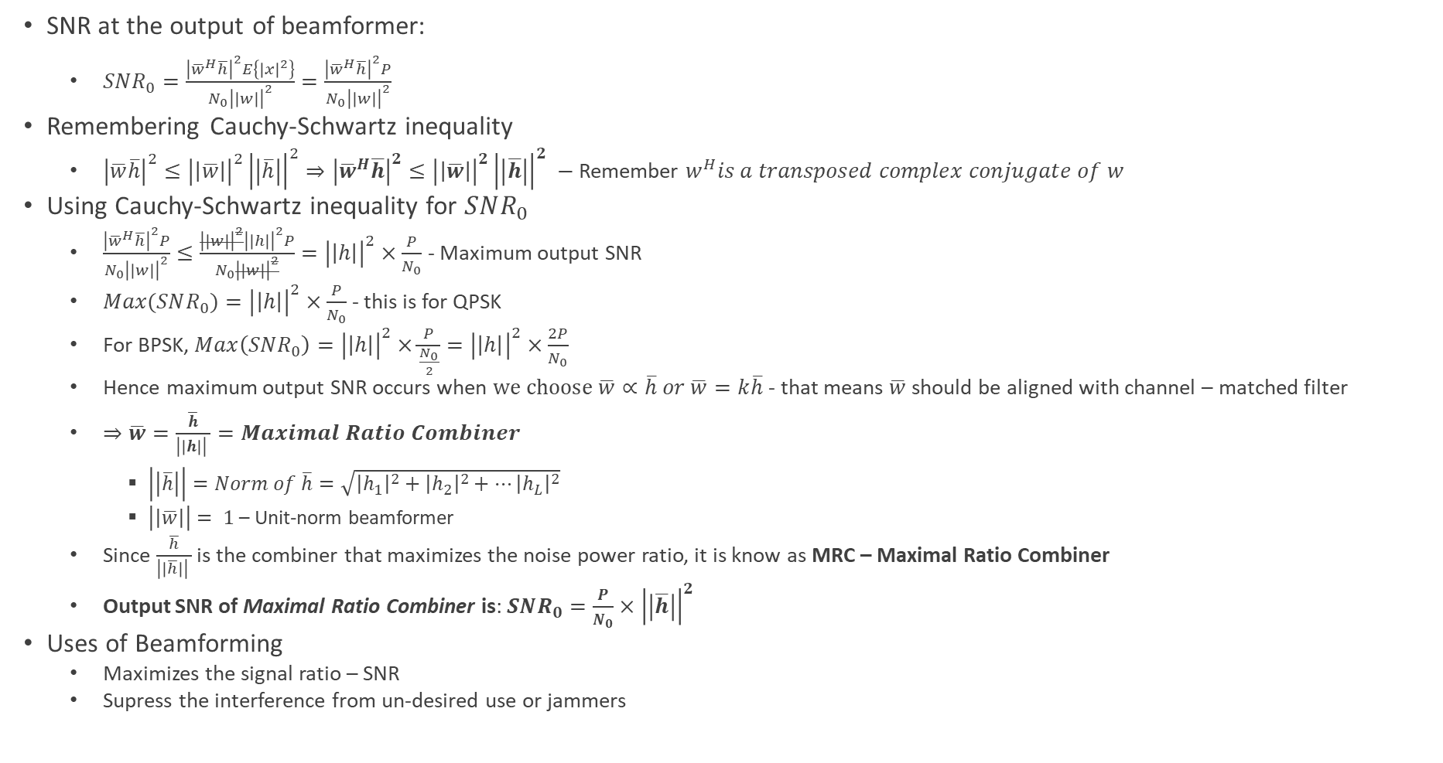
SIMO - Beamformer
SNR at the output of beamformer:
$SNR_{0}=\frac{{\left|{\overline{w}}^{H}\overline{h}\right|}^{2}E\left\{{\left|x\right|}^{2}\right\}}{N_{0}{\left|\left|w\right|\right|}^{2}}=\frac{{\left|{\overline{w}}^{H}\overline{h}\right|}^{2}P}{N_{0}{\left|\left|w\right|\right|}^{2}}$
Remembering Cauchy-Schwartz inequality
${\left|\overline{w}\overline{h}\right|}^{2}≤{\left|\left|\overline{w}\right|\right|}^{2}{\left|\left|\overline{h}\right|\right|}^{2}⇒{\left|{\overline{w}}^{H}\overline{h}\right|}^{2}≤{\left|\left|\overline{w}\right|\right|}^{2}{\left|\left|\overline{h}\right|\right|}^{2} −$Remember $w^{H}is a transposed complex conjugate of w$
Using Cauchy-Schwartz inequality for $SNR_{0}$
$\frac{{\left|{\overline{w}}^{H}\overline{h}\right|}^{2}P}{N_{0}{\left|\left|w\right|\right|}^{2}}≤\frac{{\left|\left|w\right|\right|}^{2}{\left|\left|h\right|\right|}^{2}P}{N_{0}{\left|\left|w\right|\right|}^{2}}={\left|\left|h\right|\right|}^{2}×\frac{P}{N_{0}}$ - Maximum output SNR
$Max(SNR_{0})={\left|\left|h\right|\right|}^{2}×\frac{P}{N_{0}}$ - this is for QPSK
For BPSK, $Max\left(SNR_{0}\right)={\left|\left|h\right|\right|}^{2}×\frac{P}{\frac{N_{0}}{2}}={\left|\left|h\right|\right|}^{2}×\frac{2P}{N_{0}}$
Hence maximum output SNR occurs when $we choose \overline{w}∝\overline{h} or \overline{w}=k\overline{h}$ - that means $\overline{w}$ should be aligned with channel – matched filter
$⇒\overline{w}=\frac{\overline{h}}{{\left|\left|h\right|\right|}^{ }}=Maximal Ratio Combiner$
$\left|\left|\overline{h}\right|\right|=Norm of \overline{h}=\sqrt{{\left|h_{1}\right|}^{2}+{\left|h_{2}\right|}^{2}+…{\left|h_{L}\right|}^{2}}$
$\left|\left|\overline{w}\right|\right|= 1$ – Unit-norm beamformer
Since $\frac{\overline{h}}{{\left|\left|\overline{h}\right|\right|}^{ }}$ is the combiner that maximizes the noise power ratio, it is know as MRC – Maximal Ratio Combiner
Output SNR of Maximal Ratio Combiner is: $SNR_{0}=\frac{P}{N_{0}}×{\left|\left|\overline{h}\right|\right|}^{2}$
Uses of Beamforming
Maximizes the signal ratio – SNR
Supress the interference from un-desired use or jammers

Slide 41
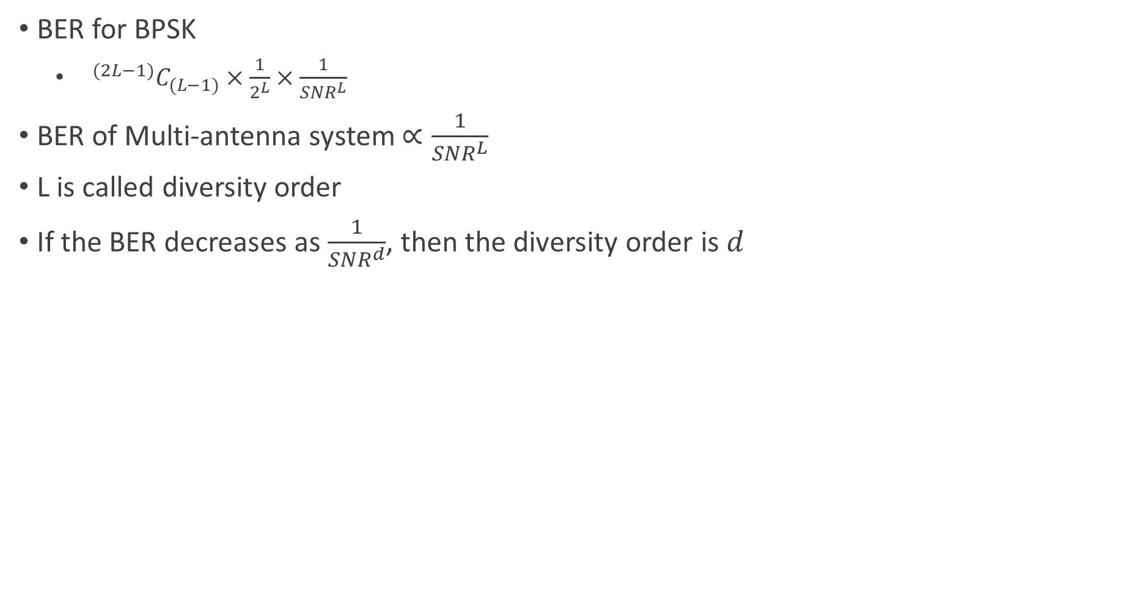
BERs for Multiple Antenna System
BER for BPSK
$^{(2L−1)}C_{(L−1)}×\frac{1}{2^{L}}×\frac{1}{SNR^{L}}$
BER of Multi-antenna system $∝\frac{1}{SNR^{L}}$
L is called diversity order
If the BER decreases as $\frac{1}{SNR^{d}}$, then the diversity order is $d$

Slide 42
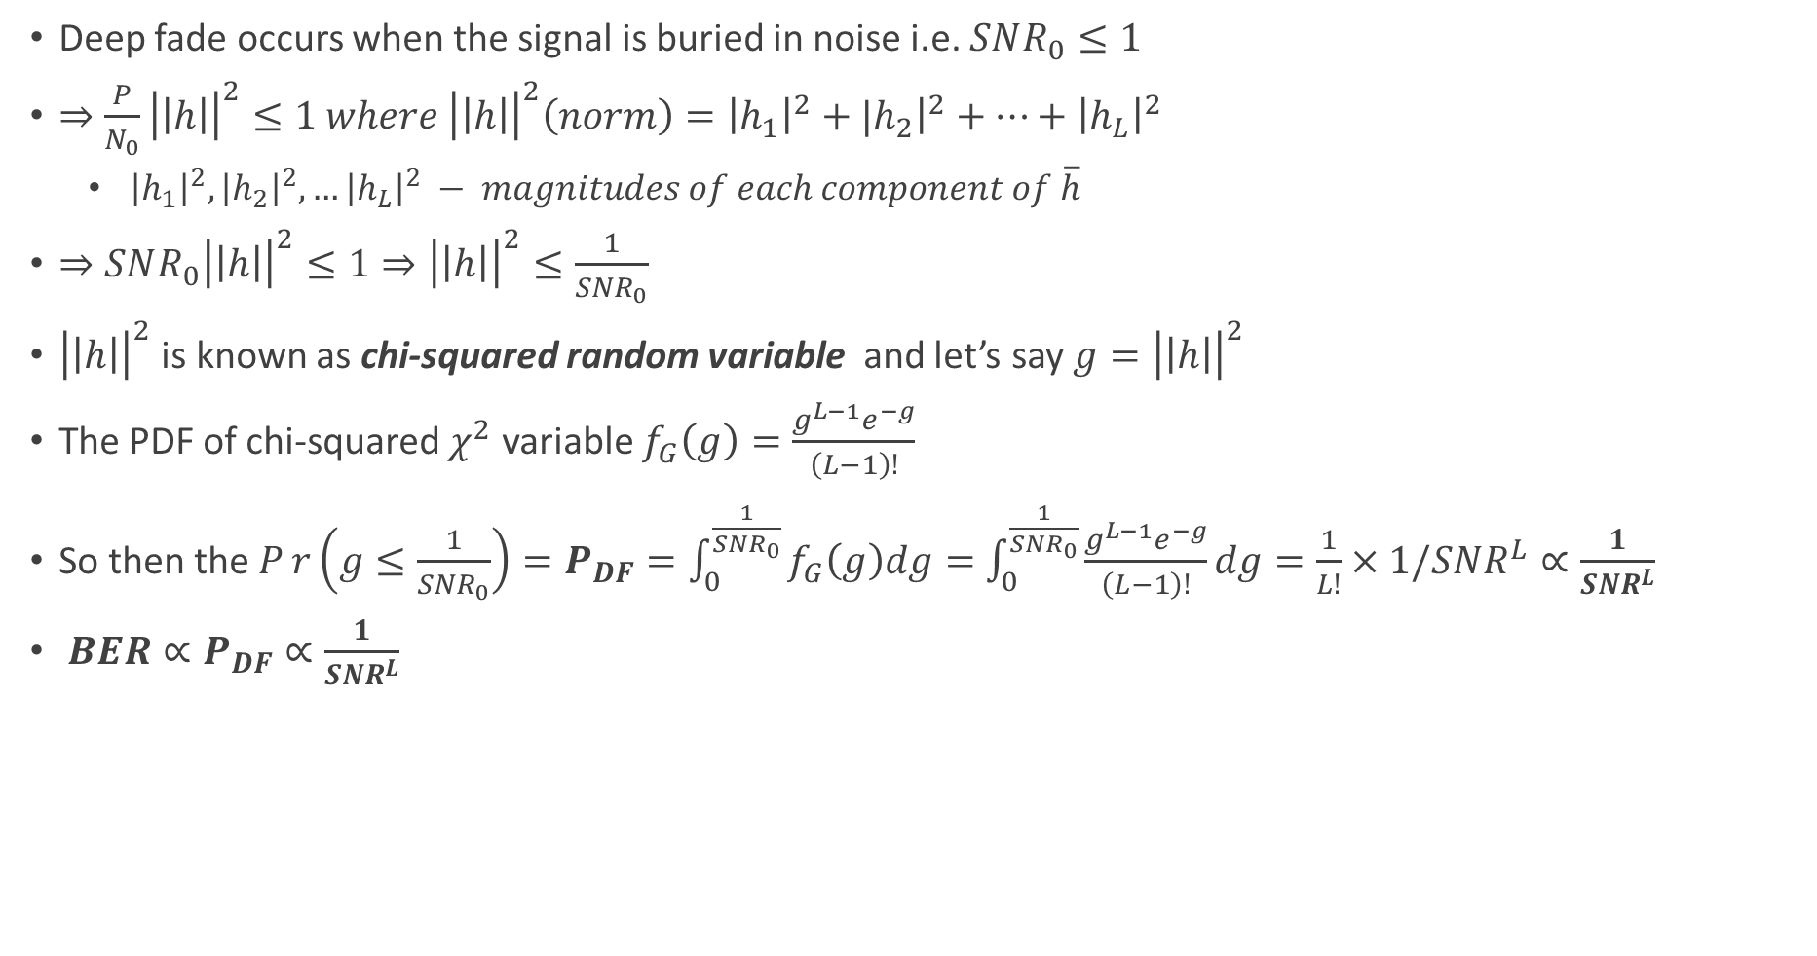
Deep Fade in Multi-Antenna System
Deep fade occurs when the signal is buried in noise i.e. $SNR_{0}≤1$
$⇒\frac{P}{N_{0}}{\left|\left|h\right|\right|}^{2}≤1 where {\left|\left|h\right|\right|}^{2}\left(norm\right)={\left|h_{1}\right|}^{2}+{|h}_{2}{\left.​\right|}^{2}+…+{\left|h_{L}\right|}^{2}$
${\left|h_{1}\right|}^{2}, {\left|h_{2}\right|}^{2},…{\left|h_{L}\right|}^{2} − magnitudes of each component of \overline{h}$
$⇒SNR_{0}{\left|\left|h\right|\right|}^{2}≤1⇒{\left|\left|h\right|\right|}^{2}≤\frac{1}{SNR_{0}}$
${\left|\left|h\right|\right|}^{2}$ is known as chi-squared random variable and let’s say $g={\left|\left|h\right|\right|}^{2}$
The PDF of chi-squared $χ^{2}$ variable $f_{G}\left(g\right)=\frac{g^{L−1}e^{−g}}{\left(L−1\right)!}$
So then the $Pr\left(g≤\frac{1}{SNR_{0}}\right)=P_{DF}=\int_{0}^{\frac{1}{SNR_{0}}}{f_{G}\left(g\right)dg=}$ $\int_{0}^{\frac{1}{SNR_{0}}}{\frac{g^{L−1}e^{−g}}{\left(L−1\right)!}dg=\frac{1}{L!}×1/SNR^{L}}∝\frac{1}{SNR^{L}}$
$BER∝P_{DF}∝\frac{1}{SNR^{L}}$

Slide 43
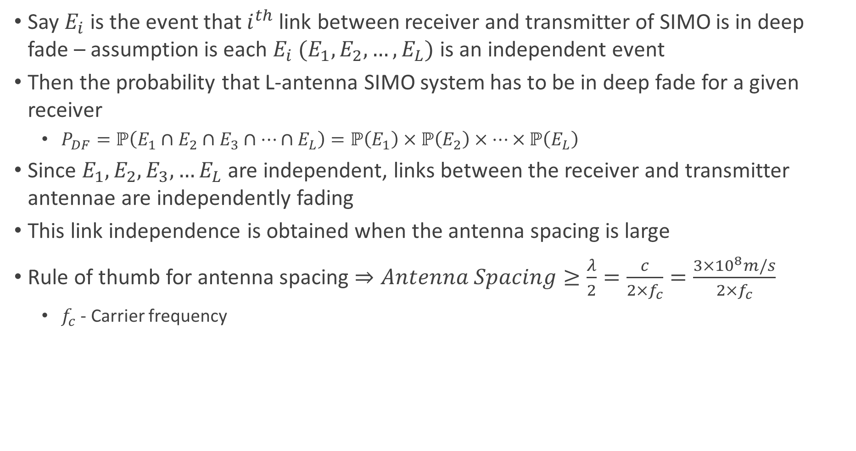
Multi-Antenna System - Deep Fade Justification
Say $E_{i}$ is the event that $i^{th}$ link between receiver and transmitter of SIMO is in deep fade – assumption is each $E_{i} (E_{1},E_{2},…,E_{L})$ is an independent event
Then the probability that L-antenna SIMO system has to be in deep fade for a given receiver
$P_{DF}=ℙ\left(E_{1}∩E_{2}∩E_{3}∩…∩E_{L}\right)=ℙ\left(E_{1}\right)×ℙ\left(E_{2}\right)×…×ℙ\left(E_{L}\right)$
Since $E_{1}, E_{2}, E_{3},…E_{L}$ are independent, links between the receiver and transmitter antennae are independently fading
This link independence is obtained when the antenna spacing is large
Rule of thumb for antenna spacing $⇒Antenna Spacing≥\frac{λ}{2}=\frac{c}{{2×f}_{c}}=\frac{{3×10}^{8}m/s}{2×f_{c}}$
$f_{c}$ - Carrier frequency

Slide 44
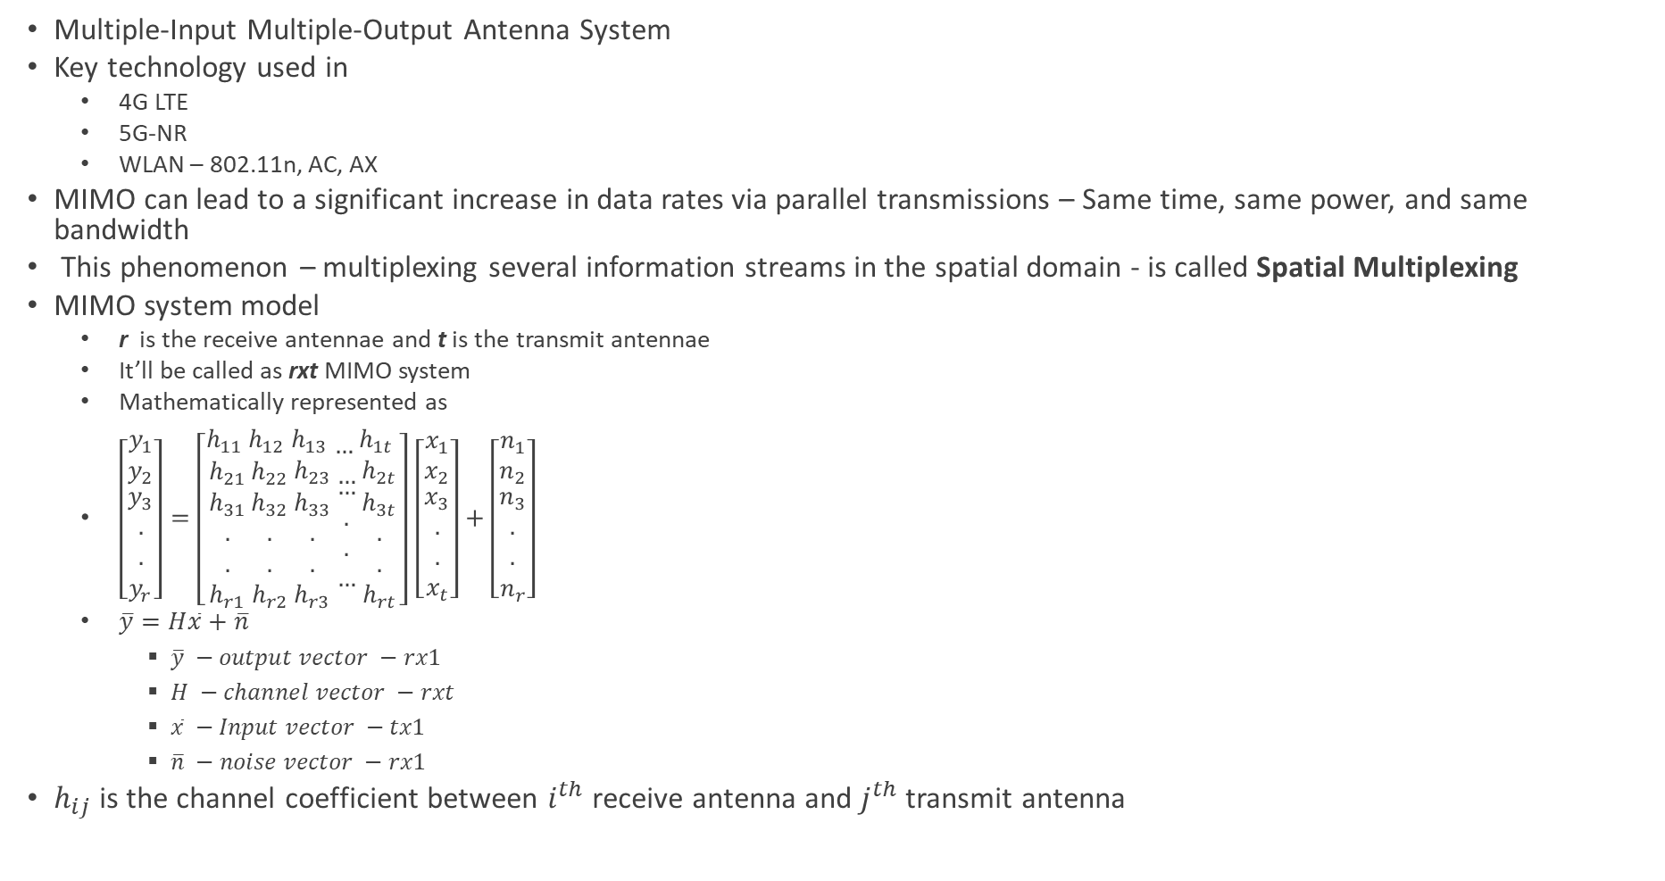
MIMO System
Multiple-Input Multiple-Output Antenna System
Key technology used in
4G LTE
5G-NR
WLAN – 802.11n, AC, AX
MIMO can lead to a significant increase in data rates via parallel transmissions – Same time, same power, and same bandwidth
This phenomenon – multiplexing several information streams in the spatial domain - is called Spatial Multiplexing
MIMO system model
r is the receive antennae and t is the transmit antennae
It’ll be called as rxt MIMO system
Mathematically represented as
$\left[\begin{matrix}y_{1} \\ y_{2} \\ \begin{aligned}y_{3} \\ . \\ . \\ y_{r}\end{aligned}\end{matrix}\right]=\left[\begin{matrix}h_{11} \\ h_{21} \\ \begin{aligned}h_{31} \\ . \\ . \\ h_{r1}\end{aligned}\end{matrix}\begin{matrix}h_{12} \\ h_{22} \\ \begin{aligned}h_{32} \\ . \\ . \\ h_{r2}\end{aligned}\end{matrix}\begin{matrix}h_{13} \\ h_{23} \\ \begin{aligned}h_{33} \\ . \\ . \\ h_{r3}\end{aligned}\end{matrix}\begin{matrix}… \\ … \\ \begin{aligned}… \\ . \\ . \\ …\end{aligned}\end{matrix}\begin{matrix}h_{1t} \\ h_{2t} \\ \begin{aligned}h_{3t} \\ . \\ . \\ h_{rt}\end{aligned}\end{matrix}\right]$ $\left[\begin{matrix}x_{1} \\ x_{2} \\ \begin{aligned}x_{3} \\ . \\ . \\ x_{t}\end{aligned}\end{matrix}\right]+\left[\begin{matrix}n_{1} \\ n_{2} \\ \begin{aligned}n_{3} \\ . \\ . \\ n_{r}\end{aligned}\end{matrix}\right]$
$\overline{y}=H\overline{x}+\overline{n}$
$\overline{y} −output vector −rx1$
$H −channel vector −rxt$
$\overline{x} −Input vector −tx1$
$\overline{n} −noise vector −rx1$
$h_{ij}$ is the channel coefficient between $i^{th}$ receive antenna and $j^{th}$ transmit antenna

Slide 45
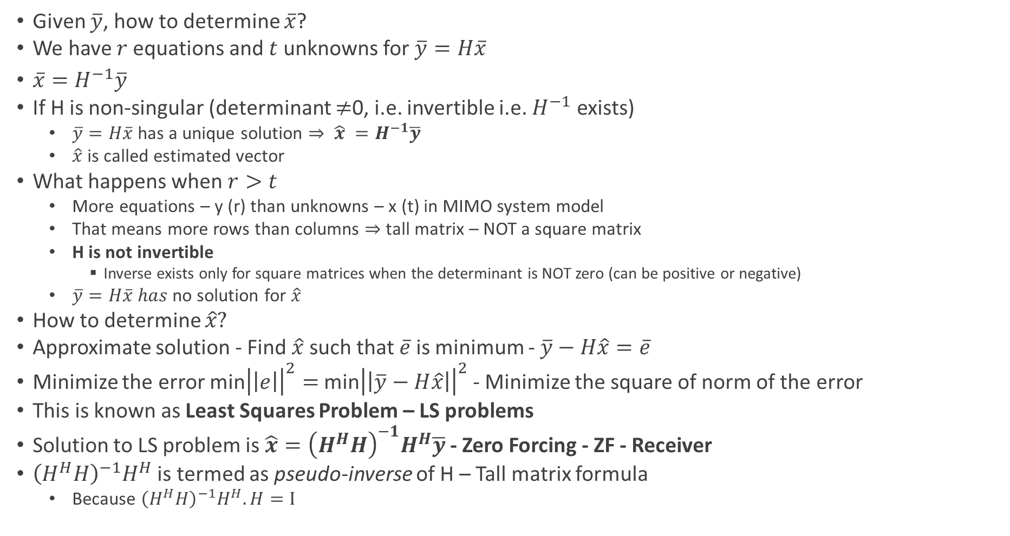
MIMO Receiver
Given $\overline{y}$, how to determine $\overline{x}$?
We have $r$equations and $t$unknowns for $\overline{y}=H\overline{x}$
$\overline{x}=H^{−1}\overline{y}$
If H is non-singular (determinant $≠$0, i.e. invertible i.e. $H^{−1}$ exists)
$\overline{y}=H\overline{x}$ has a unique solution $⇒ \hat{x} =H^{−1}\overline{y}$
$\hat{x}$ is called estimated vector
What happens when $r>t$
More equations – y (r) than unknowns – x (t) in MIMO system model
That means more rows than columns $⇒$ tall matrix – NOT a square matrix
H is not invertible
Inverse exists only for square matrices when the determinant is NOT zero (can be positive or negative)
$\overline{y}=H\overline{x} has$no solution for $\hat{x}$
How to determine $\hat{x}?$
Approximate solution - Find $\hat{x}$ such that $\overline{e}$ is minimum - $\overline{y}−H\hat{x}=\overline{e}$
Minimize the error min${\left|\left|e\right|\right|}^{2}=$ min${\left|\left|\overline{y}−H\hat{x}\right|\right|}^{2}$ - Minimize the square of norm of the error
This is known as Least Squares Problem – LS problems
Solution to LS problem is $\hat{x}={\left(H^{H}H\right)}^{−1}H^{H}\overline{y}$ - Zero Forcing - ZF - Receiver
${\left(H^{H}H\right)}^{−1}H^{H}$ is termed as pseudo-inverse of H – Tall matrix formula
Because ${\left(H^{H}H\right)}^{−1}H^{H}.H=I$

Slide 46
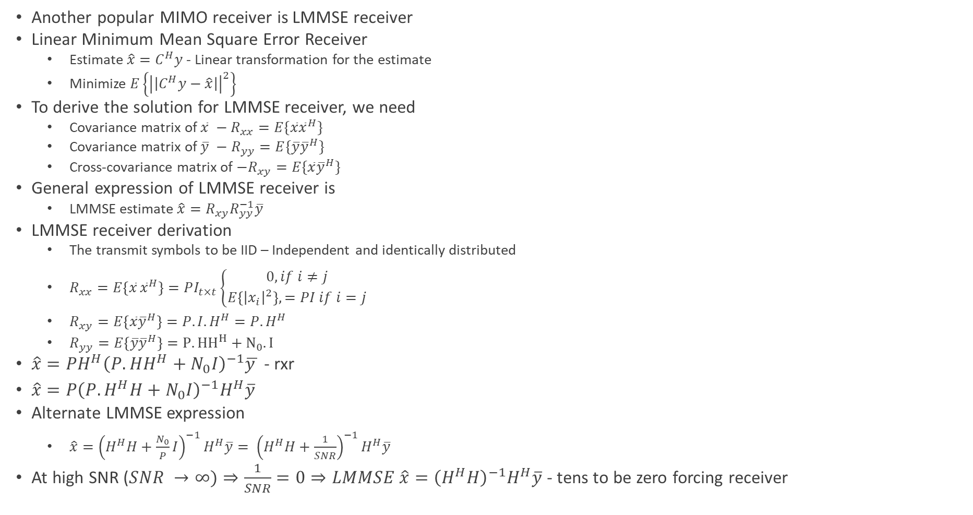
MIMO LMMSE Receiver
Another popular MIMO receiver is LMMSE receiver
Linear Minimum Mean Square Error Receiver
Estimate ${\hat{x}=C}^{H}y$ - Linear transformation for the estimate
Minimize $E\left\{{\left|\left|C^{H}y−\hat{x}\right|\right|}^{2}\right\}$
To derive the solution for LMMSE receiver, we need
Covariance matrix of $\overline{x} −R_{xx}=E\{\overline{x}{\overline{x}}^{H}\}$
Covariance matrix of $\overline{y} −R_{yy}=E\{\overline{y}{\overline{y}}^{H}\}$
Cross-covariance matrix of $−R_{xy}=E\{\overline{x}{\overline{y}}^{H}\}$
General expression of LMMSE receiver is
LMMSE estimate $\hat{x}=R_{xy}R_{yy}^{−1}\overline{y}$
LMMSE receiver derivation
The transmit symbols to be IID – Independent and identically distributed
$R_{xx}=E\left\{{\overline{x}}_{ }{\overline{x}}_{ }^{H}\right\}=PI_{t×t}\left\{\begin{aligned}0, if i≠j \\ E\left\{{\left|x_{i}\right|}^{2}\right\},=PI if i=j\end{aligned}\right.$
$R_{xy}=E\left\{\overline{x}{\overline{y}}^{H}\right\}=P.I.H^{H}=P.H^{H}$
$R_{yy}=E\left\{\overline{y}{\overline{y}}^{H}\right\}=P.{HH}^{H}+N_{0}.I$
$\hat{x}=PH^{H}{\left(P.HH^{H}+N_{0}I\right)}^{−1}\overline{y }$ - rxr
$\hat{x}=P{\left(P.H^{H}H+N_{0}I\right)}^{−1}H^{H}\overline{y}$
Alternate LMMSE expression
$\hat{x}={{\left(H^{H}H+\frac{N_{0}}{P}I\right)}^{−1}H^{H}\overline{y}=}^{ }{{\left(H^{H}H+\frac{1}{SNR}\right)}^{−1}H}^{H}\overline{y}$
At high SNR ($SNR →∞)⇒\frac{1}{SNR}=0⇒LMMSE \hat{x}={\left(H^{H}H\right)}^{−1}H^{H}\overline{y}$ - tens to be zero forcing receiver

Slide 47
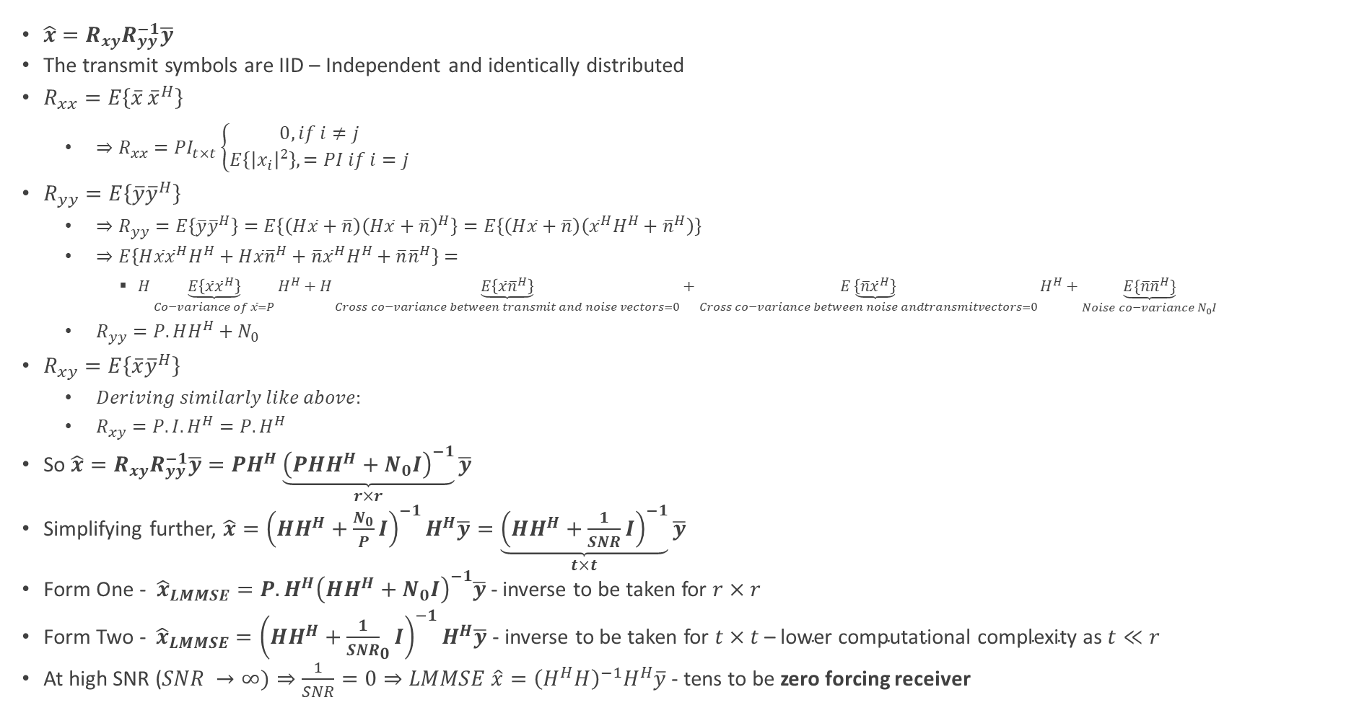
MIMO LMMSE Receiver Derivation
$\hat{x}=R_{xy}R_{yy}^{−1}\overline{y}$
The transmit symbols are IID – Independent and identically distributed
$R_{xx}=E\left\{{\overline{x}}_{ }{\overline{x}}_{ }^{H}\right\}$
$⇒R_{xx}=PI_{t×t}\left\{\begin{aligned}0, if i≠j \\ E\left\{{\left|x_{i}\right|}^{2}\right\},=PI if i=j\end{aligned}\right.$
$R_{yy}=E\left\{\overline{y}{\overline{y}}^{H}\right\}$
$⇒R_{yy}=E\left\{\overline{y}{\overline{y}}^{H}\right\}=E\left\{\left(H\overline{x}+\overline{n}\right){\left(H\overline{x}+\overline{n}\right)}^{H}\right\}=E\left\{\left(H\overline{x}+\overline{n}\right)\left({\overline{x}}^{H}H^{H}+{\overline{n}}^{H}\right)\right\}$
$⇒E\left\{H\overline{x}{\overline{x}}^{H}H^{H}+H\overline{x}{\overline{n}}^{H}+\overline{n}{\overline{x}}^{H}H^{H}+\overline{n}{\overline{n}}^{H}\right\}=$
$H\underset{Co−variance of \overline{x}=P}{\underbrace{E\left\{\overline{x}{\overline{x}}^{H}\right\}}}H^{H}+H\underset{Cross co−variance between transmit and noise vectors=0}{\underbrace{E\left\{\overline{x}{\overline{n}}^{H}\right\}}}+\underset{Cross co−variance between noise andtransmitvectors=0}{E\underbrace{\left\{\overline{n}{\overline{x}}^{H}\right\}}}H^{H}+\underset{Noise co−variance N_{0}I}{\underbrace{E\{\overline{n}{\overline{n}}^{H}\}}}$
$R_{yy}=P.HH^{H}+N_{0}$
$R_{xy}=E\left\{\overline{x}{\overline{y}}^{H}\right\}$
$Deriving similarly like above:$
$R_{xy}=P.I.H^{H}=P.H^{H}$
So $\hat{x}=R_{xy}R_{yy}^{−1}\overline{y}=PH^{H}\underset{r×r}{\underbrace{{\left(PHH^{H}+N_{0}I\right)}^{−1}}}\overline{y}$
Simplifying further, $\hat{x}={\left(HH^{H}+\frac{N_{0}}{P}I\right)}^{−1}H^{H}\overline{y}=\underset{t×t}{\underbrace{{\left(HH^{H}+\frac{1}{SNR}I\right)}^{−1}}}\overline{y}$
Form One - ${\hat{x}}_{LMMSE}=P.H^{H}{\left(HH^{H}+N_{0}I\right)}^{−1}\overline{y}$ - inverse to be taken for $r×r$
Form Two - ${\hat{x}}_{LMMSE}={\left(HH^{H}+{\frac{1}{SNR}}_{0}I\right)}^{−1}H^{H}\overline{y}$ - inverse to be taken for $t×t \text{– }\text{lower} \text{computational} \text{complexity} \text{as} t≪r$
At high SNR ($SNR →∞)⇒\frac{1}{SNR}=0⇒LMMSE \hat{x}={\left(H^{H}H\right)}^{−1}H^{H}\overline{y}$ - tens to be zero forcing receiver

Slide 48
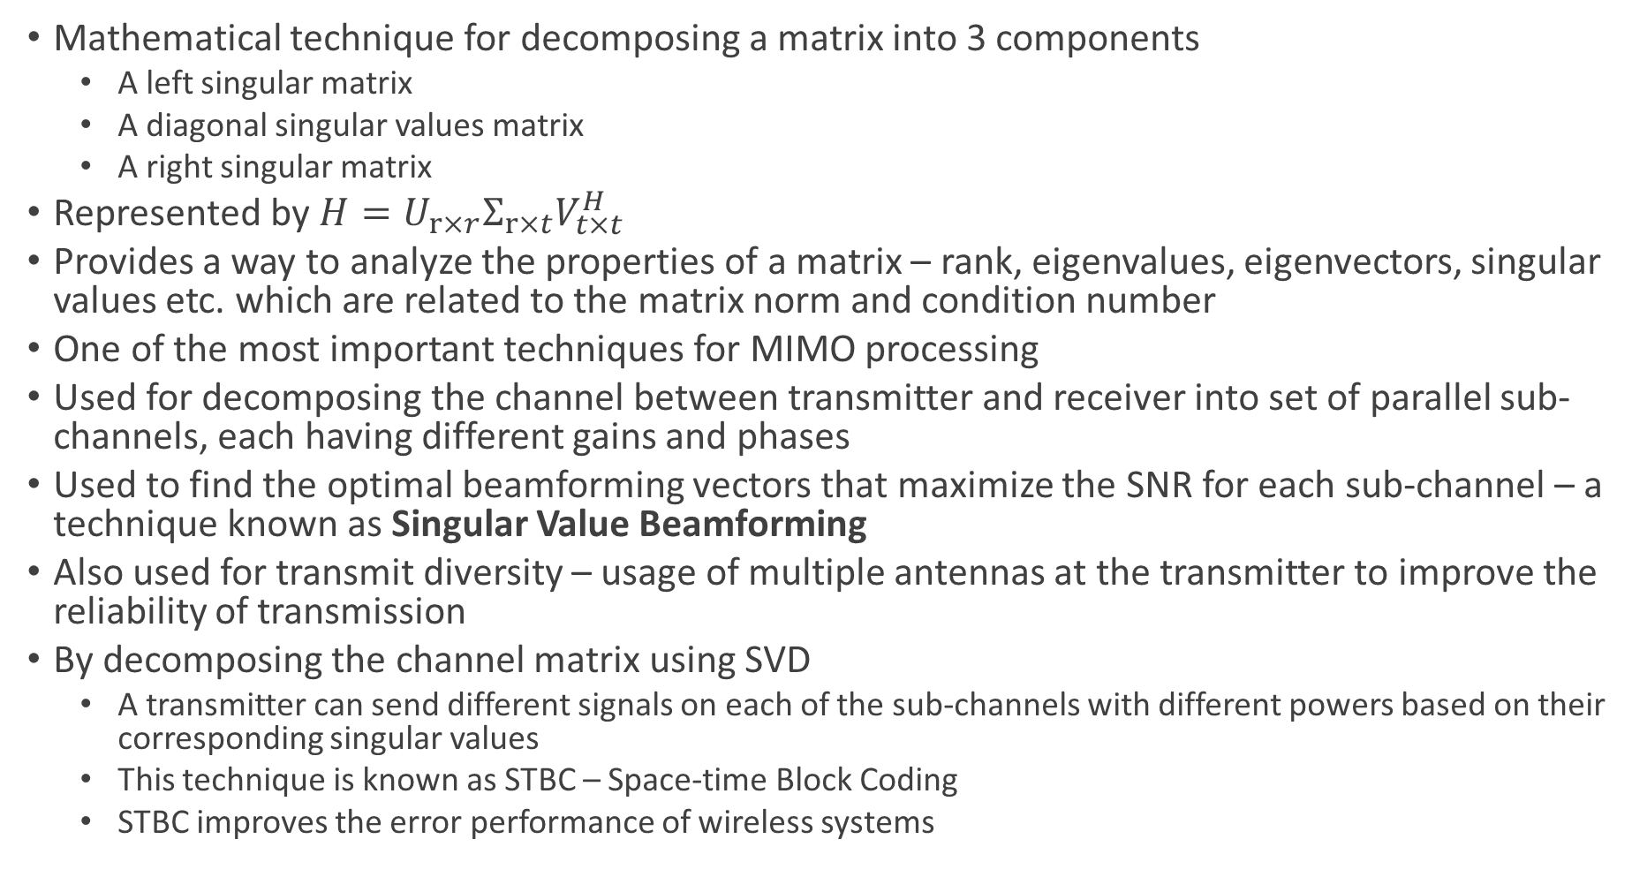
SVD – Singular Value Decomposition
Mathematical technique for decomposing a matrix into 3 components
A left singular matrix
A diagonal singular values matrix
A right singular matrix
Represented by $H=U_{r×r}Σ_{r×t}V_{t×t}^{H}$
Provides a way to analyze the properties of a matrix – rank, eigenvalues, eigenvectors, singular values etc. which are related to the matrix norm and condition number
One of the most important techniques for MIMO processing
Used for decomposing the channel between transmitter and receiver into set of parallel sub-channels, each having different gains and phases
Used to find the optimal beamforming vectors that maximize the SNR for each sub-channel – a technique known as Singular Value Beamforming
Also used for transmit diversity – usage of multiple antennas at the transmitter to improve the reliability of transmission
By decomposing the channel matrix using SVD
A transmitter can send different signals on each of the sub-channels with different powers based on their corresponding singular values
This technique is known as STBC – Space-time Block Coding
STBC improves the error performance of wireless systems

Slide 49
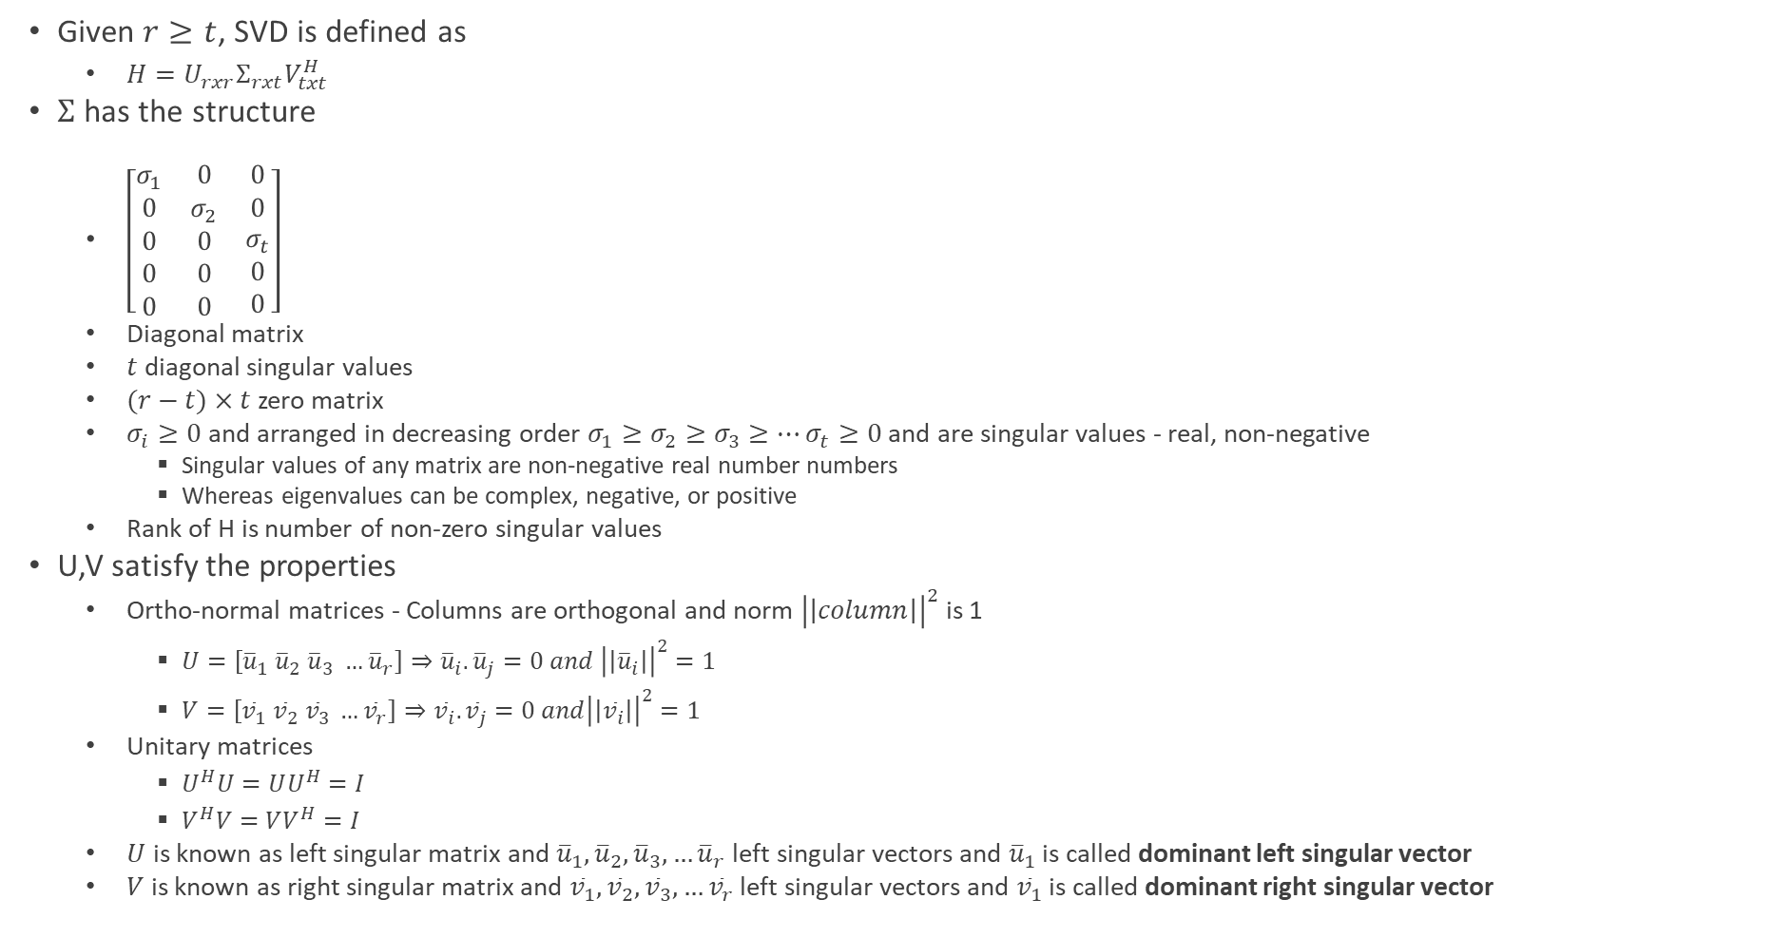
SVD – Singular Value Decomposition
Given $r≥t$, SVD is defined as
$H=U_{rxr}Σ_{rxt}V_{txt}^{H}$
$Σ$ has the structure
$\left[\begin{matrix}σ_{1} & 0 & 0 \\ 0 & σ_{2} & 0 \\ \begin{aligned}0 \\ 0 \\ 0\end{aligned} & \begin{aligned}0 \\ 0 \\ 0\end{aligned} & \begin{aligned}σ_{t} \\ 0 \\ 0\end{aligned}\end{matrix}\right]$
Diagonal matrix
$t$ diagonal singular values
$(r−t)×t$ zero matrix
$σ_{i}≥0$ and arranged in decreasing order $σ_{1}≥σ_{2}≥σ_{3}≥…σ_{t}≥0$ and are singular values - real, non-negative
Singular values of any matrix are non-negative real number numbers
Whereas eigenvalues can be complex, negative, or positive
Rank of H is number of non-zero singular values
U,V satisfy the properties
Ortho-normal matrices - Columns are orthogonal and norm ${\left|\left|column\right|\right|}^{2}$is 1
$U=\left[{\overline{u}}_{1}{ \overline{u}}_{2} {\overline{u}}_{3} …{\overline{u}}_{r}\right]⇒{\overline{u}}_{i}.{\overline{u}}_{j}=0 and {\left|\left|{\overline{u}}_{i}\right|\right|}^{2}=1$
$V=\left[{\overline{v}}_{1}{ \overline{v}}_{2} {\overline{v}}_{3} …{\overline{v}}_{r}\right]⇒{\overline{v}}_{i}.{\overline{v}}_{j}=0 and{\left|\left|{\overline{v}}_{i}\right|\right|}^{2}=1$
Unitary matrices
$U^{H}U=UU^{H}=I$
$V^{H}V=VV^{H}=I$
$U$ is known as left singular matrix and ${\overline{u}}_{1}, {\overline{u}}_{2},{\overline{u}}_{3},…{\overline{u}}_{r}$ left singular vectors and ${\overline{u}}_{1}$ is called dominant left singular vector
$V$ is known as right singular matrix and ${\overline{v}}_{1}, {\overline{v}}_{2},{\overline{v}}_{3},…{\overline{v}}_{r}$ left singular vectors and ${\overline{v}}_{1}$ is called dominant right singular vector

Slide 50

SVD Relation to Eigenvalue Decomposition
$HH^{H}=U{\left[\begin{aligned}\begin{aligned}\begin{matrix}σ_{1}^{2} \\ 0 \\ 0\end{matrix} \\ 0\end{aligned} \\ 0 \\ 0\end{aligned}\begin{aligned}\begin{aligned} \begin{matrix}0 \\ σ_{2}^{2} \\ 0\end{matrix} \\ 0\end{aligned} \\ 0 \\ 0\end{aligned}\begin{aligned} \begin{aligned}\begin{matrix}\begin{aligned}… \\ …\end{aligned} \\ … \\ …\end{matrix} \\ …\end{aligned} \\ … \\ …\end{aligned}\begin{aligned} \begin{aligned}\begin{matrix}0 \\ 0 \\ σ_{t}^{2}\end{matrix} \\ 0\end{aligned} \\ 0 \\ 0\end{aligned} \begin{aligned}\begin{aligned}\begin{matrix}0 \\ 0 \\ 0\end{matrix} \\ 0\end{aligned} \\ 0 \\ 0\end{aligned} \begin{aligned}\begin{aligned}\begin{matrix}0 \\ 0 \\ 0\end{matrix} \\ 0\end{aligned} \\ 0 \\ 0\end{aligned} \begin{aligned}\begin{aligned}\begin{matrix}0 \\ 0 \\ 0\end{matrix} \\ 0\end{aligned} \\ 0 \\ 0\end{aligned}\right]}_{r×t}U^{H}$
$σ_{1}^{2}, σ_{2}^{2}, σ_{3}^{2}…σ_{t}^{2}$ are non-zero eigenvalues and rest $\left(r−t\right)$ values are zero of $HH^{H}$
U contains eigenvectors ${\overline{u}}_{1}, {\overline{u}}_{2},{\overline{u}}_{3},…{\overline{u}}_{r}$ (the left singular vectors) of $HH^{H}$
$H^{H}H=V{\left[\begin{matrix}σ_{1}^{2} & ⋯ & 0 \\ ⋮ & ⋱ & ⋮ \\ 0 & ⋯ & σ_{t}^{2}\end{matrix}\right]}_{t×t}V^{H}$
$σ_{1}^{2}, σ_{2}^{2}, σ_{3}^{2}…σ_{t}^{2}$ - are $t$non-zero eigenvalues of $H^{H}H$
$V$ contains eigenvectors ${\overline{v}}_{1}, {\overline{v}}_{2},{\overline{v}}_{3},…{\overline{v}}_{t}$ (the right singular vectors) of $H^{H}H$

Slide 51

SVD in MIMO Processing
MIMO channel model $\overline{y}=H\overline{x}+\overline{n}$
Substitute $H=UΣV^{H}$
At the receiver without pre-coding at the transmitter
$\overline{y}=UΣV^{H}\overline{x}+\overline{n}$
Process using $U^{H}⇒\tilde{y}=U^{H}\overline{y}$
$⇒\tilde{y}=U^{H}\left(H\overline{x}+\overline{n}\right)=U^{H}H\overline{x}+U^{H}\overline{n}=U^{H}UΣV^{H}\overline{x}+U^{H}\overline{n}=ΣV^{H}\overline{x}+\tilde{n} (\tilde{n}=U^{H}\overline{n})$
$U^{H}$ is the combiner or receive beam former or receive filter
At the transmitter with pre-coding
Pre-process/multiply prior to transmission using $V:\overline{x}=V\tilde{x}$
$\tilde{x} −Original symbol vector$
$\overline{x}−Transmitted vector$
$V−Precoder or Transmit beamforming matrix$
At the receiver with transmitter pre-coding
$\overline{y}=UΣV^{H}(V\tilde{x})+\overline{n}$
Process using $U^{H}⇒\tilde{y}=U^{H}\overline{y}$
$⇒\tilde{y}=U^{H}\left(H\overline{x}+\overline{n}\right)=U^{H}HV\tilde{x}+U^{H}\overline{n}=U^{H}UΣV^{H}V\tilde{x}+U^{H}\overline{n}=Σ\tilde{x}+\tilde{n} (\tilde{n}=U^{H}\overline{n})$
$U^{H}$ is the combiner or receive beam former or receive filter

Slide 52

SVD in MIMO Processing
SVD-based transmitted pre-coded signals at the receive antennas output
$\tilde{y}=Σ\tilde{x}+\tilde{n} (\tilde{n}=U^{H}\overline{n})$
$\tilde{y}=\left[\begin{matrix}{\tilde{y}}_{1} \\ {\tilde{y}}_{2} \\ \begin{aligned}{\tilde{y}}_{3} \\ . \\ . \\ {\tilde{y}}_{r}\end{aligned}\end{matrix}\right]=\left[\begin{matrix}σ_{1} \\ 0 \\ \begin{aligned}\begin{aligned}0 \\ 0 \\ 0\end{aligned} \\ 0 \\ 0 \\ 0\end{aligned}\end{matrix}\begin{matrix}0 \\ σ_{2} \\ \begin{aligned}\begin{aligned}0 \\ 0 \\ 0\end{aligned} \\ 0 \\ 0 \\ 0\end{aligned}\end{matrix}\begin{matrix}0 \\ 0 \\ \begin{aligned}\begin{aligned}σ_{3} \\ 0 \\ 0\end{aligned} \\ 0 \\ 0 \\ 0\end{aligned}\end{matrix}\begin{matrix}0 \\ 0 \\ \begin{aligned}\begin{aligned}0 \\ σ_{4} \\ 0\end{aligned} \\ 0 \\ 0 \\ 0\end{aligned}\end{matrix}\begin{matrix}0 \\ 0 \\ \begin{aligned}\begin{aligned}0 \\ 0 \\ σ_{5}\end{aligned} \\ 0 \\ 0 \\ 0\end{aligned}\end{matrix}\right]\left[\begin{matrix}{\tilde{x}}_{1} \\ {\tilde{x}}_{2} \\ \begin{aligned}{\tilde{x}}_{3} \\ {\tilde{x}}_{4} \\ . \\ . \\ {\tilde{x}}_{t}\end{aligned}\end{matrix}\right]+\left[\begin{matrix}{\tilde{n}}_{1} \\ {\tilde{n}}_{2} \\ \begin{aligned}{\tilde{n}}_{3} \\ . \\ . \\ {\tilde{n}}_{r}\end{aligned}\end{matrix}\right]$
$\tilde{y}$ will have more than t components as $r≫t$. $\left(t+1\right), \left(t+2\right),…r$ can be ignored as these are noise
Hence the system of MIMO equations with SVD are:
${\tilde{y}}_{1}=σ_{1}{\tilde{x}}_{1}+{\tilde{n}}_{1}$
${\tilde{y}}_{2}=σ_{2}{\tilde{x}}_{2}+{\tilde{n}}_{2}$
${\tilde{y}}_{3}=σ_{3}{\tilde{x}}_{3}+{\tilde{n}}_{3}$
…
${\tilde{y}}_{t}=σ_{t}{\tilde{x}}_{t}+{\tilde{n}}_{t}$
Decoupled channels – spatial multiplexing
Consider $i^{th}channel⇒{\tilde{y}}_{i}=σ_{i}{\tilde{x}}_{i}+{\tilde{n}}_{i}$
Signal power = $E\left\{{\left|\tilde{x}\right|}^{2}\right\}=P_{i}$
Noise power = $N_{0}$
$SNR_{o}^{i}=σ^{2}.\frac{P_{i}}{N_{0}}$

Slide 53

Capacity of MIMO Wireless Systems
Shannon’s channel capacity – maximum data rate for error free transmission
$\log_{2}\left(1+SNR\right)$
Maximum data rate for $i^{th}$ channel in MIMO is $\log_{2}{(1+σ^{2}.\frac{P_{i}}{N_{0}})}$
So, the total data transmission capacity of the MIMO channel
$\sum_{i=1}^{t}{R_{i}=}\sum_{i=1}^{t}{\log_{2}\left(1+SNR_{o}^{i}\right)=}\sum_{i=1}^{t}{\log_{2}\left(1+σ^{2}.\frac{P_{i}}{N_{0}}\right) }$
Let’s call the maximum transmit power at the transmitter – total permissible transmit power – as $P_{0}$
Therefore sum of all MIMO streams/links/modes $P_{0}=\sum_{i=1}^{t}{P_{i}}$
What is the possible maximum error-free transmission rate of MIMO channel per a unit bandwidth – bits/second/hertz
Solution is as per below optimization problem
$Maximize \sum_{i=1}^{t}{\log_{2}\left(1+\frac{σ_{i}^{2}P_{i}}{N_{0}}\right) }$
$subject to the constraint \sum_{i=1}^{t}{P_{i}}=P_{0}$
Solved using Lagrange multiplier -$f\left(x\right)+λg\left(x\right)−KKT framework$
The optimal power solution for maximum error-free transmission rate is
$P_{j}={\left(\frac{1}{λ}−\frac{N_{0}}{σ_{j}^{2}}\right)}^{+}+indicates that if the value <0, then the value is 0$
$P_{j} is\left(\frac{1}{λ}−\frac{N_{0}}{σ_{j}^{2}}\right){if P}_{j}≥0, else 0$
$P_{j}=\left\{\begin{aligned}\left(\frac{1}{λ}−\frac{N_{0}}{σ_{j}^{2}}\right), if \frac{1}{λ}≥\frac{N_{0}}{σ_{j}^{2}} \\ 0,if \frac{1}{λ}< \frac{N_{0}}{σ_{j}^{2}}\end{aligned}\right.$

Slide 54

MIMO Capacity
Optimal power allocation to various MIMO streams/modes - Water-filling/pouring power allocation
$If σ_{j} is small⇒\left(\frac{1}{λ}−\frac{N_{0}}{σ_{j}^{2}}\right) is small⇒$Weaker channels are allocated with lower power ( based on this water-filling power allocation)
Corollary of the above, stronger channels will be allocated more power

Slide 55
Alamouti Code
The main idea behind Alamouti coding is to transmit the same data over multiple antennas in a way that maximizes diversity and protects against error – error protection coding
If one of the antennas experiences fading or interference, the data can still be recovered from the other antenna
This is achieved by transmitting the data in a space-time block code, where the data is transmitted over multiple time slots and multiple antennas improving the reliability and capacity of transmission
Particularly useful when the transmitted signal is subjected to fading due to multipath propagation
It is a 2x1 Orthogonal STBC – used for 2 transmit antennae and 1 receive antenna system (a 1x2 (rxt) diverse system – MISO system)
It encodes two complex symbols onto two transmit antennae and transmits over two consecutive time slots providing diversity and improved SNR at the receiver
In the first time slot, the two complex symbols are transmitted on the two antennas
In the second time slot, the same two symbols are transmitted again, but with the conjugate of one symbol transmitted on the second antenna
Achieves diversity order 2 without the knowledge of the channel state information (CSI) for beamforming (channel coefficients being sent by the receiver) at the transmitter

Slide 56

Alamouti Code
MISO channel is represented by $\left[h_{1} h_{2}\right]={\overline{h}}^{T}$
$h_{1} −channel coefficient between transmit antenna 1 and receive antenna 1$
$h_{2}−channel coefficient between transmit antenna 2 and receive antenna 1$
The first transmit vector $t_{1}$ is $\left[\begin{aligned}x_{1} \\ x_{2}\end{aligned}\right]$
$x_{1}−transmit antenna 1$
$x_{2}−transmit antenna 2$
The second transmit vector $t_{2}$ is $\left[\begin{aligned}{−x}_{2}^{∗} \\ x_{1}^{∗}\end{aligned}\right]$
Hence $y_{1}=\left[h1 h2\right]\left[\begin{aligned}x_{1} \\ x_{2}\end{aligned}\right]+n_{1}=h_{1}x_{1}+h_{2}x_{2}+n_{1}$
$y_{2}=\left[h_{1} h_{2}\right]\left[\begin{aligned}{−x}_{2}^{∗} \\ x_{1}^{∗}\end{aligned}\right]+n_{2}^{ }=−h_{1}x_{2}^{∗}+h_{2}x_{1}^{∗}+n_{2}^{ }⇒\left[h_{2}^{ }−h_{1}^{ }\right]\left[\begin{aligned}x_{1} \\ x_{2}\end{aligned}\right]+n_{2}^{ }$
$⇒y_{2}^{∗}=−h_{1}^{∗}x_{2}+h_{2}^{∗}x_{1}+n_{2}^{∗}$
$y_{2}^{∗}=\left[h_{2}^{∗} −h_{1}^{∗}\right]\left[\begin{aligned}x_{1} \\ x_{2}\end{aligned}\right]+n_{2}^{∗}$
Hence output system of equations
$\left[\begin{aligned}y_{1} \\ y_{2}^{∗}\end{aligned}\right]=\left[\begin{matrix}h_{1} & h_{2} \\ h_{2}^{∗} & −h_{1}^{∗}\end{matrix}\right]\left[\begin{aligned}x_{1} \\ x_{2}\end{aligned}\right]+\left[\begin{aligned}n_{1} \\ n_{2}^{∗}\end{aligned}\right]$

Slide 57

Alamouti Code
$\underset{Output Vector−\overline{y}}{\underbrace{\left[\begin{aligned}y_{1} \\ y_{2}^{∗}\end{aligned}\right]=}}\underset{Channel Vector −H}{\underbrace{\left[\begin{matrix}h_{1} & h_{2} \\ h_{2}^{∗} & −h_{1}^{∗}\end{matrix}\right]}}\underset{Transmit Vector−\overline{x}}{\underbrace{\left[\begin{aligned}x_{1} \\ x_{2}\end{aligned}\right]}}+\underset{Noise Vector −\overline{n}}{\underbrace{\left[\begin{aligned}n_{1} \\ n_{2}^{∗}\end{aligned}\right]}}$
Columns of channel matrix of Alamouti system are orthogonal vectors
Hence Alamouti code is known as Orthogonal Space-time Block Code – OSTBC
Can be extended to arbitrary number of receive antennae
Since the matrix is orthogonal, decoding can be simply performed by multiplying by inverse
Inverse of Alamouti Matrix - $H^{−1}= \frac{1}{{\left||h|\right|}^{2}}H^{H}=\frac{1}{{\left||h|\right|}^{2}}$ $\left[\begin{matrix}h_{1}^{∗} & h_{2} \\ h_{2}^{∗} & −h_{1}^{ }\end{matrix}\right]$
${\left|\left|h\right|\right|}^{2}={\left|h_{1}\right|}^{2}+{\left|h_{2}\right|}^{2}$ - Norm square of $1×2$ channel vector $= {\left|\left[h_{1} { h}_{2}\right]\right|}^{2}={\left(\sqrt{{\left|h_{1}\right|}^{2}+{\left|h_{2}\right|}^{2}}\right)}^{2}=(h_{1}^{2}+h_{2}^{2})$
Decoder o/p = $H^{−1}\overline{y}=\frac{1}{{\left|\left|h\right|\right|}^{2}}×H^{H}×\overline{y}, where \overline{y}=\left[\begin{aligned}y_{1} \\ y_{2}^{∗}\end{aligned}\right]$
Alamouti code transmits two symbols per two time instants with a net of one symbol per a time instant i.e. R=1 – such a code is termed a full rate code

Slide 58

SNR and BER of Alamouti Code
SNR
The available power P at the transmitter is split equally across two transmit streams/antennae
$⇒E\left\{{\left|x_{1}\right|}^{2}\right\}=E\left\{{\left|x_{2}\right|}^{2}\right\}=\frac{P}{2}$
Channel output SNR of each stream is - $SNR_{0}={\left|\left|h\right|\right|}^{2}×\frac{\frac{P}{2}}{N_{0}}$
$⇒\frac{1}{2}×{\left|\left|h\right|\right|}^{2}×\frac{P}{N_{0}}=\frac{1}{2}×{\left|\left|h\right|\right|}^{2}×SNR_{tx}=\frac{1}{2}×\left({\left|h_{1}\right|}^{2}+{\left|h_{2}\right|}^{2}\right)×SNR_{tx}$
Where for BPSK $SNR=\frac{P}{N_{0}}$ and QPSK $SNR=\frac{2P}{N_{0}}$
$SNR_{o}=\frac{1}{2}×{\left|\left|h\right|\right|}^{2}×\frac{\frac{P}{2}}{N_{0}}=\frac{1}{2}×{\left|\left|h\right|\right|}^{2}×SNR where {\left|\left|h\right|\right|}^{2}=({\left|h_{1}\right|}^{2}+{\left|h_{2}\right|}^{2})$
Alternatively, ${SNR}_{0}= \frac{1}{2}×\frac{{\left|\left|h\right|\right|}^{2}}{σ^{2}}P$
BER
The output BER of Alamouti Scheme for BPSK and QPSK $=\frac{3}{SNR^{2}}$

Slide 59
OFDM Technology

Slide 60

Single and Multi-carrier Modulation
Single Carrier System
For a bandwidth B/2, the symbol time is $\frac{1}{B}$
Example : For a single carrier system of 10 MHz bandwidth, the symbol time is $\frac{1}{10 MHz }=0.1 μs$
As the bandwidth increases, symbol time decreases or shrinks
Due to multi-path in wireless channel, different copies of the transmitted signal arrive with different delays - $τ_{0},τ_{1}, τ_{2}, …,τ_{l−1 }$
As a result, multi-path components are spread over time which is called as Delay Spread
For large bandwidth
Delay Spread >> Symbol Time/Duration $⇒t_{ds}≫t_{s}$
At higher bandwidths, the multi-path signal copies with different delays superimpose at the receiver causing ISI – Inter-symbol Interference increasing BER
How to eliminate ISI?
ISI can be eliminated using Multi-carrier Modulation (MCM) using OFDM

Slide 61
What is OFDM
OFDM is widely employed in most of the modern cellular and wifi systems
MIMO-OFDM is one of the most widely used technologies today
4G LTE, 5G-NR
802.11n, 802.11ac, 802.11ax
Due its transmission over very large bandwidth, it enables ultra-high data rates
OFDM exploits frequency dimension and MIMO exploits space dimension
Space + Frequency Multiplexing => Extra-ordinarily high data rates

Slide 62

OFDM - Multi-carrier Modulation
Instead of using one carrier, use N carriers/sub-carriers
Divides the bandwidth into N sub-bands/carriers
Each sub-band bandwidth is $\frac{B}{N}$ across N bands, B is total bandwidth $\left[−\frac{B}{2}, +\frac{B}{2}\right]$
The sub-carrier bandwidth is also called as sub-carrier spacing, sub-carrier bandwidth etc. – $\frac{B}{N}$
Sub-carriers are placed at $….−\frac{2B}{N}, −\frac{B}{N}, 0,\frac{B}{N},\frac{2B}{N},\frac{3B}{N},…$
If $\frac{B}{N}$is called as $f_{0}⇒N sub−carrier$placement is $…,−2f_{0}, −f_{0}, {0, f}_{0}, 2f_{0}, ….$
As per signals and systems, the mathematical representation of a generic carrier of frequency is
$f_{c}$ $=e^{j2πf_{c}t}$
$k^{th}$ sub-carrier is placed at $kf_{0}, where f_{0}=\frac{B}{N}$
$f_{k}=kf_{0}= e^{j2πkf_{0}t}$
Modulate each sub-carrier with a symbol
$k^{th}$modulated sub-carrier $x_{k}(t)$ = $X_{k}×e^{j2πkf_{0}t}$
Hence the aggregate transmit signal
Becomes the sum of all modulated sub-carrier signals
$x\left(t\right)=\sum_{k}{X_{k}e^{j2πkf_{0}t}}$
Also termed as symbol loaded on sub-carrier $kf_{0}$

Slide 63
Fourier Series
Fourier series exists for a continuous periodic signal
For continuous periodic signals, Fourier series or complex exponential Fourier series or trigonometric Fourier series will be used
For continuous aperiodic signals, Fourier transform is used
For discrete aperiodic signals, Discrete-Time Fourier transform is used
For discrete periodic signals, Discrete Fourier Series is used
For discrete limited signals, FFT or DFT is used

Slide 64

OFDM - Demodulation
Considering a noiseless and non-fading channel/scenario
$y\left(t\right)=x\left(t\right)=\sum_{k}{X_{k}e^{j2πkf_{0}t}}$
$\sum_{k}{X_{k}e^{j2πkf_{0}t}}$ is a Fourier series or complex exponential Fourier series of $x\left(t\right)$
Fundamental frequency $f_{0}=\frac{B}{N}$and various $X_{k}$ representing the Fourier coefficients $X_{l}$
All frequencies $kf_{0}$ are multiples of the fundamental frequency $f_{0}=\frac{1}{T_{0}}=\frac{B}{N}$
Therefore to extract $X_{l}$ coefficient of a Fourier coefficient corresponding to the frequency $f_{l}$
Multiply the input signal $y\left(t\right)$ with $e^{−j2πlf_{0}t}$ (complex conjugate of the input), and $f_{0} or\frac{1}{T}$, and integrate over a limit of $\left[0,\frac{1}{f_{0}}\right] or\left[−\frac{1}{2f_{0}},\frac{1}{2f_{0}}\right]or \left[0,\frac{1}{f_{0}}\right]or [−\frac{T}{2},\frac{T}{2}]$
${⇒X}_{l} =f_{0}\int_{−\frac{1}{2f_{0}}}^{\frac{1}{2f_{0}}}{y(t)×{{(e}^{j2πlf_{0}t})}^{∗}dt}=f_{0}\int_{−\frac{1}{2f_{0}}}^{\frac{1}{2f_{0}}}{\sum_{k}{X_{k}e^{j2πkf_{0}t}}×{e^{−j2πlf_{0}t}}^{ }dt}$
$\frac{1}{f_{0}}=T$ is the OFDM symbol duration $⇒T=\frac{1}{f_{0}}=\frac{1}{\frac{B}{N}}=\frac{N}{B}=N×\left(\frac{1}{B}\right)⇒\frac{N}{B}≫\frac{1}{B}≫$ Delay Spread
Thus OFDM eliminates ISI

Slide 65

OFDM - Demodulation
Extracting $l^{th}$symbol
${f_{0}\int_{−\frac{1}{2f_{0}}}^{\frac{1}{2f_{0}}}{y(t)×{{(e}^{j2πlf_{0}t})}^{∗}dt}=}_{ }f_{0}\int_{−\frac{1}{2f_{0}}}^{\frac{1}{2f_{0}}}{\sum_{k}{X_{k}e^{j2πkf_{0}t}}×{e^{−j2πlf_{0}t}}^{ }dt}=f_{0}\int_{0}^{\frac{1}{f_{0}}}{\sum_{k}{X_{k}e^{j2πkf_{0}t}}×{e^{−j2πlf_{0}t}}^{ }dt}$
Also called as coherent demodulation
Rewriting the above equation:
$X_{l}= \sum_{k}{X_{k}(f_{0}\int_{0}^{\frac{1}{f_{0}}}{e^{j2π\left(k−l\right)f_{0}t}dt})}$
$f_{0}\int_{0}^{\frac{1}{f_{0}}}{e^{j2π\left(k−l\right)f_{0}t}dt}\left\{\begin{aligned}0, if k≠l \\ 1, if k=l\end{aligned}\right.$
The sub-carriers $e^{j2πk}, e^{j2πl}$ are orthogonal and hence their product when they are not equal $k≠l$ is zero
$X_{l}= {\sum_{k}{X}}_{k}δ\left(k−l\right) −discrete delta function$
The sub-carrier orthogonality can leveraged to extract the symbol
$⇒$ inner product between two sub-carriers that are orthogonal is zero
In summary
Orthogonal – sub-carriers are orthogonal
Frequency Division – Dividing bandwidth into multiple sub-carriers
Multiplexing – Parallel transmission of multiple symbols over multiple sub-carriers in the same band – Wide Bandwidth Channel
Enables transmission over large bandwidth without ISI – extremely high data rates

Slide 66









OFDM Generation – IDFT $⇒$ IFFT
OFDM comprises of 1000s of sub-carriers $⇒$ difficult to generate!
Is there a simple technique to generate OFDM?
Yes – using sampling!
Considering signal BW is limited to $\frac{B}{2} (i.e. f_{max})$, the sampling frequency is $f_{s}=2×\frac{B}{2}=B$ (Nyquist Criterion)
Sampling duration $t_{s}=\frac{1}{B}=\frac{1}{f_{s}}$
The $l^{th}$ sample will be at $t=l×t_{s}=l×\frac{1}{B}=\frac{l}{B}$
$⇒x\left(l\right)=\sum_{k}{X_{k}e^{j2πkf_{0}t}=}$ $\sum_{k}{X_{k}e^{j2πk\frac{B}{N}\frac{l}{B}}=}\sum_{k}{X_{k}e^{\frac{j2πkl}{N}}}$
Scaling $x\left(l\right)$ by $\frac{1}{N}$ factor $⇒$ $\frac{1}{N}\sum_{k}{X_{k}e^{j2π\frac{kl}{N}}}$
The expression $\frac{1}{N}\sum_{k}{X_{k}e^{j2π\frac{kl}{N}}dt}$ is representation of IDFT – Inverse Discrete Fourier Transform
IDFT can be efficiently implemented using IFFT – Inverse Fast Fourier Transform
IFFT algo is widely implemented in DSP chipsets – computational complexity is $Nlog_{2}N$
Rx
$${\left(IFFT\right)}^{−1}⇒FFT$$
Demodulation
$$\underset{Frquency Domain}{\underbrace{X_{0},X_{1},X_{2},…X_{n−1}}}$$
$$H_{k}=\sum_{l=0}^{(L−1)}{h(l)e^{−j2π\frac{kl}{N}}}$$
Zero padded FFT of the channel taps
(N-L) zeros
Sub-carrier channel coefficients
Loaded Sub-carriers
Tx
IFFT
Load/Modulate
Sampling - $f_{s}=$ 1/B
IDFT
$$x\left(l\right)=\frac{1}{N}\sum_{k=0}^{(N−1)}{X_{k}e^{j2π\frac{kl}{N}}}$$
(Time Domain Samples)
$$Y_{k}=\sum_{l=0}^{(N−1)}{y(l)e^{−j2π\frac{kl}{N}}}$$
Frequency Domain Samples
$$x\left(l\right)=\frac{1}{N}\sum_{k=0}^{(N−1)}{X_{k}e^{\frac{j2πkl}{N}}}$$
IFFT
$$x\left(0\right), x\left(1\right), x(N−1)$$
Time domain samples

Slide 67

ISI Channel Model
Fading channel model for a symbol $k$, $y\left(k\right)=hx\left(k\right)+n(k)$
ISI channel model with interference from other/previous symbols in the band, for symbol $k:$
$y\left(k\right)=h\left(0\right)x\left(k\right)+h\left(1\right)x\left(k−1\right)+h\left(2\right)x\left(k−2\right)+…+h\left(L−1\right)x\left(k−\left(L−1\right)\right)+v\left(k\right)$
$\{v\left(k\right) is noise\}$
Simplifying
$y\left(k\right)=\sum_{l=0}^{l=(L−1)}{h\left(l\right)x\left(k−l\right)+v(k)} −convolution operation$
$h\left(0\right),h\left(1\right), h\left(2\right),…h\left(L−1\right)$ are called channel taps – channel filters
$y(k)$can be further simplified as $y\left(k\right)=h∗x+v(k)$
So, channel performs linear convolution

Slide 68

Convolution
Convolution is a mathematical operation on two functions (f and g) that produce a third function (f*g) that expresses how the shape of one is modified by the other
The term convolution refers to both the resultant function and the process of computing it
The resultant function is defined as the integral of the product of the two functions after one is reflected on y-axis and shifted
$\left(f∗g\right)\left(t\right)=\int_{−∞}^{∞}{f\left(τ\right)g\left(t−τ\right)dτ=\int_{−∞}^{∞}{f\left(t−τ\right)g\left(τ\right)dτ}}$
Some features of convolution are similar to cross-correlation

Slide 69

Cyclic Prefix – CP and Demodulation
$\underset{Cyclic Prefix}{\underbrace{x\left(N−\tilde{L}\right),…x\left(N−2\right),x(N−1)}},\underset{Original samples generated by IFFT }{\underbrace{x\left(0\right),x\left(1\right),x\left(2\right),…x(N−1)}}$
The cyclic prefix are $\tilde{L}$ samples from the tail of OFDM generated by IFFT
Prior to transmission, the above cyclic prefix is prefixed to the IFFT output forming OFDM block
So the total number of samples in OFDM block are $\left(N+\tilde{L}\right)$, $\tilde{L}≪N$
$\tilde{L}$ is usually a maximum of 25%*N
What is the effect of CP?
Because of the addition of CP as prefix to the output of IFFT of OFDM, the linear convolution becomes circular convolution
$y\left(k\right)=h∗x+v\left(k\right)⇒Prefix with CP⇒y\left(k\right)=h⊛x+v$
The output of OFDM channel is $y\left(k\right)=h⊛x+v$
The output of the sub-carrier k - $y\left(k\right)=h⊛x+v⇒FFT⇒Y_{K}=H_{k}×X_{k}+V_{k}$
When an FFT is taken for a circular convoluted time domain signal, it becomes the product between corresponding coefficients

Slide 70

OFDM System Model
$k$=0,1,2,…N-1 – sub-carriers
The OFDM System Model is
$Y_{0}=H_{0}×X_{0}+V_{0}$
$Y_{1}=H_{1}×X_{1}+V_{1}$
$Y_{2}=H_{2}×X_{2}+V_{2}$
…
$Y_{N−1}=H_{N−1}×X_{N−1}+V_{N−1}$
Channel coefficient $H_{k}$ are given as
$H_{k}=\sum_{0}^{L−1}{h\left(l\right)e^{−j2π\frac{kl}{N}}⇒}h\left(0\right),h\left(1\right),h\left(2\right),…h\left(L−1\right), 0,0,0,…0 \left(N−L zeros\right)$
$N Point Zero Padded FFT⇒H_{0},H_{1},H_{2},…H_{N−1} −sub−carrier channel coefficients$
CP removal
OFDM block = $\underbrace{x\left(N−\tilde{L}\right),…x\left(N−2\right),x(N−1)},$ $\underbrace{x\left(0\right),x\left(1\right),x\left(2\right),…x(N−1)}$
The prefixed CP is removed by the receiver and receiver processes the output from $x\left(0\right) or y(0)$
$y\left(0\right)=h\left(0\right)x\left(0\right)+h\left(1\right)x\left(N−1\right)+…+h\left(L−1\right)x\left(N−L+1\right)+…+0×x\left(2\right)+0×x\left(1\right)+v(0)$
This process is known as CP removal
What is OFDM achieving?
Converting a time-domain ISI channel into N parallel ISI-free (flat fading) sub-carrier channels!
ISI – Frequency selective, dispersive channel
Flat fading – Frequency flat channel, ISI free

Slide 71

OFDM Examples
The expressions $e^{jθ}$and $e^{−jθ}$can be simplified using Euler’s formula
$e^{jθ}=\cos\left(θ\right)+jsin(θ)$
$e^{−jθ}=\cos\left(−θ\right)+jsin\left(−θ\right)=\cos\left(θ\right)−jsin\left(θ\right)$
$\cos\left(−θ\right)$= $\cos\left(θ\right)$ - Since cosine is even function
$\sin\left(−θ\right)$= $−sin\left(θ\right)$ - Since sine is odd function
$H_{3}=h\left(0\right)+h\left(1\right)e^{−\frac{j3π}{2}}$
$=h\left(0\right)+h\left(1\right)\left(\cos\left(−\frac{3π}{2}\right)−jsin\left(\frac{3π}{2}\right)\right)$
$=h\left(0\right)+h(1)(0−$
Effective bit rate $=Number of bits per symbol ∗\frac{N}{T_{symbols}+T_{CP}}$

Slide 72

BER Performance of OFDM Systems
Consider channel taps - $h\left(0\right), h\left(1\right),h\left(2\right),h\left(3\right),…,h\left(L−1\right)$
Assume they are Rayleigh fading with unit power $E\left\{{\left|h\left(l\right)\right|}^{2}\right\}=1$
Noise samples $v(l)$ are i.i.d with power $N_{0}=E\{{\left|v\left(l\right)\right|}^{2}\}$
Symbols loaded on sub-carriers have power P
Effective SNR for QPSK as
$SNR_{OFDM−QPSK}=ρ_{eff}=\frac{L}{N}×\frac{P}{N_{0}}=\frac{L}{N}SNR$
L – number of channel taps
N – number of sub-carriers
BER of OFDM for QPSK
$BER_{OFDM−QPSK}=\frac{1}{2}×\left(1−\sqrt{\frac{ρ_{eff}}{2+ρ_{eff}}}\right)≈\frac{1}{2}×\frac{1}{ρ_{eff}}≈\frac{1}{2}×\frac{1}{\frac{L}{N}SNR}$
$BER_{OFDM−QPSK}≈\frac{1}{2}×\frac{N}{L}×\frac{1}{SNR}$

Slide 73

MIMO-OFDM Channel Coefficients
MIMO channel coefficients in the frequency domain corresponding to sub-carrier $k$ between $i^{th}$ receive antenna and $j^{th}$ transmit antenna $H_{ij}\left(k\right)$
$h_{ij}\left(0\right), h_{ij}\left(1\right), h_{ij}\left(2\right),…h_{ij}\left(L−1\right), \underset{\left(N−L zeros\right)}{\underbrace{0,0,0,0…0}}⇒FFT(N−pt)⇒H_{ij}\left(0\right), H_{ij}\left(1\right), …,H_{ij}\left(N−1\right)$
$H_{ij}\left(k\right)$ are given by the FFT of the channel taps and are frequency domain coefficients
$Y\left(k\right)=H\left(k\right)×X\left(k\right)+W\left(k\right)$
$H\left(k\right)−Flat MIMO channel$
There are $k=0,1,2,…\left(N−1\right)−n flat parallel MIMO channels$
Converted a frequency selective MIMO channel to a flat fading MIMO channel using OFDM

Slide 74

MIMO-OFDM
Exploits spatial multiplexing of MIMO and frequency multiplexing of OFDM leading to ultra-high data rates
MIMO-OFDM channel model
$r$ – number receive antennas, $t$ – number of transmit antennas
Channel taps between receive antenna i and transmit antenna j
$h_{ij}\left(0\right), h_{ij}\left(1\right),h_{ij}\left(2\right),…,h_{ij}\left(L−1\right), h_{ij}\left(l\right)−l^{th} channel tap between i^{th}receive antenna and j^{th}transmit antenna with l taps$
Total number of taps are $r×t×l$
Transmission
On each transmit antenna $j$ load the sub-carriers as below – i.e. perform IFFT
$X_{j}\left(0\right), X_{j}\left(1\right), X_{j}\left(2\right),…X_{j}\left(N−1\right)⇒X_{j}\left(k\right)−Symbol loaded on sub−carrier k at transmit antenna j$ – Frequency domain samples
Total number of symbols = $n×t$
IFFT can be performed as shown below
$X_{j}\left(0\right), X_{j}\left(1\right), X_{j}\left(2\right),…X_{j}\left(N−1\right)⇒IFFT⇒x_{j}\left(0\right), x_{j}\left(1\right), x_{j}\left(2\right),…,x_{j}(N−1)$ – time domain samples on transmit antenna $j$
One IFFT per each transmit antenna – total $t$ IFFT blocks at the transmitter
Add CP on each transmit antenna
$\underset{CP −\tilde{L} samples}{\underbrace{x_{j}\left(N−\tilde{L}\right), …x_{j}\left(N−2\right), x_{j}\left(N−1\right),}}\underset{original samples after IFFT −N samples}{\underbrace{x_{j}\left(0\right),x_{j}\left(1\right), x_{j}\left(2\right),…,x_{j}(N−1) }}⇒\left(N+\tilde{L}\right) samples$
What is the size of total transmission block – one OFDM block?
$\left(N+\tilde{L}\right)×t = t×\left(N+N_{CP}\right)×t$
Channel
Because of addition of CP, the linear convolution becomes circular convolution
$y_{i}\left(k\right)=\sum_{j=1}^{t}{h_{ij}⊛x_{j}+w_{j}(k)}$
Receiver
FFT is performed at each receive antenna after removing CP
$y_{i}(0),y_{i}\left(1\right),y_{i}\left(2\right),y_{i}\left(N−1\right)\left(CP removed\right)⇒FFT⇒$ $Y_{i}\left(0\right),Y_{i}\left(1\right),Y_{i}\left(2\right),…,Y_{i}(N−1)$
$y_{i}\left(k\right)$ is output on sub-carrier $k$
One FFT at each receive antenna $⇒r$FFTs

Slide 75

Net MIMO-OFDM System Model
$\underset{Y\left(k\right)}{\underbrace{\left[\begin{aligned}Y_{1}(k) \\ Y_{2}(k) \\ Y_{3}(k) \\ . \\ . \\ . \\ Y_{r}(k)\end{aligned}\right]}}=\underset{H\left(k\right)}{\underbrace{\left[\begin{matrix}H_{11}\left(k\right) & ⋯ & H_{1t}(k) \\ ⋮ & ⋱ & ⋮ \\ H_{r1}(k) & ⋯ & H_{rt}(k)\end{matrix}\right]}}×\underset{X(k)}{\underbrace{\left[\begin{aligned}X_{1}(k) \\ X_{2}(k) \\ . \\ . \\ X_{t}(k)\end{aligned}\right]}}+\underset{W(k)}{\underbrace{\left[\begin{aligned}W_{1}(k) \\ W_{2}(k) \\ . \\ . \\ W_{r}(k)\end{aligned}\right]}}$
$Y(k)$ – $r×1$ vector of outputs for all Rx antennas on sub-carrier $k$ – output symbol vector
$H(k)$ - $r×t$ MIMO channel matrix for sub-carrier $k$ – Channel matrix
$X(k)$ - $t×1$ vector of symbols loaded on sub-carrier $k$ for all Tx antennas – transmit symbol vector
$W(k)$ - $r×1$Noise vector for sub-carrier $k$ – noise vector

Slide 76

MIMO-OFDM
MIMO-OFDM model for sub-carrier $k$ is
$Y\left(k\right)=H\left(k\right)×X\left(k\right)+W\left(k\right) −Frequency domain model$
How many such parallel MIMO systems are there?
One for each sub-carrier → N parallel MIMO channels
$Y\left(0\right)=H\left(0\right)X\left(0\right)+W\left(0\right)$
$Y\left(1\right)=H\left(1\right)X\left(1\right)+W\left(1\right)$
$Y\left(2\right)=H\left(2\right)X\left(2\right)+W\left(2\right)$
….
$Y\left(N−1\right)=H\left(N−1\right)X\left(N−1\right)+W\left(N−1\right)$
How to recover $X\left(k\right)?$
Any MIMO receiver – ZF or LMMSE receiver
ZF receiver
ZF receiver : $\hat{X}\left(k\right)=H^{†}\left(k\right)Y\left(k\right)⇒\underset{Pseudo Inverse of H(k)}{\underbrace{{\left(H^{H}\left(k\right)H\left(k\right)\right)}^{−1}}}H^{H}\left(k\right)Y(k)$
LMMSE receiver
$\hat{X}\left(k\right)={\left(H^{H}\left(k\right)H\left(k\right)+\frac{1}{SNR}I\right)}^{−1}H^{H}\left(k\right)Y(k)$

Slide 77
Characterization of Wireless Channel

Slide 78

Wireless Channel Model
Wireless channel model
$h=\sum_{0}^{L−1}{a_{i}δ(t−τ)}$
$L$ – number of multi-path components/channels
$a_{i}$ - Channel attenuation
$τ_{i}$ - delay
An important characteristic of a multi-path channel is the time delay spread it causes to the received signal
This delay spread equals the time delay between
The arrival of the first received signal component (LOS or multi-path)
Last received signal component associated with a single transmitted pulse
If the delay spread is
Small compared to the inverse of the signal bandwidth, then there is little time spreading in the received signal
Relatively large compared to the inverse of the signal bandwidth, then there is significant time spreading of the received signal which leads to substantial signal distortion
Maximum delay spread
$T_{d}=τ_{L−1}−τ_{0}$
$τ_{L−1}$ - Last multi-path component received
$τ_{0}$ - First multi-path component received

Slide 79

Wireless Channel Model – Delay Spread
Another metric for the delay spread is RMS delay spread
Let $g_{i}={\left|a_{i}\right|}^{2}$
Mean delay (Weighted average of delays) $\overline{τ}=$ $\frac{\sum_{i}{g_{i}τ_{i}}}{\sum_{i}{g_{i}}}$
RMS Delay Spread - $T_{d,rms}=\sqrt{\frac{\sum_{i}{g_{i}{\left(τ_{i}−\overline{τ}\right)}^{2}}}{\sum_{i}{g_{i}}}}$
Typical delay spread in outdoor distances – 2-3$μ$s
When does ISI occur?
$T_{d}\left(Delay Spread\right)≥\frac{1}{2}T_{s} (Symbol Time)$ - ISI
On the other hand
$T_{d}\left(Delay Spread\right)<\frac{1}{2}T_{s} (Symbol Time)$ – No ISI

Slide 80

ISI Channel Model
Non ISI channel model
$y\left(k\right)=hx\left(k\right)+n\left(k\right)$
$y(k)$ depends only on $x(k)$
ISI channel model
$y\left(k\right)=h\left(0\right)x\left(k\right)+h\left(1\right)x\left(k−1\right)+h\left(2\right)x\left(k−2\right)+…+h\left(L−1\right)x\left(k−L+1\right)+n\left(k\right)$
$y\left(k\right)=h∗x+n$ – $∗$ - linear convolution
$h\left(0\right),h\left(1\right),…h(L−1)$ – channel taps or taps of the channel filter or coefficients of channel filter – FIR – Finite Impulse Response
$y(k)$ depends on $x\left(k\right),x\left(k−1\right),….$
Delay spread
$T_{d}=2μs$
$T_{s}≤4μs=2T_{d}⇒\frac{1}{B}=4μs$
$⇒B≥\frac{1}{2T_{d}}=\frac{1}{4μs}=250 kHz$
So, ISI occurs when the bandwidth is greater than 250 kHz – this bandwidth is known as Coherence bandwidth and is represented by $B_{c}$ of the channel
The relationship between $T_{d}$ and $B_{c}$ is $B_{c}=\frac{1}{2T_{d}}$ - $T_{d}$ - channel delay spread
Hence ISI occurs if:
$T_{d}≥\frac{1}{2}T_{s}$
$B≥B_{c}≥\frac{1}{2T_{d}}$
So, $B_{c}∝\frac{1}{T_{d}}$ - coherence bandwidth is inversely proportional to delay spread

Slide 81

Delay Spread
Say delay spread $T_{d}=0$
Channel model $h\left(t\right)=δ\left(t\right)$
Fourier transform $\left|H\left(f\right)\right|=1$
BW=$B_{C}=∞$
Frequency domain interpretation of $B_{c}$
When signal bandwidth $B_{s}/B≤B_{c}$, the output spectrum is undistorted
Channel response is flat over signal bandwidth
Such a channel is termed as flat fading channel
No ISI and no distortion
When signal bandwidth $B_{s}/B≥B_{c}$
Fading is frequency selective
Channel response is NOT flat and varies over signal bandwidth
Signal spectrum is distorted frequency domain and is ISI in time domain

Slide 82

Doppler Shift
What happens when a mobile moves away or towards base station/transmitter
Angle $θ$ and velocity $v$
Change in the observed/received frequency by the receiver
This is termed as doppler shift
Doppler shift $f_{D}=\frac{v×cosθ}{c}×f_{c}$
$v$ – velocity of the mobile
$c$ – speed of light
$f_{c}$ - carrier frequency
$θ$ – angle between velocity vector and line joining mobile to base station
Impact of doppler shift on the channel
Time varying delay $⇒$ Time Varying Channel
Such a channel is called Time Selective Channel
How fast is channel varying?
Let $T_{c}$ denote the time over which channel is constant
This $T_{c}$ is termed Coherence Time
$T_{c}=\frac{1}{4f_{D}}∝\frac{1}{f_{D}}$
Higher velocity => coherence time is small
Doppler bandwidth = $2f_{D}=B_{D}$

